Slide 1
Making the Most of Student Teaching: The Importance of Mentors and Scope for Change
Disclaimer: The crafting and dissemination of this presentation was supported by the National Center for the Analysis of Longitudinal Data in Education Research (CALDER), which is funded by a consortium of foundations. For more information about CALDER funders, see www.caldercenter.org/about-calder. WARNING: this presentation contains the presenter’s unmoderated opinions about controversial issues, which may cause dizziness, nausea, and/or seizures. Note that the views expressed are those of the presenter(s) and do not necessarily reflect the views of our funders or the institutions to which the authors are affiliated.
(FOR MORE INFORMATION, SEE: WWW.TELC.US)

Slide 2
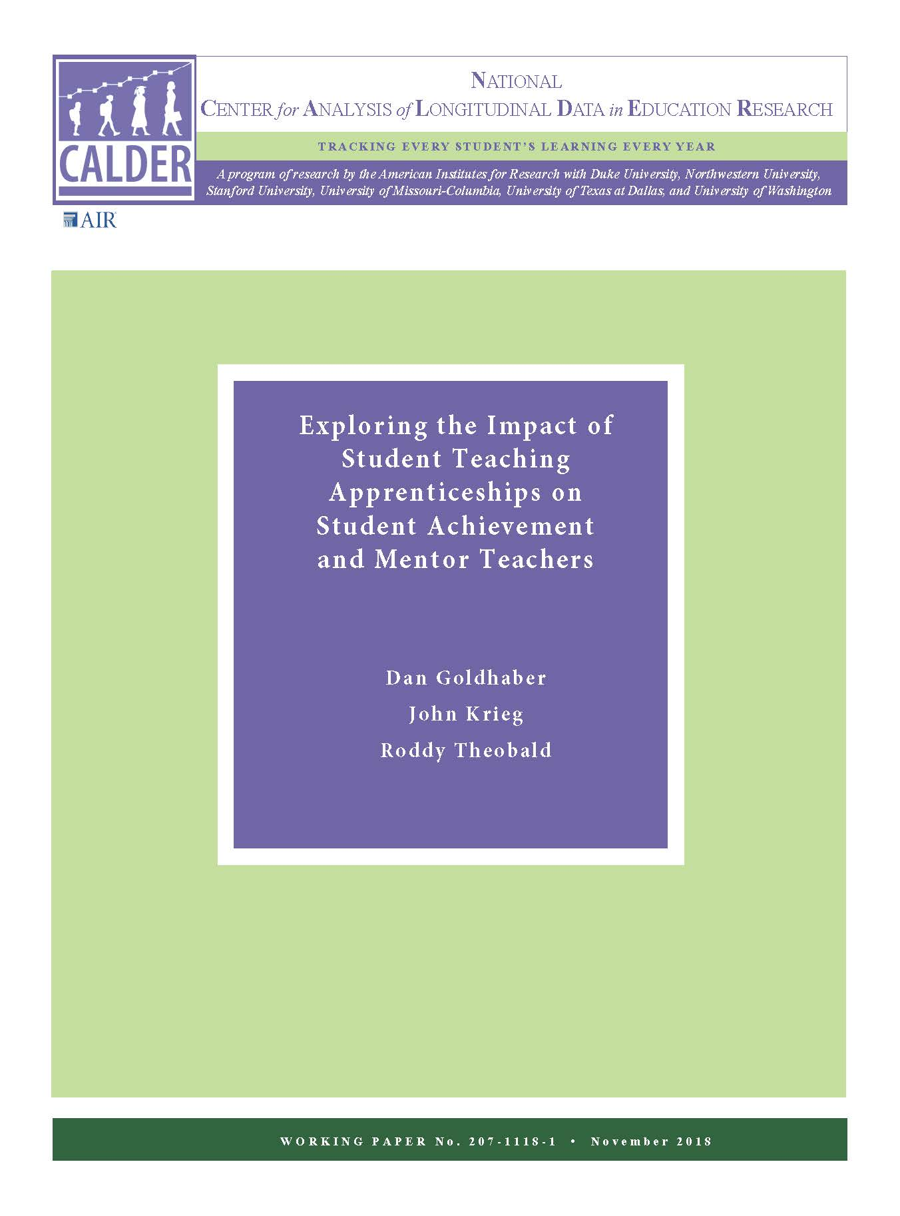
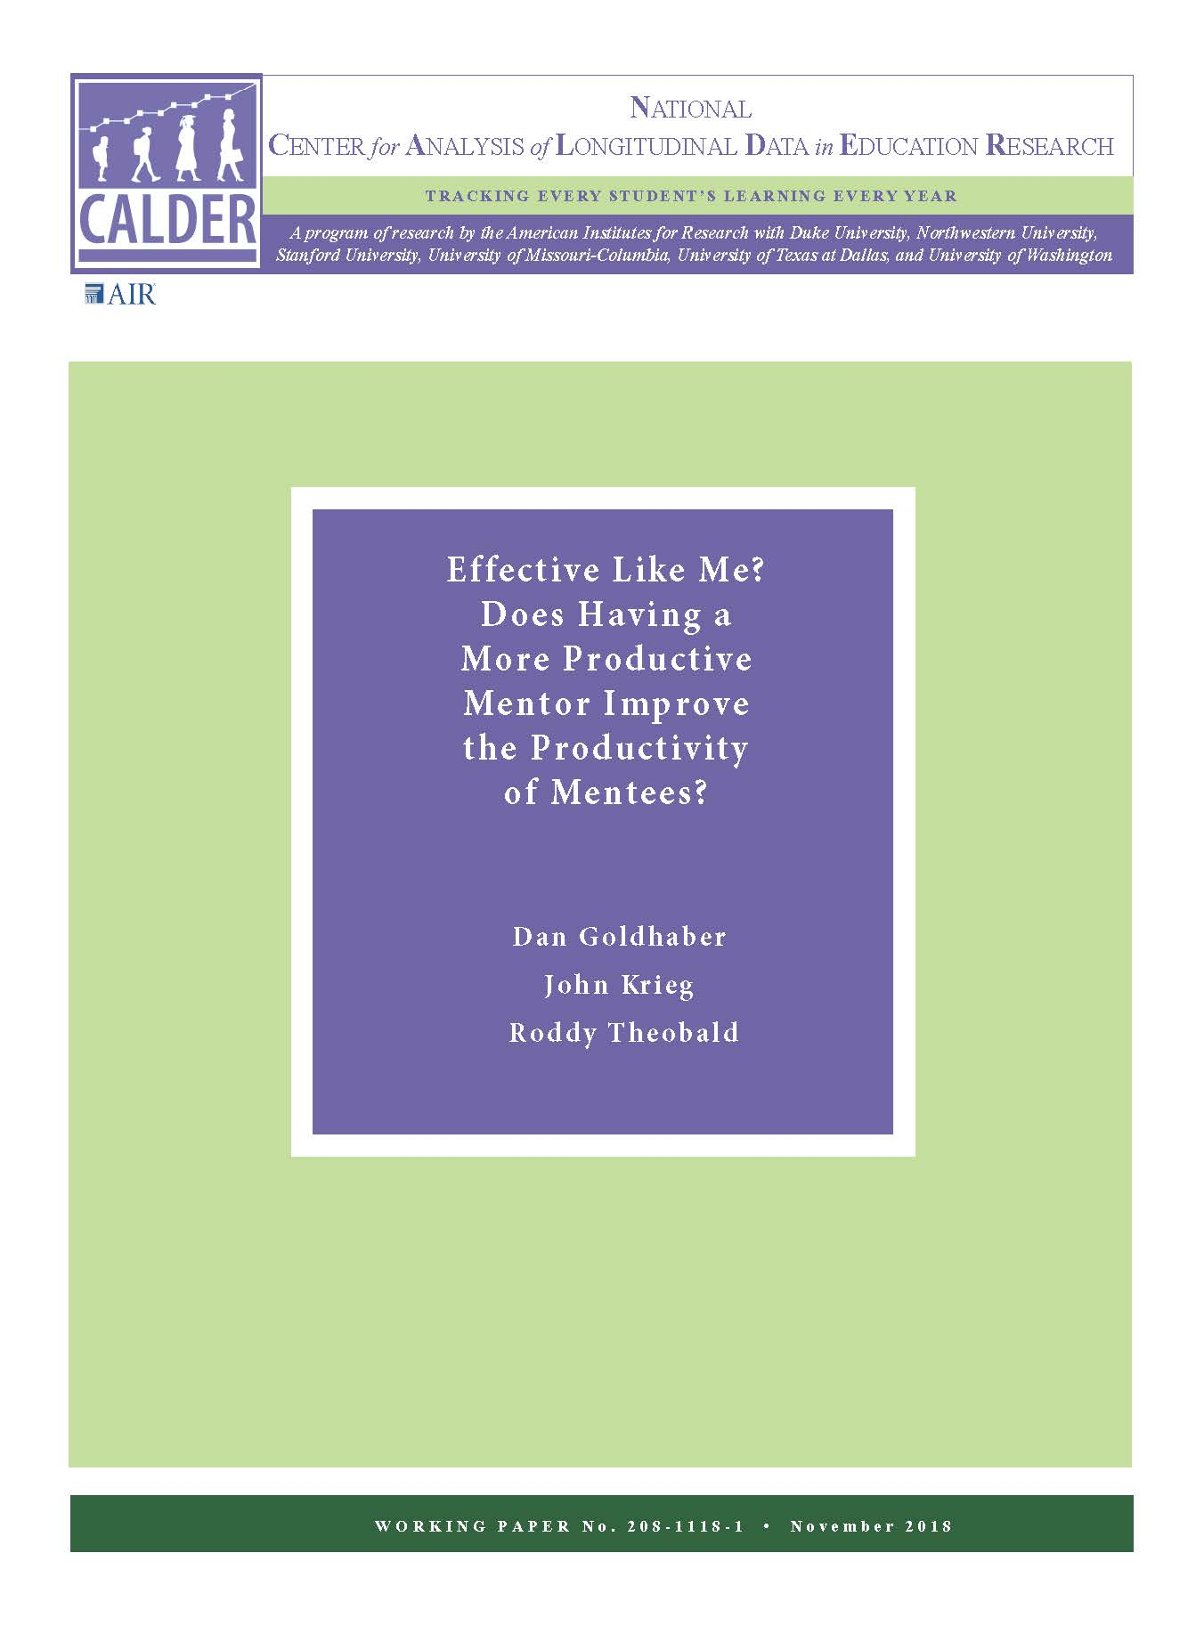
More of A Story Than A Research Presentation
+ A little bonus material!
Notes:
Get rid of ISTI

Slide 3
Teacher Education Learning Collaborative (TELC) Data
TELC Data
15 of 21 TEPs in Washington (about 80% of in-state prepared teachers): where and with whom student teachers do their apprenticeships
Most recent dataset (through student teaching placements in 2017-18): 23,922 unique teacher candidates
Value added sample (for candidates and their mentors): 1,044 mentee observations in math (924 unique mentors) and 944 mentee observations in ELA (895 unique mentors)
Washington State (OSPI) data
Inservice information about teachers in the state (experience, licensure tests, emergency credentials, etc.) and their students in K-12 public schools (test scores in math and ELA, demographic information, program participation, etc.) in Washington

Slide 4
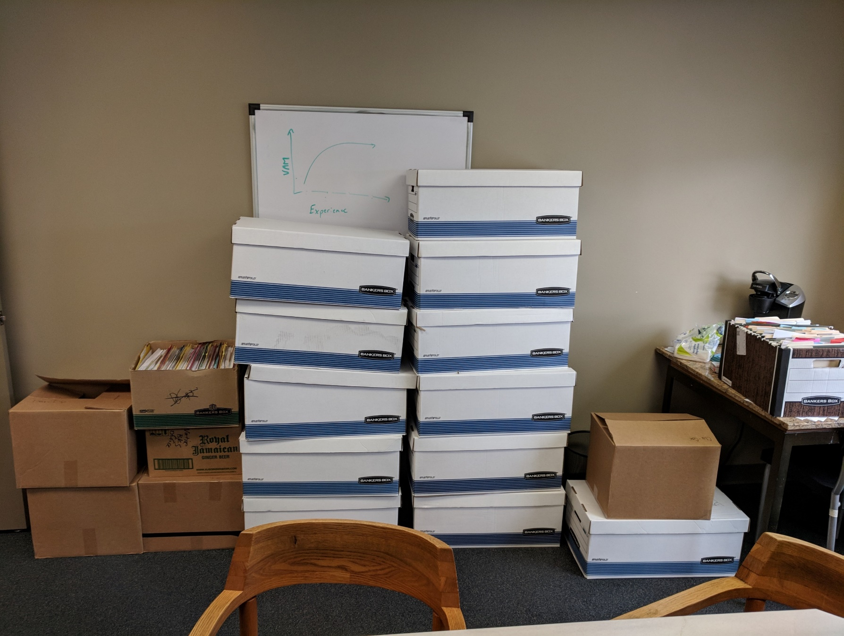
Why RAs Matter!

Slide 5
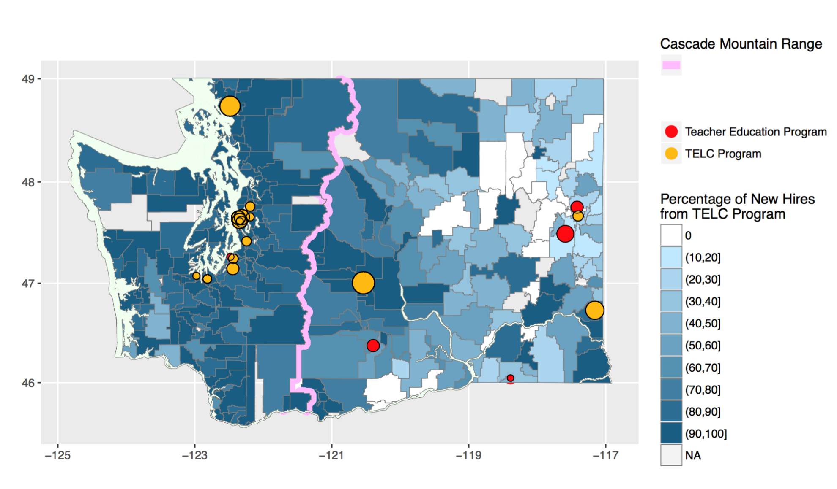
Percentage of New, in-State Teachers From TELC Programs, by District
Krieg, J., Goldhaber, D., & Theobald, R. (2019). Teacher candidate apprenticeships: Assessing the who and where of student teaching. Journal of Teacher Education. https://doi.org/10.1177/0022487119858983.

Slide 6
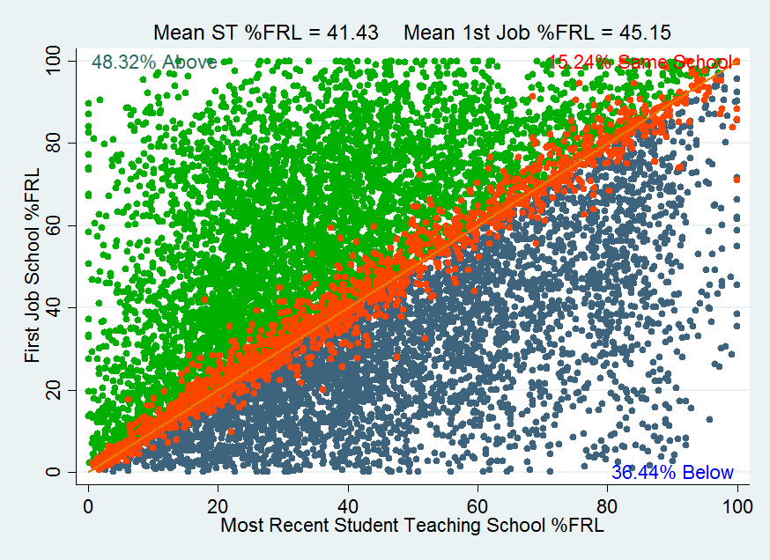
In Which Schools Does Student Teaching Take Place?
Source: Goldhaber, D., Krieg, J. M., & Theobald, R. (2017). Does the match matter? Exploring whether student teaching experiences affect teacher effectiveness. American Educational Research Journal, 54(2), 325-359.

Slide 7
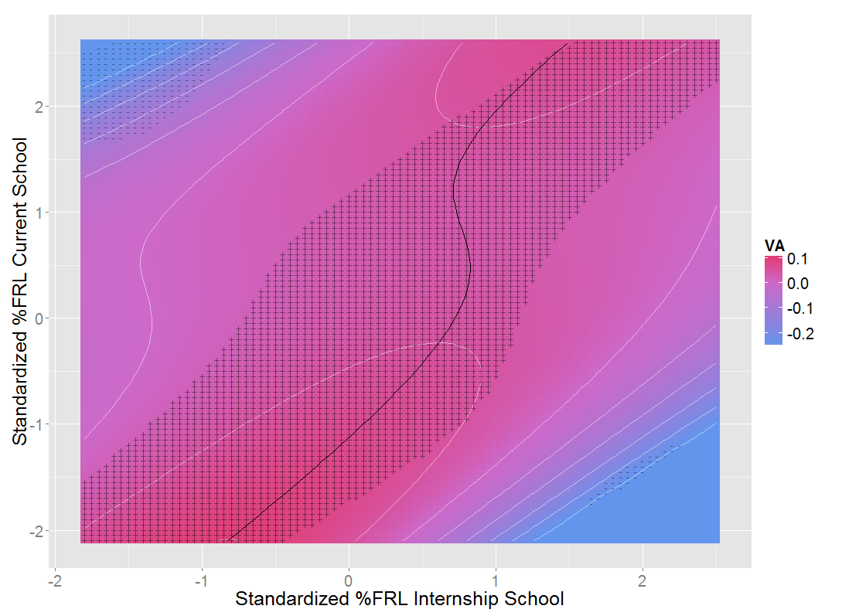
Student Demographic Match Preservice and Inservice and Predicted Teacher Effectiveness
Source: Goldhaber, D., Krieg, J. M., & Theobald, R. (2017). Does the match matter? Exploring whether student teaching experiences affect teacher effectiveness. American Educational Research Journal, 54(2), 325-359.

Slide 8
Analytic Approach
STEP 1: ESTIMATE MENTOR TEACHER VALUE ADDED PRIOR TO APPRENTICESHIP:
$$Y_{ijst^{′}}=α_{0}+α_{1}Y_{i(t^{′}−1)}+α_{2}X_{it^{′}}+\sum_{k}{α_{k+3}I({Exp}_{jt^{′}}=k)}+τ_{jks(t^{′}<t_{jk}^{M}\}}^{M}+ε_{ijst′}$$
STEP 2: INCLUDE MENTOR VALUE ADDED AS PREDICTOR OF STUDENT ACHIEVEMENT IN MENTEES’ FUTURE CLASSROOMS:
$$Y_{ikst}=γ_{0}+γ_{1}Y_{i(t−1)}+γ_{2}X_{it}+\sum_{k}^{4}{γ_{k+3}I({Exp}_{kt}=k)}+γ_{8}{\hat{τ}}_{jks(t^{′}<t_{jk}^{M}\}}^{M}+$$
$$γ_{9}\text{log}\left(t−t_{jk}^{M}\right)+γ_{10}\text{log}\left(t−t_{jk}^{M}\right)∗{\hat{τ}}_{jks(t^{′}<t_{jk}^{M}\}}^{M} +ε_{ijst}$$
Accounts for decay in relationship between mentor value added and mentee outcomes as time since student teaching increases

Slide 9
Findings
Table 3. Relationships between Mentor Value Added and Student Achievement
Subject: | Math |  |  |  |  | ELA
Column: | 1 | 2 | 3 | 4 | 5 | 6 | 7 | 8 | 9 | 10
Mentor VA | 0.116** | 0.190** | 0.163** | 0.169** | 0.112* | 0.050 | 0.103+ | 0.112+ | 0.117* | 0.113+
 | (0.038) | (0.061) | (0.059) | (0.055) | (0.052) | (0.035) | (0.062) | (0.059) | (0.059) | (0.067)
Log Time Since Student Teaching “Log(Time)” |  | 0.007 | 0.009 | 0.007 | 0.041* |  | -0.020 | -0.017 | -0.009 | 0.015
 |  | (0.019) | (0.019) | (0.019) | (0.019) |  | (0.016) | (0.016) | (0.016) | (0.017)
Mentor VA * Log(Time) |  | -0.082+ | -0.055 | -0.067 | -0.065 |  | -0.052 | -0.058 | -0.045 | -0.042
 |  | (0.048) | (0.048) | (0.048) | (0.047) |  | (0.047) | (0.047) | (0.047) | (0.049)
Teachers | 1044 | 1044 | 1044 | 1044 | 1044 | 994 | 994 | 994 | 994 | 994
Students | 78458 | 78458 | 78458 | 78458 | 78458 | 65632 | 65632 | 65632 | 65632 | 65632
Mentor Controls |  |  | X | X | X |  |  | X | X | X
Mentee Controls |  |  |  | X | X |  |  |  | X | X
District Fixed Effects |  |  |  |  | X |  |  |  |  | X
Source: Goldhaber, D., Krieg, J., & Theobald, R. (Forthcoming). Effective Like Me? Does Having a More Productive Mentor Improve the Productivity of Mentees?. Labour Economics

Slide 10
How Important Is The Mentor Teacher?
3
2
1
Typical Growth
Months of Student Learning
-1
Highly Effective Mentor Teacher (2 SDs above mean)
Average Mentor
-2
Very Ineffective Mentor (2 SDs below mean)
-3
0
Years
1
2
3
4
5
Years
Years of Teaching Experience
Source: Goldhaber, D., Krieg, J., & Theobald, R. (2018b). Effective Like Me? Does Having a More Productive Mentor Improve the Productivity of Mentees?. CALDER Working Paper No. 208-1118-1

Slide 11
So, It Looks Like Student Teaching Matters
Source: Goldhaber, D., Krieg, J., Naito, N., & Theobald, R. (2019a). Making the most of student teaching: The importance of mentors and scope of change. CALDER Research Brief 15-0519.
…but maybe none of this is causal
Notes:
STILL NEED TO TALK ABOUT THIS

Slide 12
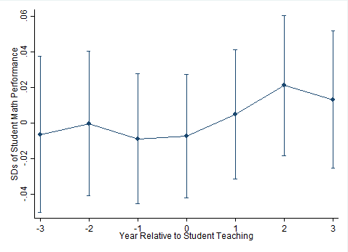
Maybe Hosting A Student Teacher Harms Student Achievement?
Student teaching year
Source: Goldhaber, D., Krieg, J., & Theobald, R. (2018a). Exploring the impact of student teaching apprenticeships on student achievement and mentor teachers. CALDER Working Paper 207-1118-1.

Slide 13
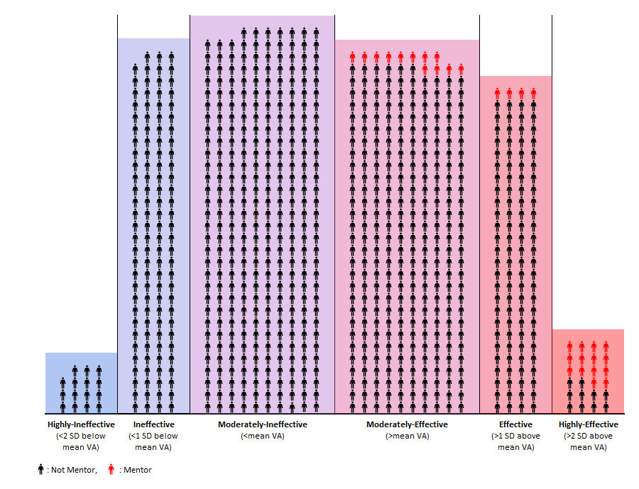


Scope of Change for Placements
Overall, 3% of teachers host a student teacher
Number of Teachers in Categories
Source: Goldhaber, D., Krieg, J., Naito, N., & Theobald, R. (2019a). Making the most of student teaching: The importance of mentors and scope of change. CALDER Research Brief 15-0519.
Each icon represents 10 teachers in value added grades and subjects
Notes:
Goldhaber, D., Krieg, J., Naito, N., & Theobald, R. (2019). Making the most of student teaching: The importance of mentors and scope of change. CALDER Research Brief.

Slide 14
ISTI Overview
Field Placement Initiative
Programs identify a pool of potential student teaching placements.
We use state administrative data to identify which placements are likely to best support student teachers’ professional development.
We evaluate placements using school performance measures, school faculty turnover, teacher performance measures, and teacher experience.
Using these characteristics, we rank placements and identify “high placement” and “low placement” groups.
Feedback Initiative
The intensive feedback initiative includes two components: more frequent feedback and more contextualized evaluations.
The research team implements random assignment of student teachers to the feedback initiative.
Student teachers in the high feedback initiative receive at least five evaluations during the internship.
Following each evaluation, the student teacher, mentor teacher, and field supervisor receive feedback reports about the evaluation

Slide 15
Algorithm for Creating “Index” Used to Predict More Promising Placements
Teacher Index: 3 Mentor Characteristics
Observation ratings based on district rubric
VAM score –standardized within grade/subject; averaged across subjects
Years of teaching experience
School Index: 2 School Characteristics
Teacher retention (“stay-ratio”)
School-level VAM
Overall Index: Weight teacher index 75% & school index 25%
- “High-index” placements = above median in county-grade-subject block

Slide 16
How frequently do interns receive differentiated feedback?
Highest rating
E.g., “exemplary”, “significantly above expectations”
Lowest rating
E.g., “unsatisfactory”, “significantly below expectations”
Notes:
Evaluation results here refers to scores on individual items. The figure regresses evaluation scores on the number of the observation, se clustered by intern. The pattern of scores across the internship looks quite similar when we include program/evaluator/item/intern FE.

Slide 17
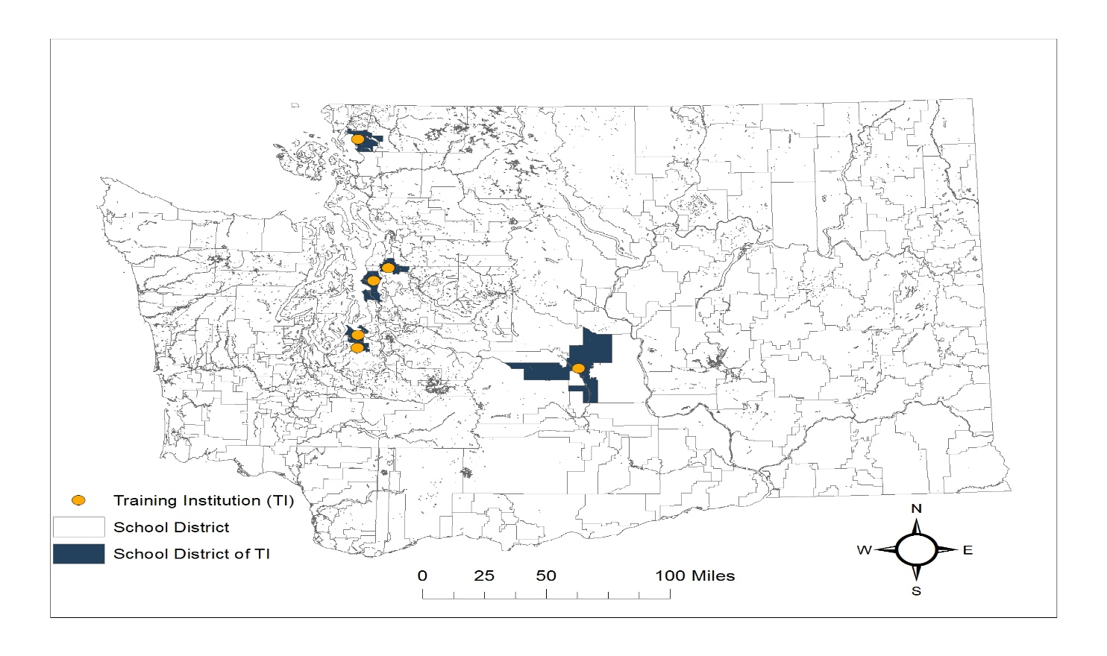
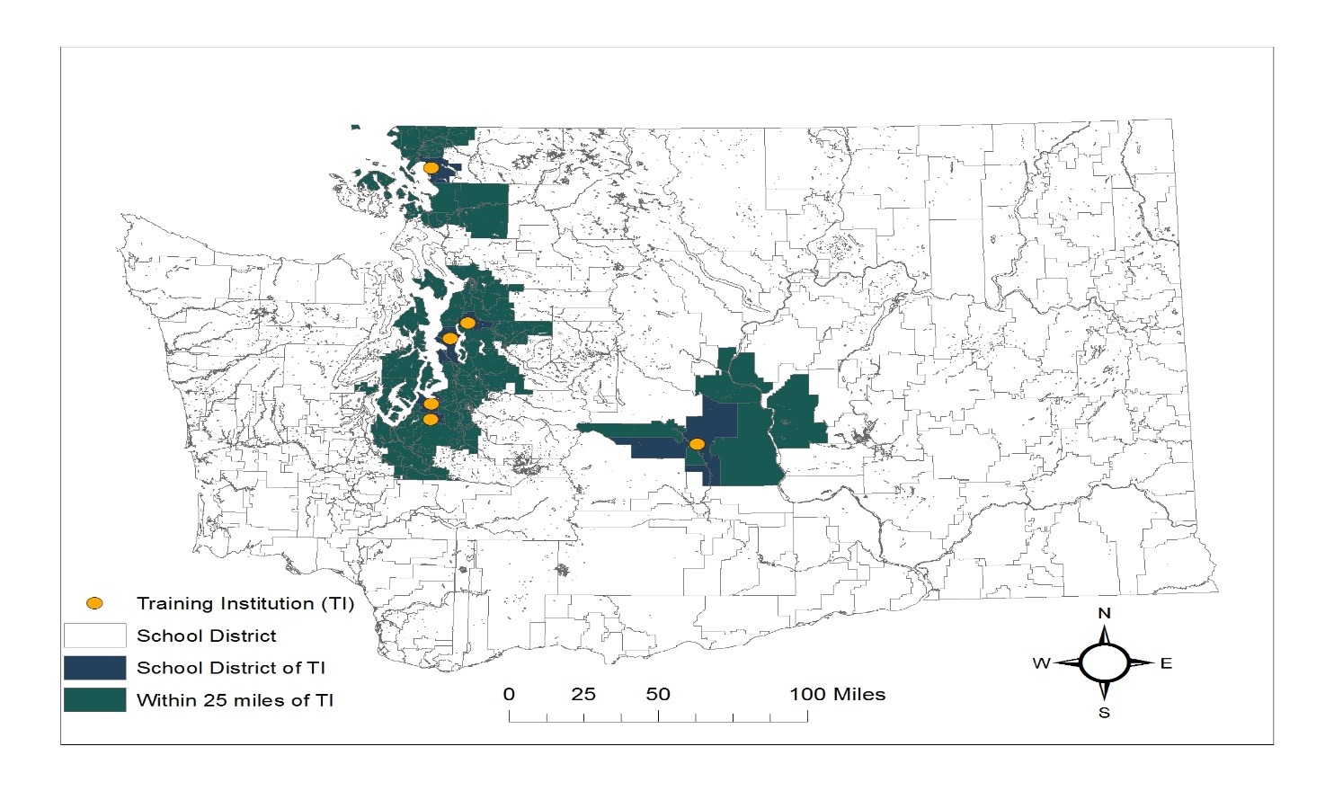
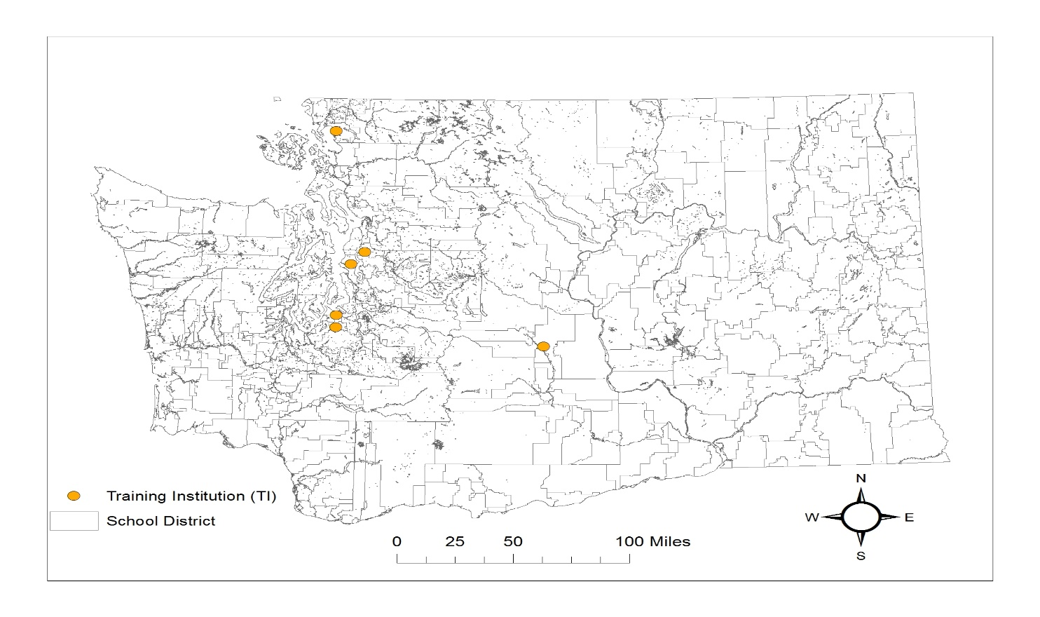
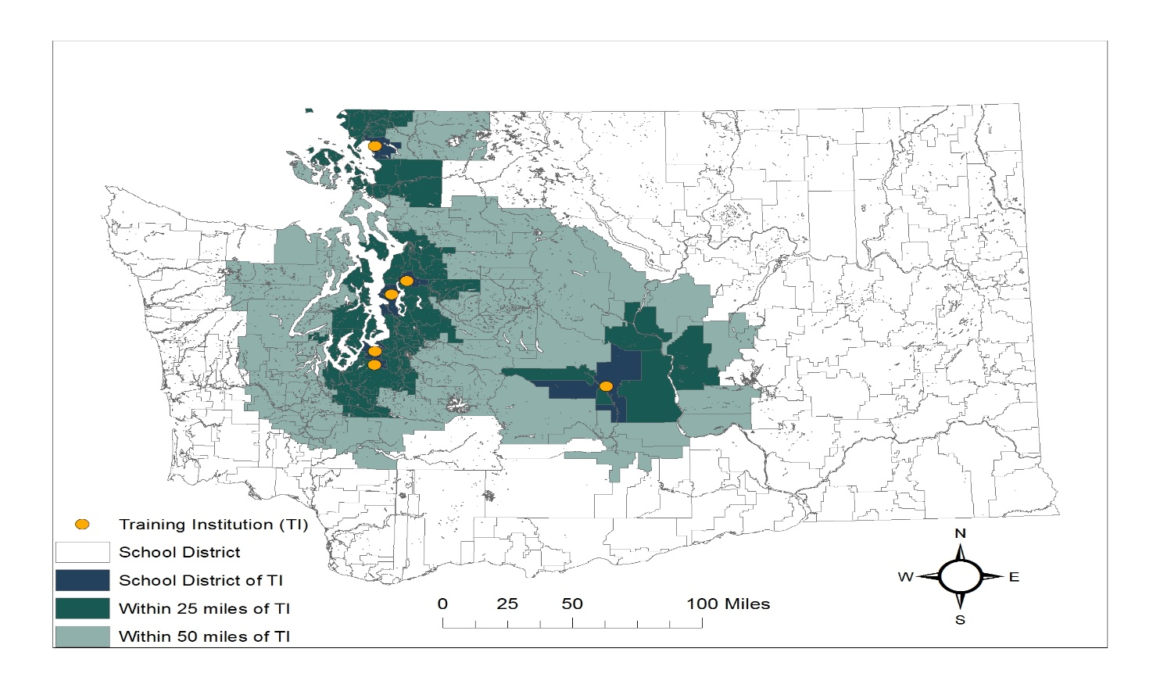
We Should Think About Role of Student Teaching for Staffing Challenges
First Job District | TEP | Home | Internship
Same district as…
Within 25 miles of…
Within 50 miles of…
7.9%
23.3%
37.5%
Source: Krieg, J. M., Theobald, R., & Goldhaber, D. (2016). A foot in the door: Exploring the role of student teaching assignments in teachers’ initial job placements. Educational Evaluation and Policy Analysis, 38(2), 364-388.
23.2%
54.3%
65.7%
33.4%
66.6%
75.7%

Slide 18
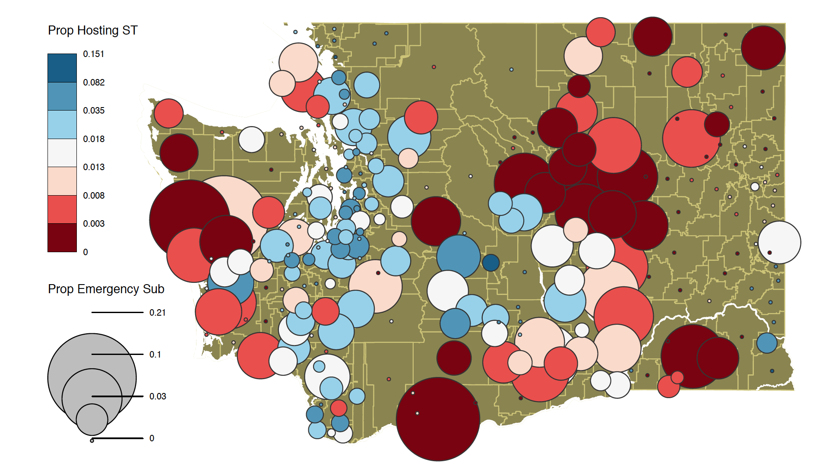
Student Teaching & the Geography of Teacher Shortages
Source: Goldhaber, D., Krieg, J., Naito, N., & Theobald, R. (2019b). Student teaching and the geography of teacher shortages. CALDER Working Paper No. 222-1019.

Slide 19
Student Teaching & the Geography of Teacher Shortages
Percentage of New Hires with Emergency Credentials in Each District (Statewide about 1% in 2018)
 | (1) | (2) | (3) | (4) | (5)
Percent of Teachers Hosting a ST | -0.222*** | -0.181** | -0.142** | -0.137** | -0.093*
 | (0.058) | (0.058) | (0.053) | (0.051) | (0.038)
City (ref. Suburb) |  | 0.003 |  | 0.183 | 0.077
 |  | (0.181) |  | (0.228) | (0.198)
Town (ref. Suburb) |  | 0.645* |  | 0.417+ | 0.231
 |  | (0.259) |  | (0.236) | (0.229)
Rural (ref. Suburb) |  | 0.588 |  | 0.305 | -0.152
 |  | (0.358) |  | (0.277) | (0.220)
Log distance to nearest TEP |  |  | 0.239** | 0.217* | 0.145*
 |  |  | (0.079) | (0.085) | (0.068)
Additional District Controls |  |  |  |  | X
Number of District-Year Observations | 1,097 | 1,097 | 1,097 | 1,097 | 1,097
R-squared | 0.116 | 0.123 | 0.126 | 0.129 | 0.152
Source: Goldhaber, D., Krieg, J., Naito, N., & Theobald, R. (2019b). Student teaching and the geography of teacher shortages. CALDER Working Paper No. 222-1019.

Slide 20
References
Goldhaber, D., Krieg, J. M., & Theobald, R. (2017). Does the match matter? Exploring whether student teaching experiences affect teacher effectiveness. American Educational Research Journal, 54(2), 325-359.
Goldhaber, D., Krieg, J., Naito, N., & Theobald, R. (2019a). Making the most of student teaching: The importance of mentors and scope of change. CALDER Research Brief 15-0519.
Goldhaber, D., Krieg, J., Naito, N., & Theobald, R. (2019b). Student teaching and the geography of teacher shortages. CALDER Working Paper No. 222-1019.
Goldhaber, D., Krieg, J., & Theobald, R. (2018a). Exploring the impact of student teaching apprenticeships on student achievement and mentor teachers. CALDER Working Paper 207-1118-1.
Goldhaber, D., Krieg, J., & Theobald, R. (2018b). Effective Like Me? Does Having a More Productive Mentor Improve the Productivity of Mentees?. CALDER Working Paper No. 208-1118-1
Goldhaber, D., Krieg, J., & Theobald, R. (Forthcoming). Effective Like Me? Does Having a More Productive Mentor Improve the Productivity of Mentees?. Labour Economics
Krieg, J. M., Theobald, R., & Goldhaber, D. (2016). A foot in the door: Exploring the role of student teaching assignments in teachers’ initial job placements. Educational Evaluation and Policy Analysis, 38(2), 364-388.
Krieg, J., Goldhaber, D., & Theobald, R. (2019). Teacher candidate apprenticeships: Assessing the who and where of student teaching. Journal of Teacher Education. https://doi.org/10.1177/0022487119858983.

