Slide 1
Properties of Light
Rectilinear Propagation
Reflection
Refraction
Interference
Diffraction
Polarisation

Slide 2
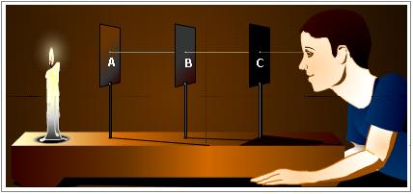
Rectilinear propagation
i.e. motion along a straight line

Slide 3
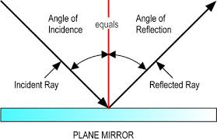
Reflection
Reflection is the change in direction of a wavefront at an interface between two different media so that the wavefront returns into the medium from which it originated

Slide 4
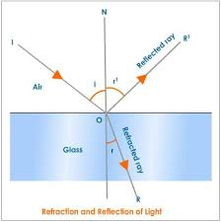
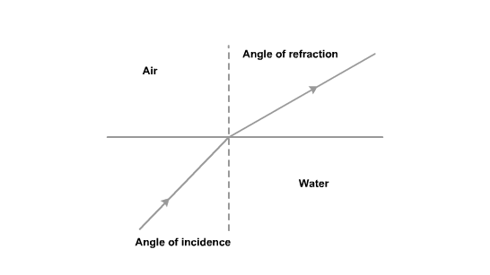
Refraction
Refraction is the change in direction of a wave due to a change in its transmission medium.

Slide 5
Interference
When two light waves superimpose then alternative bright and dark fringes are formed in the region of superimpose.
or
The modification of intensity in the region of superimpose

Slide 6
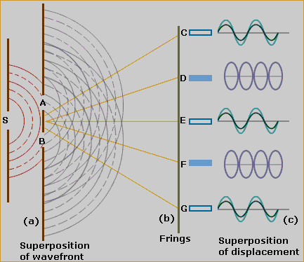
Interference pattern

Slide 7
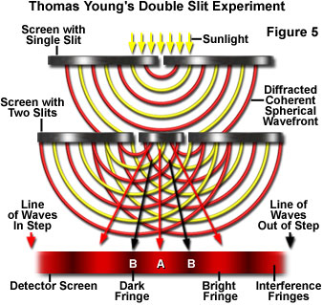
Interference pattern
.

Slide 8
Diffraction
Bending of light ray at the corners of the obstacle
screen
Light ray
θ
Geometrical shadow
Obstacle

