Slide 1
Introduction to light

Slide 2
Some questions which you already known in lower classes
What is Light?
What is the Nature of Light?
What are the properties of light?
Some applications of light?

Slide 3
What is Light?
Light is a form of Energy
Sense of Vision

Slide 4
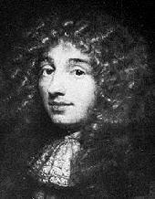
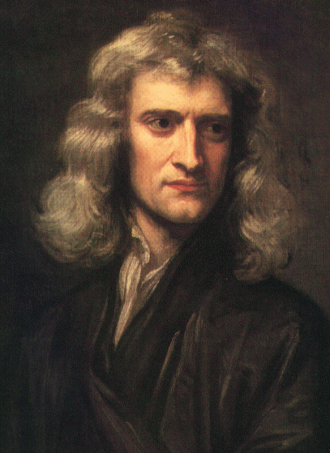
Historical Information
For centuries the nature of light was disputed. In the 17th century, Isaac Newton proposed the “corpuscular theory” stating that light is composed of particles. Other scientists, like Robert Hooke and Christian Huygens, believed light to be a wave. Today we know that light behaves as both a wave and as a particle.
i.e. Light has both wave and particle nature
Christian Huygens Isaac Newton

Slide 5
Newton’s particle theory
According to Newton Light consists of tiny elastic particles.
In this theory:
The colour of the light is due to the size of the particles. i.e. different size particles exhibit different colour
These particles travel with much more velocity in medium than in air, which is a wrong assumption. He compared the light with sound so he applied the same to light i.e. sound travel with more velocity in medium than air.
so this theory failed ( This theory can explain only reflection and refraction)

Slide 6
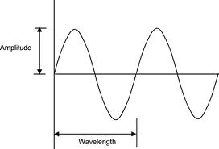
Huygen’s wave theory
According to Huygen light has wave nature. To explain this theory he introduced a new idea i.e. WAVE FRONT
WAVE FRONT: The locus of all points having same phase

Slide 7
Huygen’s theory explained the properties of light.
Those are
Reflection
Refraction
Interference
Diffraction
Polarisation
But failed to explain Photo electric effect and Compton effects, which are explained by particle nature.
So this theory also failed.
To explain all the properties and effects of light we have to agree that light has both wave and particle nature.

Slide 8
Applications of Light
Light has so many applications based on nature and properties of light.
Those are
Laser
Optical fibre
Holography

Slide 9
.
Thank You.

