Slide 1
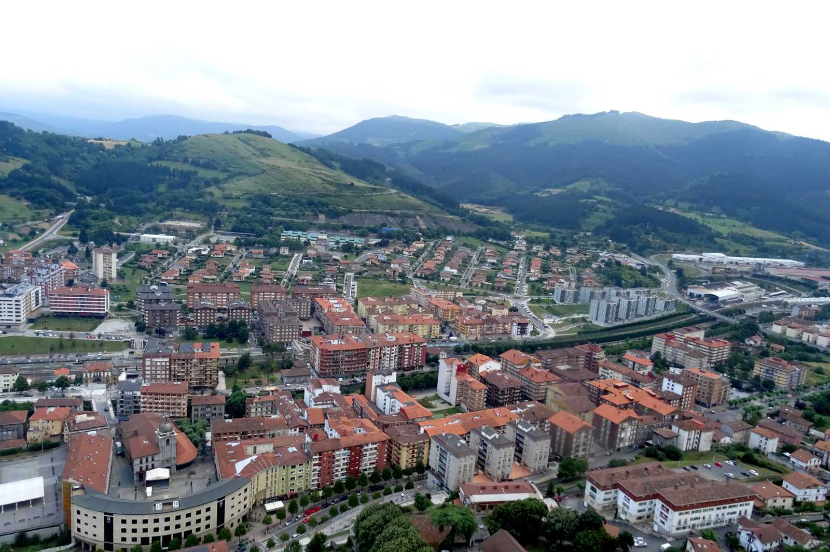
Laudio

Slide 2
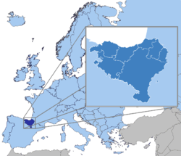
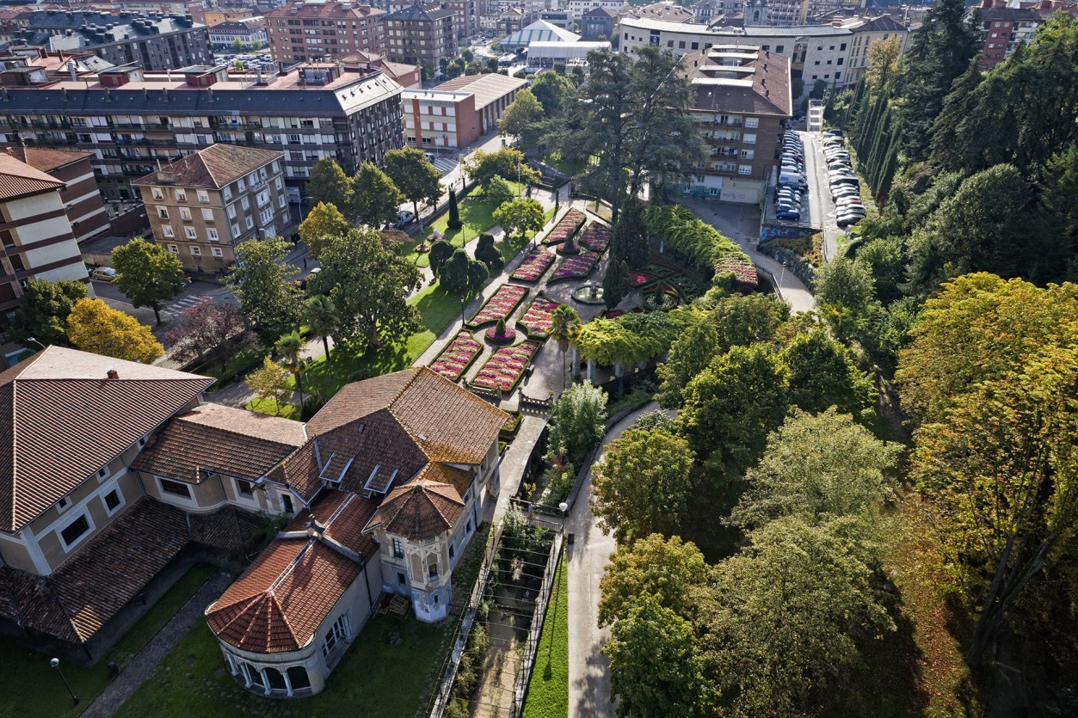
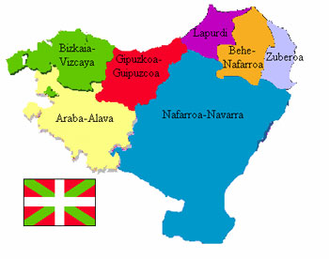
Location
Laudio is a Spanish municipality in the province of Alava, autonomous community of the Basque Country.

Slide 3
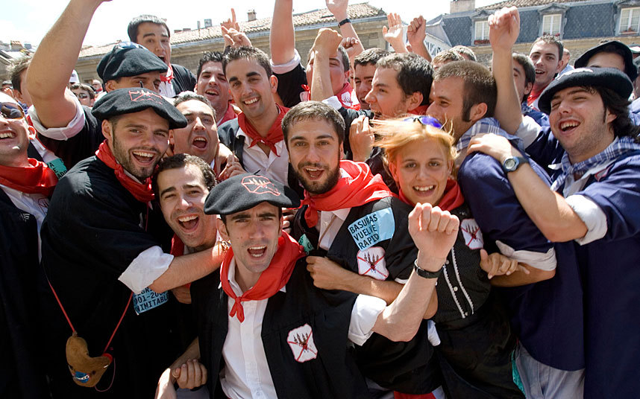
Population
According to the National Statistical Institute, Laudio has about 18212 inhabitants.( study done in 2016).
In fact, demographically, it is the second largest town/city in the province of Alava after its capital Vitoria-Gasteiz.
Change of population number of Laudio
2012 | 2013 | 2014 | 2015 | 2016
18 498 | 18 510 | 18 428 | 18 300 | 18 212

Slide 4
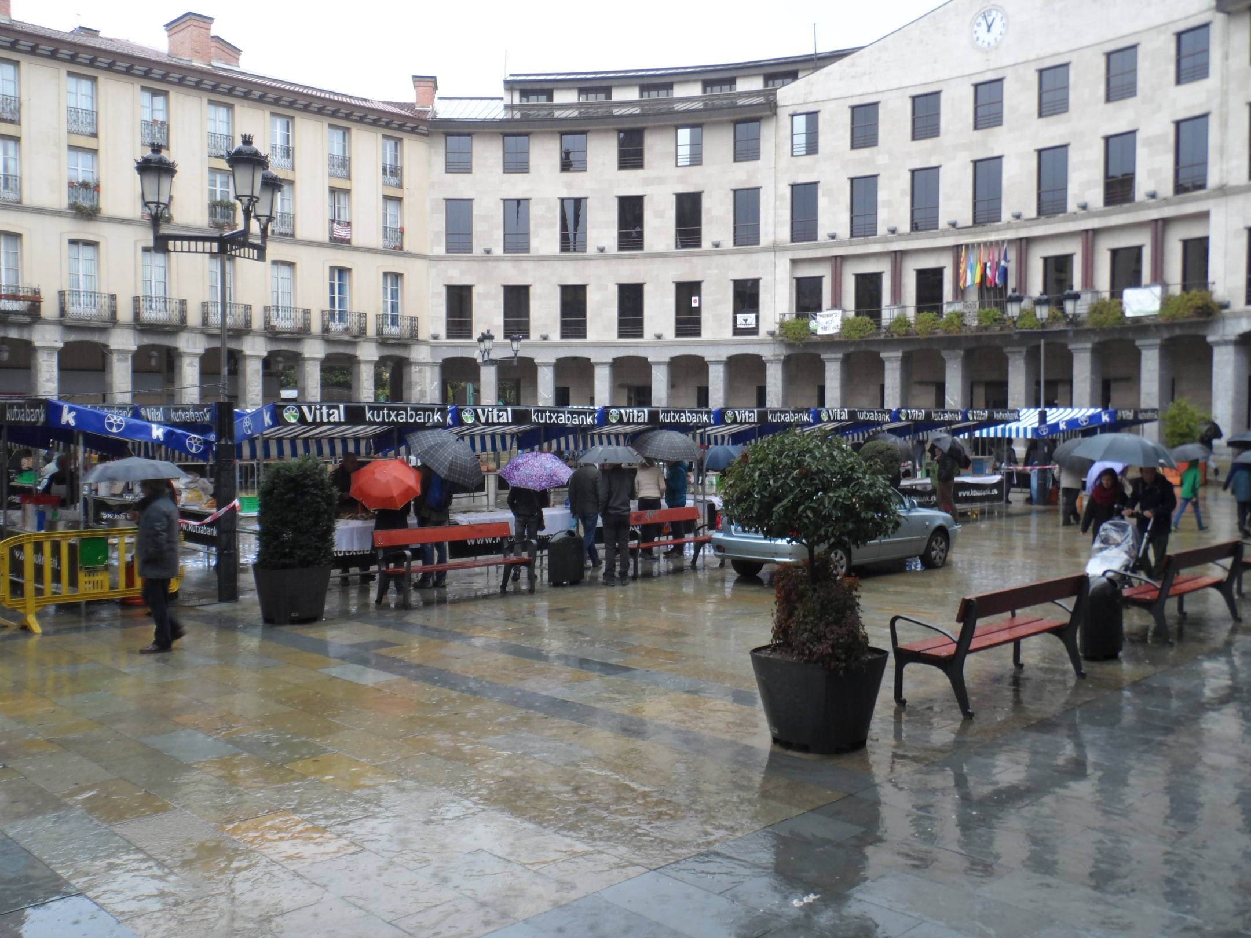
Climate
Laudio is located in an oceanic, temperate and humid climatic zone.
There is significant rainfall throughout the year. And in Laudio the average temperature is 13.8 ° C.

Slide 5
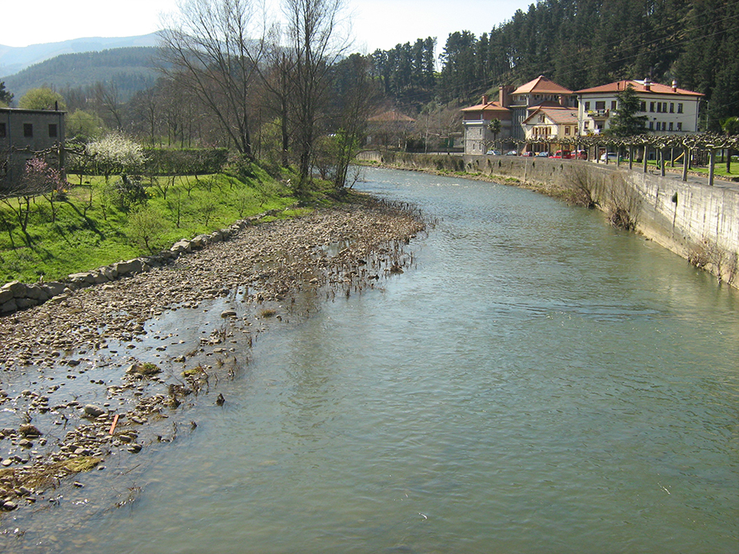
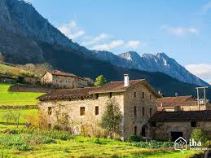
Nature
The main river in Laudio is the river Nérvion.
Laudio is set amid mountains making it perfect for nature lovers.
People can witness the rural and calm
of this valley.

Slide 6
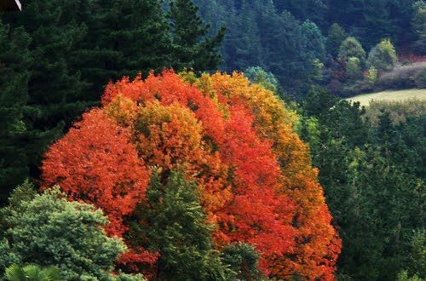
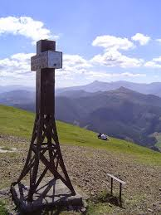
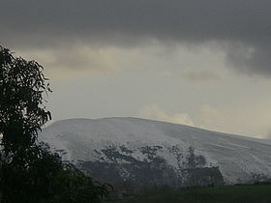
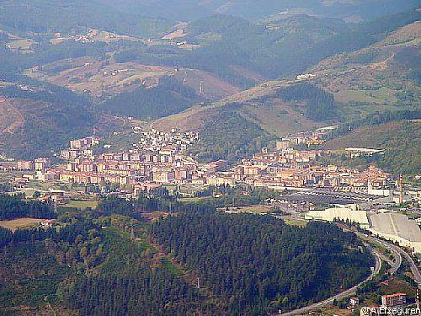
Nature and landscapes
Mountains
Ganekogorta
Goikogane

Slide 7
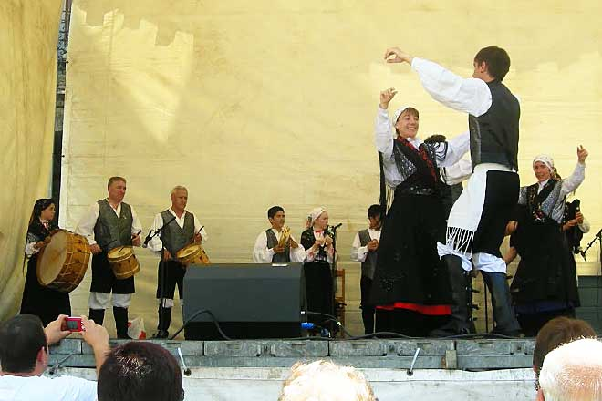
Festivals
“De los pueblos" festival in Laudio is mainly a folkloric festival but it also has other activities, similar to our festivals

Slide 8
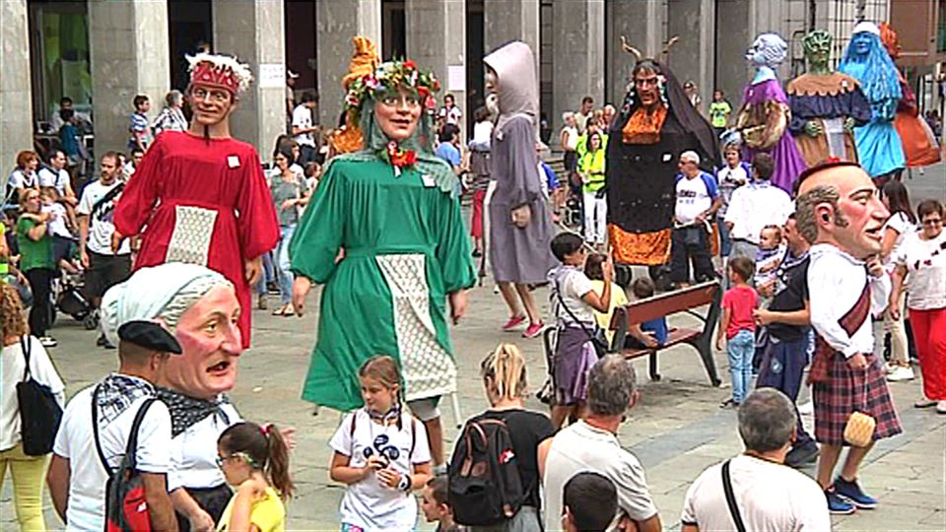
Festivals
“Las Fiestas de San Roque" is a traditional festival in August.

Slide 9
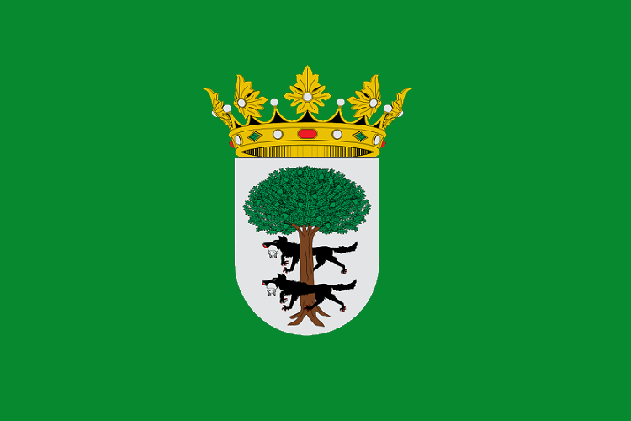
-Maria Condeço, nº12 8ºC
From Portugal

