Slide 1
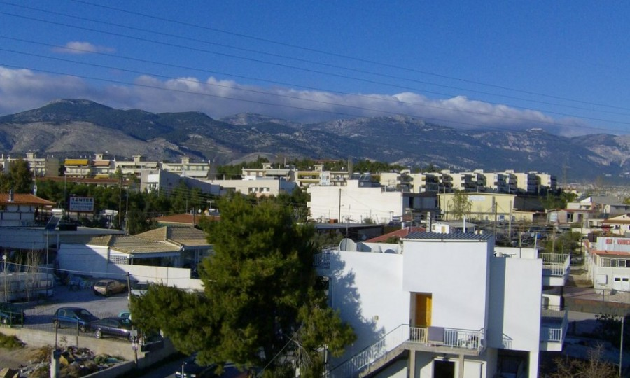
Acharnes (Αχαρνές)
Rafael Losacco no. 16
Tiago Laranjinha no. 20
Joaquim Cabral no. 13

Slide 2
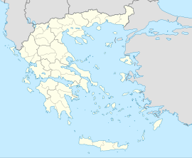
Acharnes
It is a Greek city located in the periphery of Attica. It has 106 000 inhabitants.
The municipality has an area of 149.956 km2
.
Acharnes
Flag of Acharnes

Slide 3
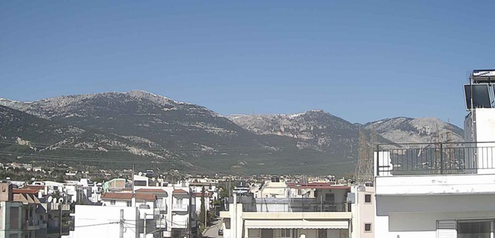
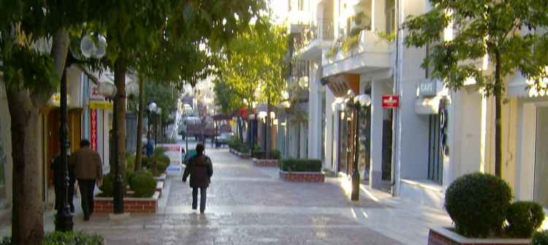
Symbol of the municipality of Acharnes

Slide 4
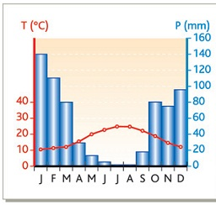
Climate
The climate is temperate Mediterranean, hot and dry in summer, mild temperatures in winter and more humidity.
Thermopluviometric graph of Greece.

Slide 5
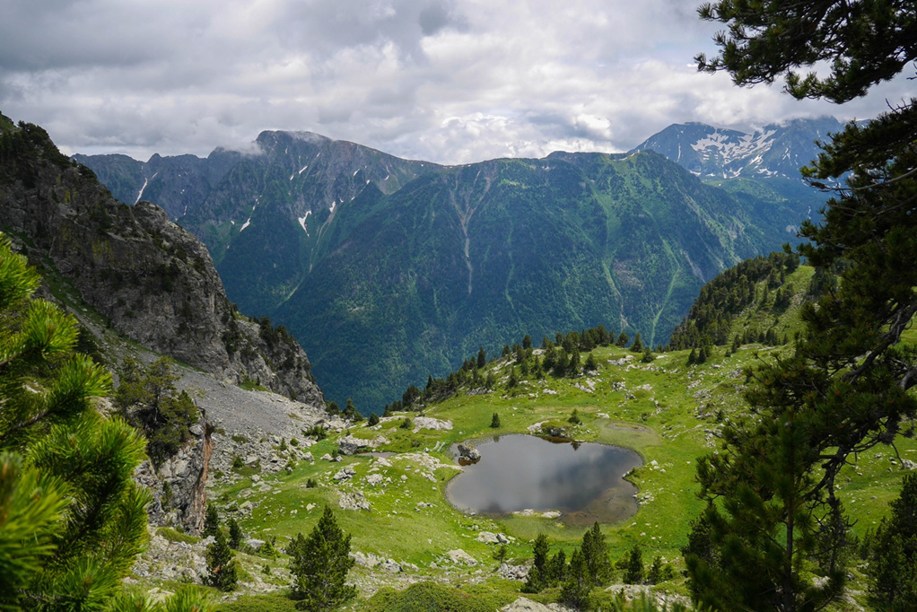
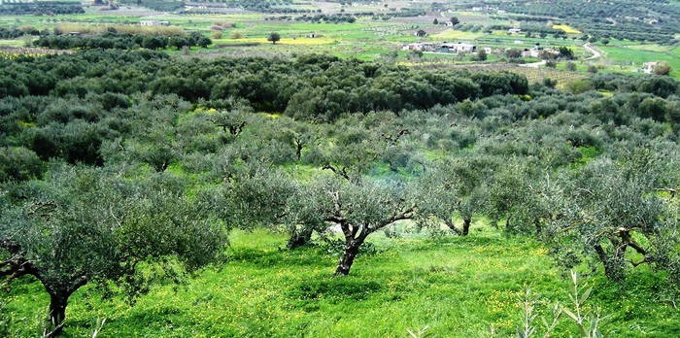
Nature
The mountains cover most of the territory and the rivers are few in number due to little precipitation. Due to the reduced fertility of mountainous soil, the Greeks produce many grains, vines, olive trees, figs and carob trees that are well adapted to the climate.

Slide 6
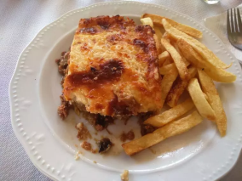
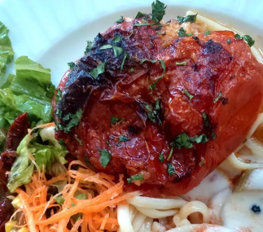
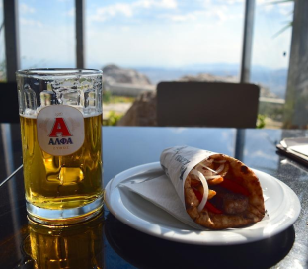
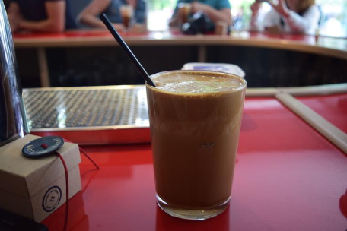
Gastronomy
It is a combination of eggplants, ground lamb, tomatoes, onions, olive oil, white sauce and a lot of seasonings.
Moussaka:
Gemista:
Souvlaki:
Frappé:
It is tomato or chili stuffed with rice and cooked with sauce and olive oil.
It is served on plate or pita bread with gravy, salad and chips.
It is a blend of instant coffee with ice cubes.

Slide 7
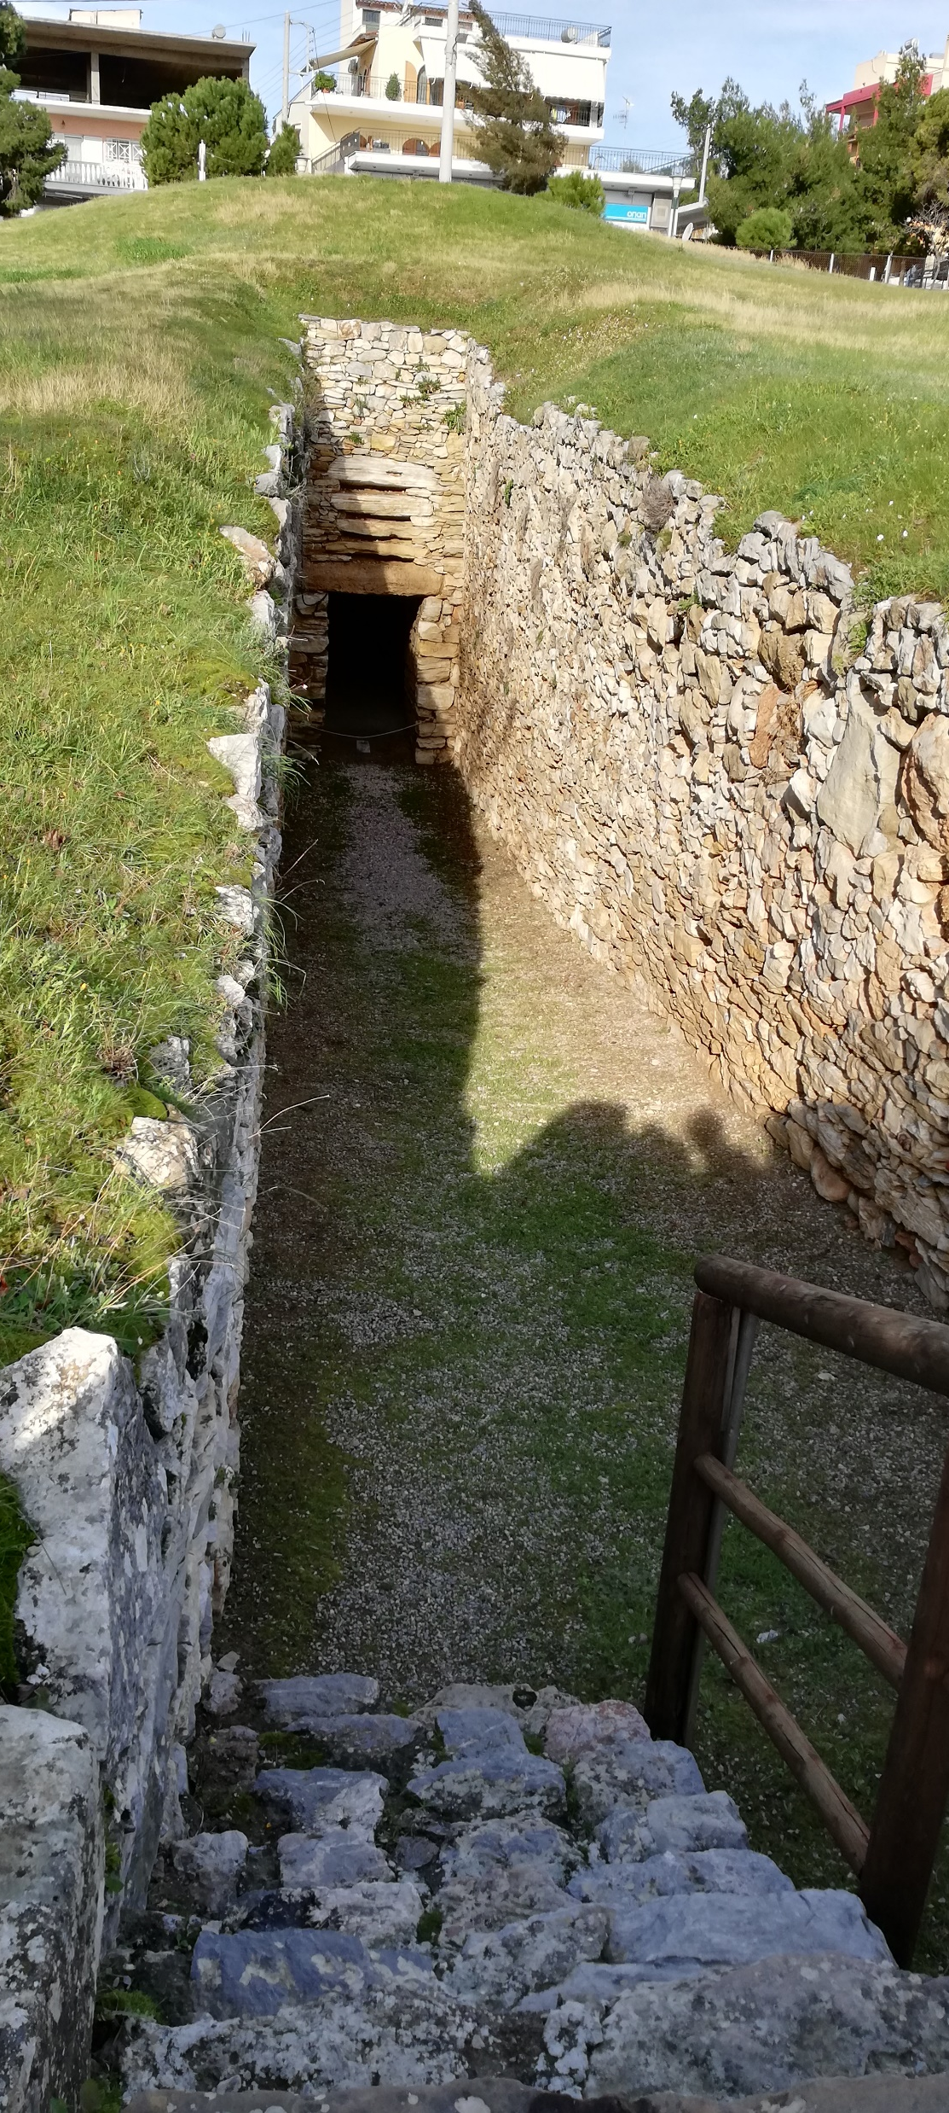
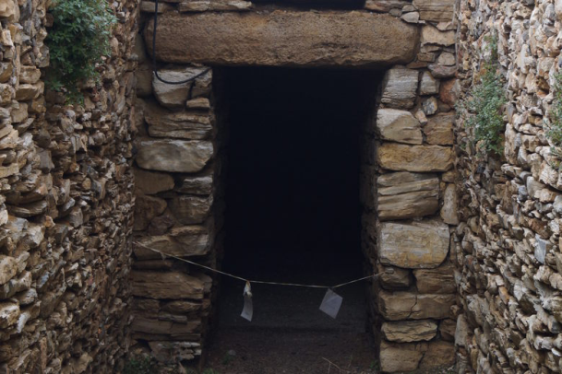
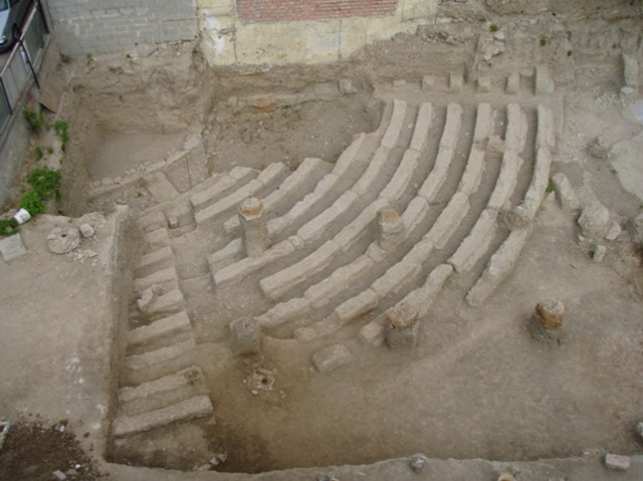
Monuments
Domelike tomb of Acharnes
Old theatre of Acharnes

