Slide 1
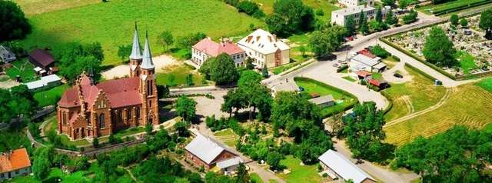
Janowiec koscielny
Poland

Slide 2
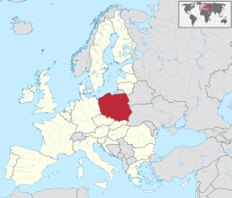
Location
Janowiec Kościelny (Polish: Gmina Janowiec Kościelny) is a gminy (commune) in Poland, the Warmian-Masurian Voivodeship and Nidzicki County.
The county seat is the town of Janowiec Kościelny.

Slide 3
Population
3490 inhabitants

Slide 4
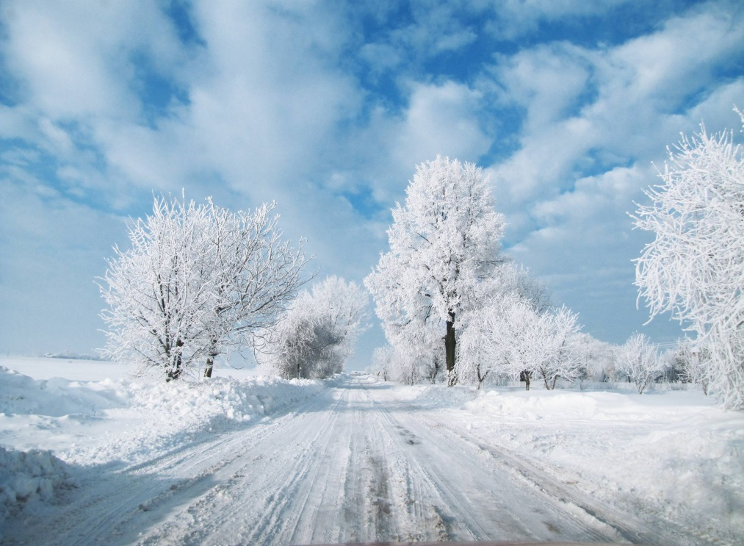
Climate
The climate in Poland is temperate, with a hot and short summer, and a long, cold winter in all regions of the country.
During the summer months temperatures are between 20 ° C and 27 ° C.
The hottest month is July, when the temperature can hit 30 ° C. Definitely, winter is not a good time to travel to Poland. The coldest month is January.

Slide 5
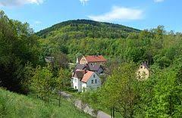
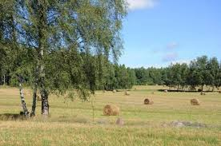
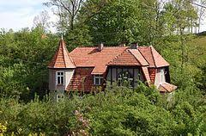
Nature

Slide 6
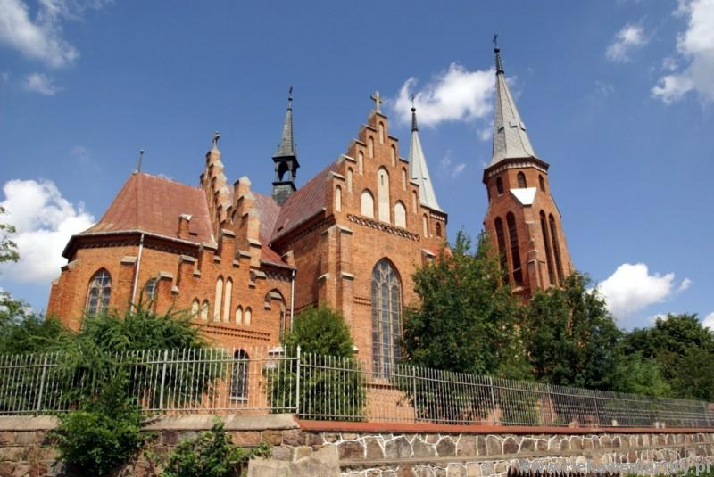
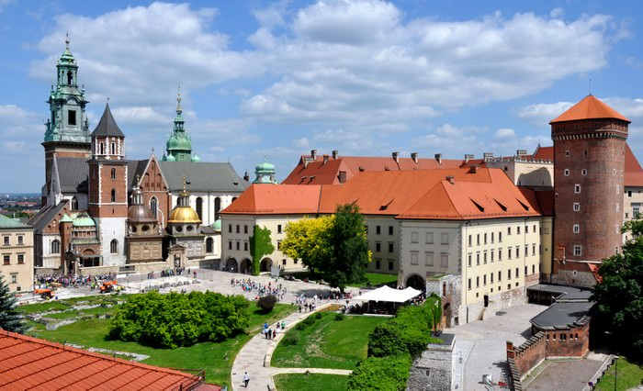
Monuments
Church
Wawel castle

Slide 7
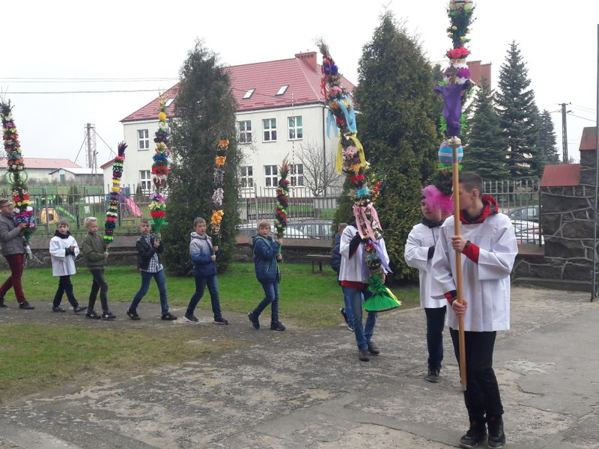
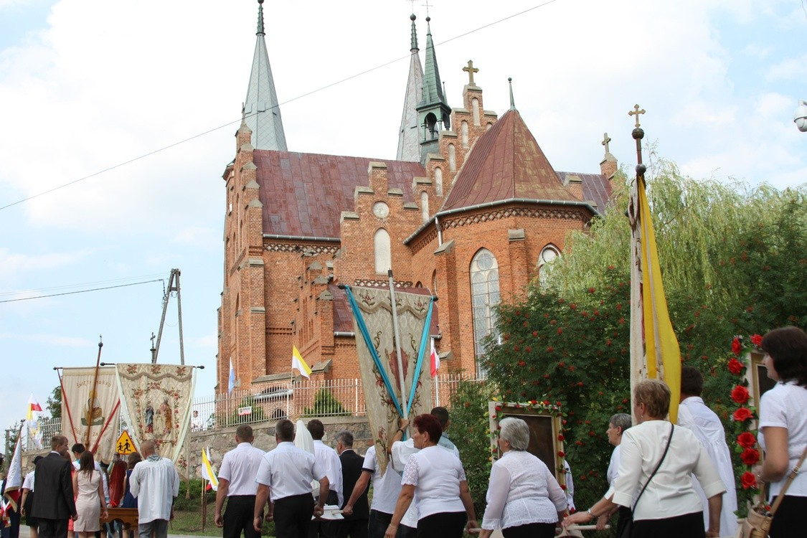
Festivals and Celebrations
Religious celebrations

Slide 8
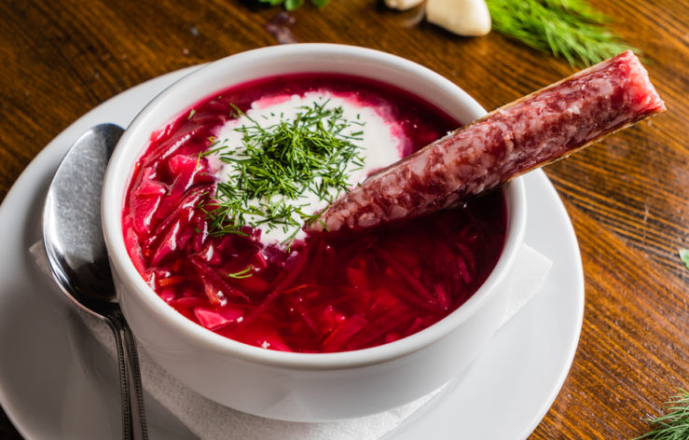
Gastronomy
Barszcz czerwony
Bigos
Chłodnik

Slide 9
Beatriz Oliveira nº 4
Daniela Lopes nº 10
Sofia Joaquim nº 21

