Slide 1
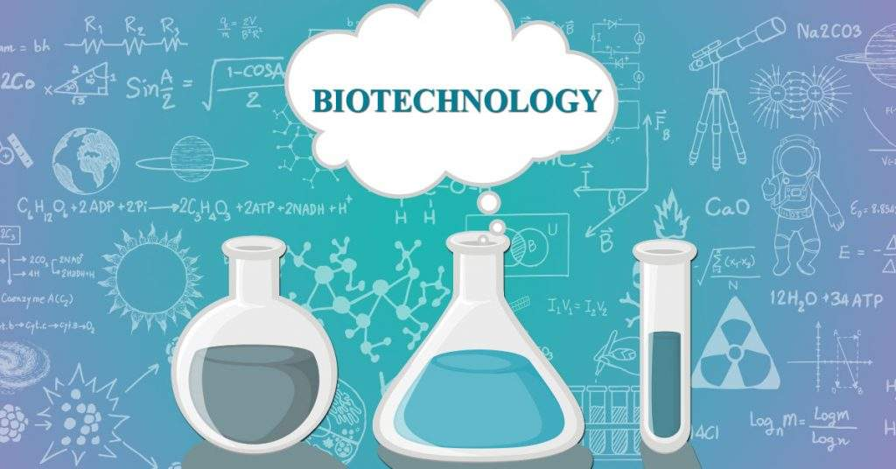

Slide 2
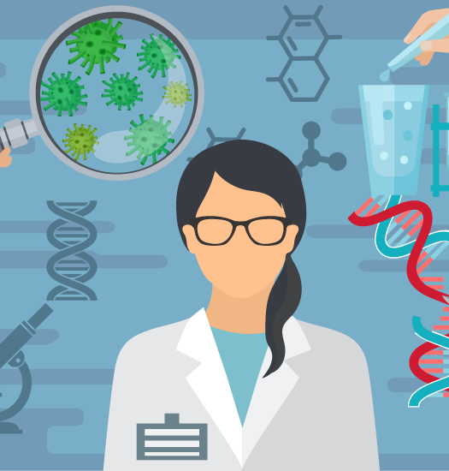
Biotechnology
The manipulation of living organisms or their components to produce useful commercial products

Slide 3
Biotechnology
Medical Biotechnology
Vaccines, diagnostics, pharmaceuticals, treatments
Industrial Biotechnology
Enzymes and microorganisms for processing products
Environmental Biotechnology
Microorganisms for bioremediation
Agricultural Biotechnology
Enhanced crops, feed, fertilizers

Slide 4
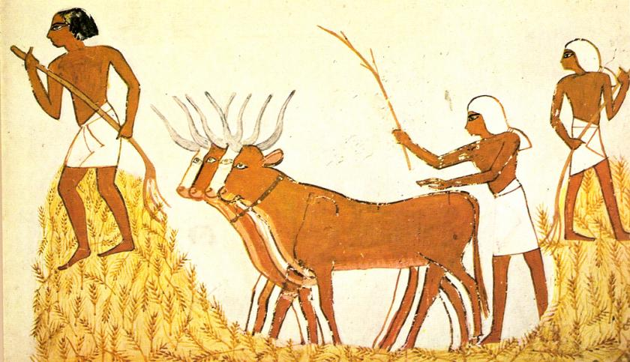
Selective Breeding
Since ancient times, people have understood how to manipulate DNA!
Selective Breeding
The process by which desired traits of certain plants and animals are selected and passed on to future generations

Slide 5
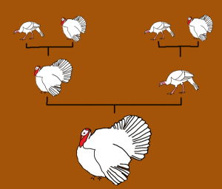
Selective Breeding
Hybridization
Crossing parent offspring with different traits to produce offspring with specific traits
Widely used by farmers, animal breeders, scientists, and gardeners
Select traits that will give the hybrid organisms a competitive edge
Disease resistant, produce more offspring, faster growing, better looking, better tasting, etc

Slide 6
Selective Breeding
Hybridization
Horses = Big, fast, excitable, endurance
Donkeys = Small, slow, calm
Mules = Strong, calm, endurance

Slide 7
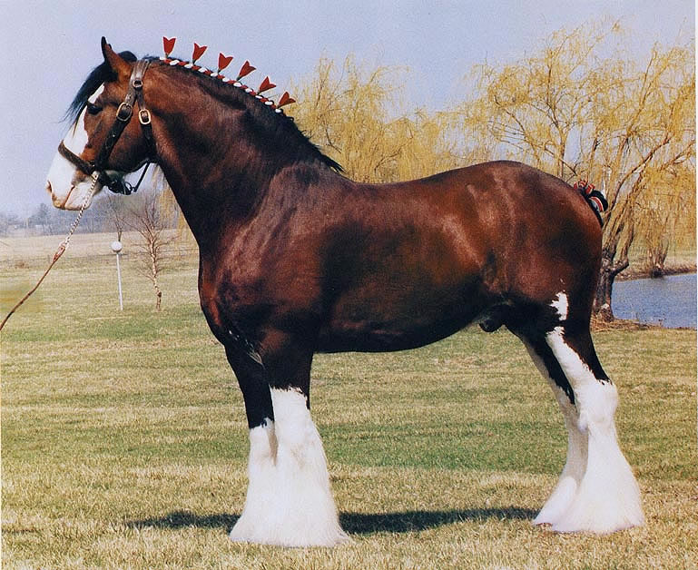
Selective Breeding
Inbreeding
Crossing of two closely related organisms with desired traits to ensure the passing of those traits and to eliminated undesired traits in future generations
“Purebreds” are maintained by inbreeding
Dog breeds
Clydesdale horses

Slide 8
Genetic Engineering
By 1970, researchers had discovered the structure of DNA and understood the Central Dogma of information flow (DNA → RNA → Proteins).
Genetic Engineering
1980’s and 90’s Scientists then began manipulating DNA using technology
Technology used to alter, increase or decrease specific genes in selected organisms
Many applications from human health to agriculture

Slide 9
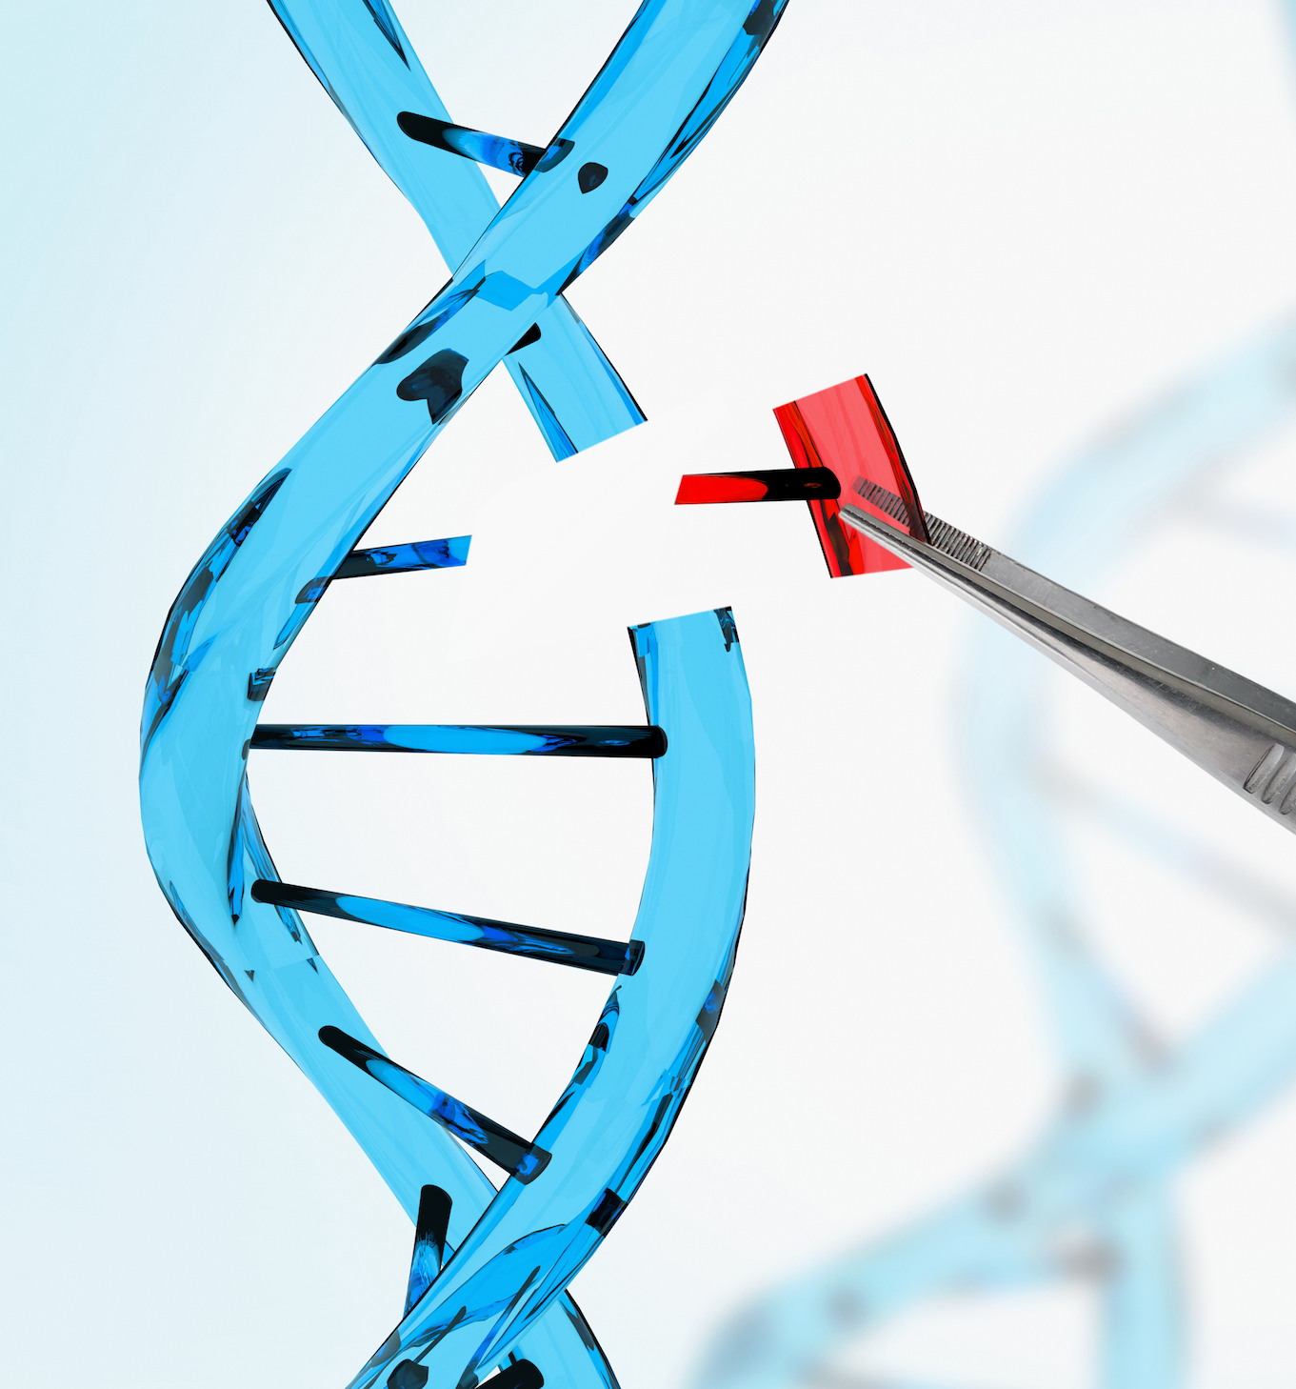
Genetic Engineering
Genome : total DNA present in the nucleus of cells
Genetic engineering requires tools to manipulate DNA and isolate genes from the rest of the genome!

Slide 10
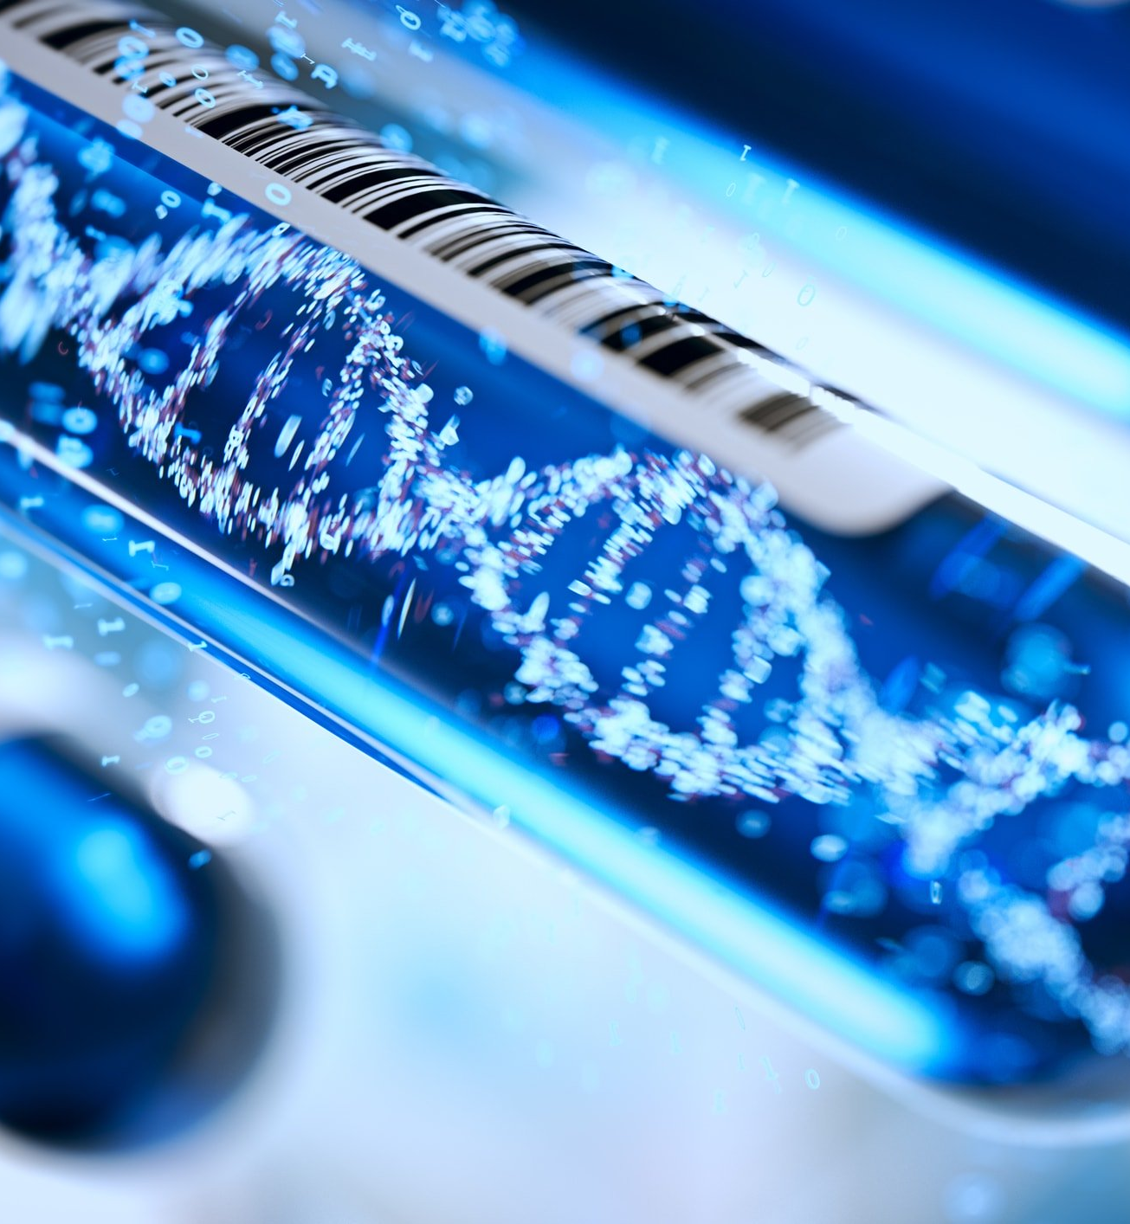
DNA Extraction
Before the DNA can be sequenced, DNA must be extracted from the organism
1. Cells are lysed
2. Cell contents are “washed” and separated
Proteins, salts, etc are removed
3. DNA is precipitated out of solution with isopropyl alcohol
4. Extracted DNA is suspended in solution until needed

Slide 11
Restriction Enzymes
Restriction enzymes
Proteins that recognize and bind to specific DNA sequences and CUT the DNA within that sequence
Restriction enzymes come from bacteria
Serve as a defense against viruses
Restriction enzymes cut the viral DNA into fragments
Many different types of restriction enzymes, each responsible for isolating specific genes or regions of the genome

Slide 12
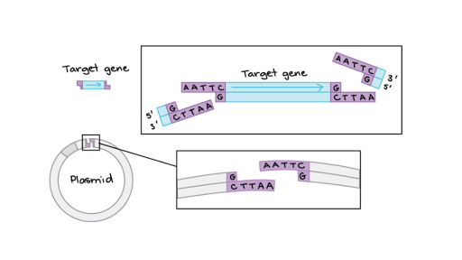
Restriction Enzymes
Some restriction enzymes at genes with “sticky ends”
Sticky ends contain single stranded DNA that is complementary and can be joined together
Like two pieces of Velcro, ready to hook on to their opposite side!

Slide 13
Gel Electrophoresis
After a long DNA molecule has been cut by restriction enzymes into many smaller fragments, several things can be done:
DNA sequence of gene can be studied
Gene cut from DNA can be inserted into another organism
BUT FIRST the DNA fragments must be separated from one another!
Gel Electrophoresis
Uses an electrical current to separate a mixture of DNA fragments according to their sizes

Slide 14
Gel Electrophoresis
A sample of DNA is loaded into a gel (kind of like a thin rectangle of jello!)
Negative electrode is placed at DNA end
Positive electrode is placed at the far end
Because DNA has a negative charge, it moves TOWARDS the positive charge
Gel allows SMALL molecules to move quickly through, but LARGE molecules move slowly

Slide 15
Gel Electrophoresis
So…. You can estimate the size of the fragment by how far it moves!
This pattern of bands creates a “restriction map” of the original DNA
Shows the lengths of DNA fragments between restriction sites in a strand of DNA

Slide 16
DNA Fingerprinting
Your complete set of DNA is unique to you!
A DNA Fingerprint is a specific type of restriction map which can be used to identify a person at the molecular level
DNA samples are cut with restriction enzymes and the specific pattern of bands can be used identify criminals, show relationships between individuals, and more!

Slide 18
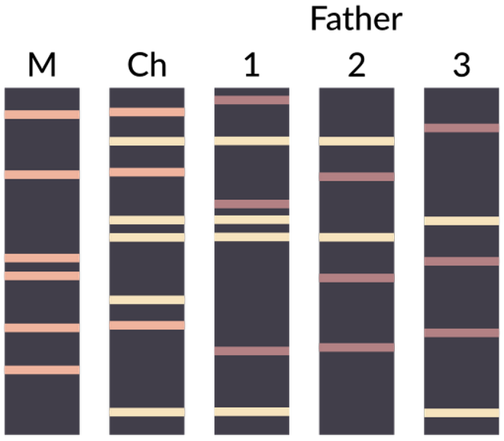

Slide 19
PCR – Polymerase Chain Reaction
How do scientists get an amount of DNA that is large enough to be studied and manipulated? They copy the same segment over and over and over!
Polymerase Chain Reaction (PCR)
Technique that produces millions (or billions!) of copies of a specific DNA sequence in a short period of time

Slide 20
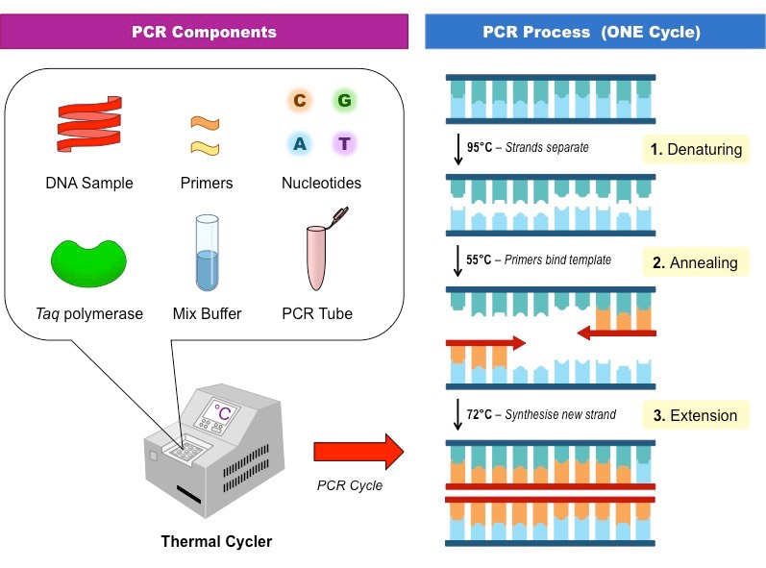
PCR – Polymerase Chain Reaction
PCR is like DNA replication taking place in a test tube!
Step 1: Instead of using Helicase, PCR separates DNA with heat
Step 2: The sample is cooled so primers can attach
Step 3: Polymerase builds new strands of DNA

Slide 21
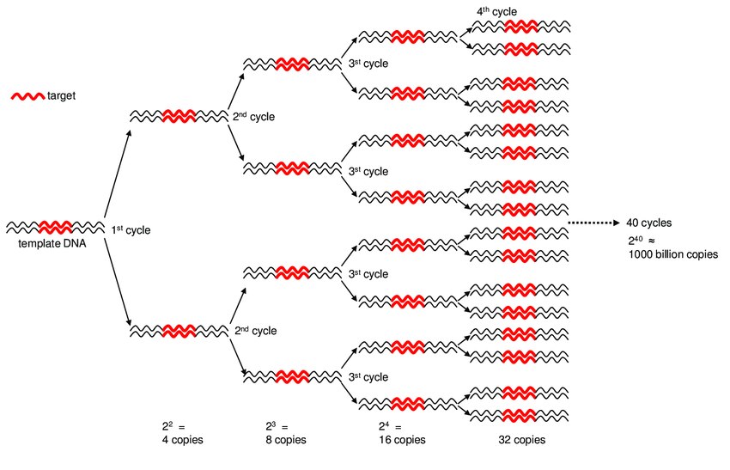
PCR – Polymerase Chain Reaction
Each heating and cooling PCR cycle doubles the amount of DNA
After only 30 cycles, the DNA is copied more than one billion times

Slide 22
Recombinant DNA
Genetic engineering is based on the use of recombinant DNA technology
Recombinant DNA
DNA that contains genes from more than one organism
Transgenic Organisms
Have one or more genes from another organism in their genome

Slide 23
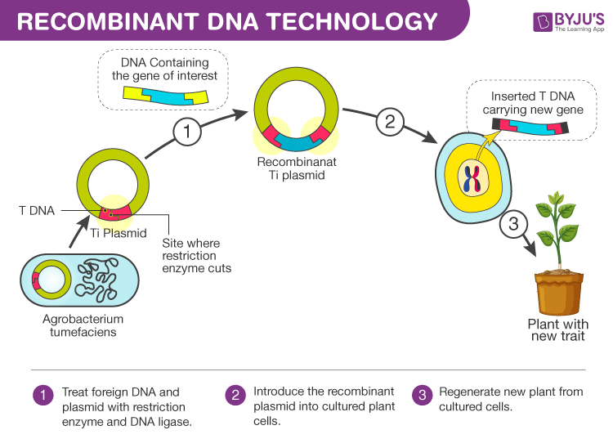
Recombinant DNA
Used to produce…
Pharmaceuticals
“Pharming”
Crops resistant to frost
Crops resistant to disease
Crops resistant to pests
Animals for research
GMO’s = Genetically Modified Organisms

Slide 24
Cloning
Clone
Genetically identical copy of a gene or organism
“Natural” cloning
Asexual plant reproduction
Starfish regeneration
Binary fission in bacteria

Slide 25
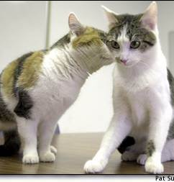
Cloning
Why don’t these cloned cats look identical?
Many factors, including the environment, affect the expression of genes
Cloning Potential:
Cloned organ transplant
Endangered species survival

Slide 26
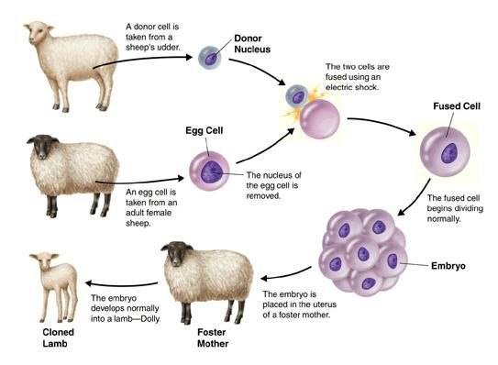
Cloning
Step 1. Egg is retrieved from female. Nucleus of egg is removed.
Step 2. Somatic cell (diploid) nucleus is placed into the empty egg.
Step 3. The “fertilized” cell begins dividing.
Step 4. Developing embryo is placed into a surrogate female.
The clone…DOLLY…is identical to which sheep???

Slide 27
Human Genome Project
The human genome has at least 3 billion base pairs!
Human Genome Project
Goal 1 : Map and sequence all DNA base pairs in human chromosomes
Accomplished in 2003!
Goal 2 : Identify every gene within the human genome
Scientists continue to conduct research to determine the roles of genes

Slide 28
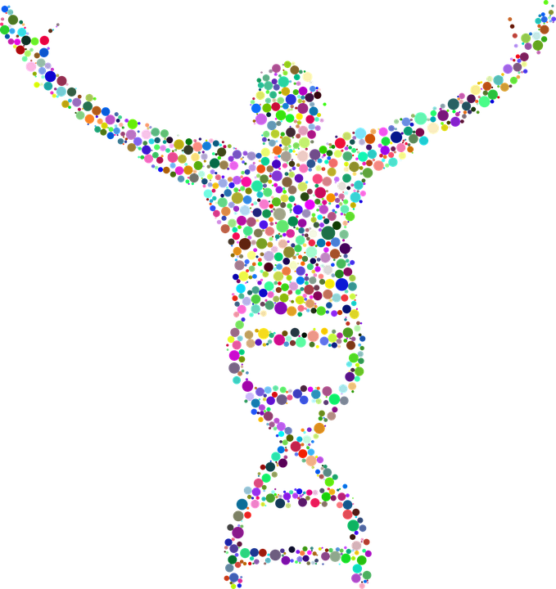
Human Genome Project
Genes are sequenced, genomes are compared, proteins are analyzed…
What happens to the huge amounts of data that are produced?
Bioinformatics
Use of computer databases to organize and analyze biological data
Gives scientists a way to store, share, and find data

Slide 29
Genetic Screening
Genetic Screening
Process of testing DNA to determine a person’s risk of having or passing on a genetic disorder
Typically involves pedigree analysis and DNA tests

Slide 30
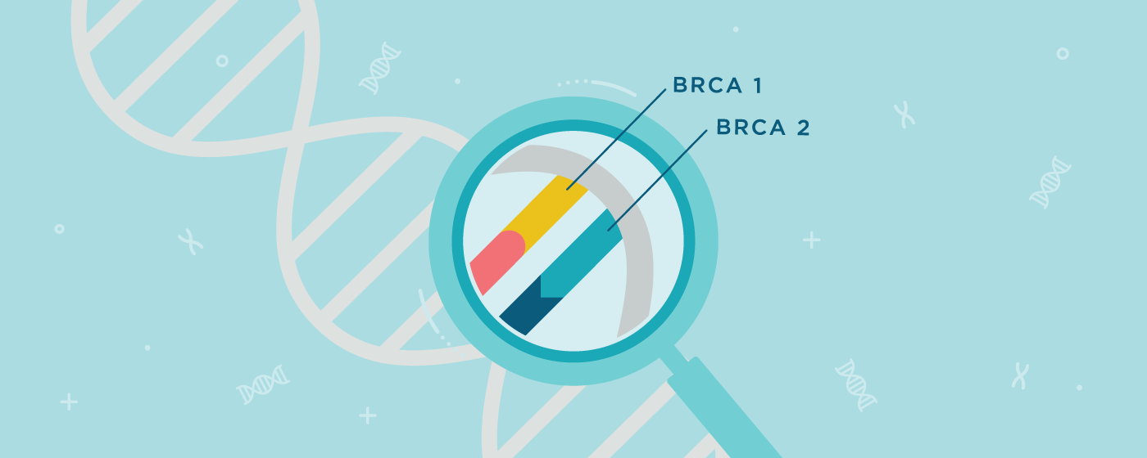
Genetic Screening
Used to look for specific genes or proteins that indicate a particular disorder
A mutation in a gene called BRCA1 has been linked to breast cancer
Genetic screening can indicate an increased risk and is used to help individuals make informed decisions.

Slide 31
Gene Therapy
Gene Therapy
The replacement of a defective or missing gene, or the addition of a new gene, into a person’s genome to treat a disease
First successful gene therapy took place in 1990 to “fix” a genetic autoimmune disease

Slide 32
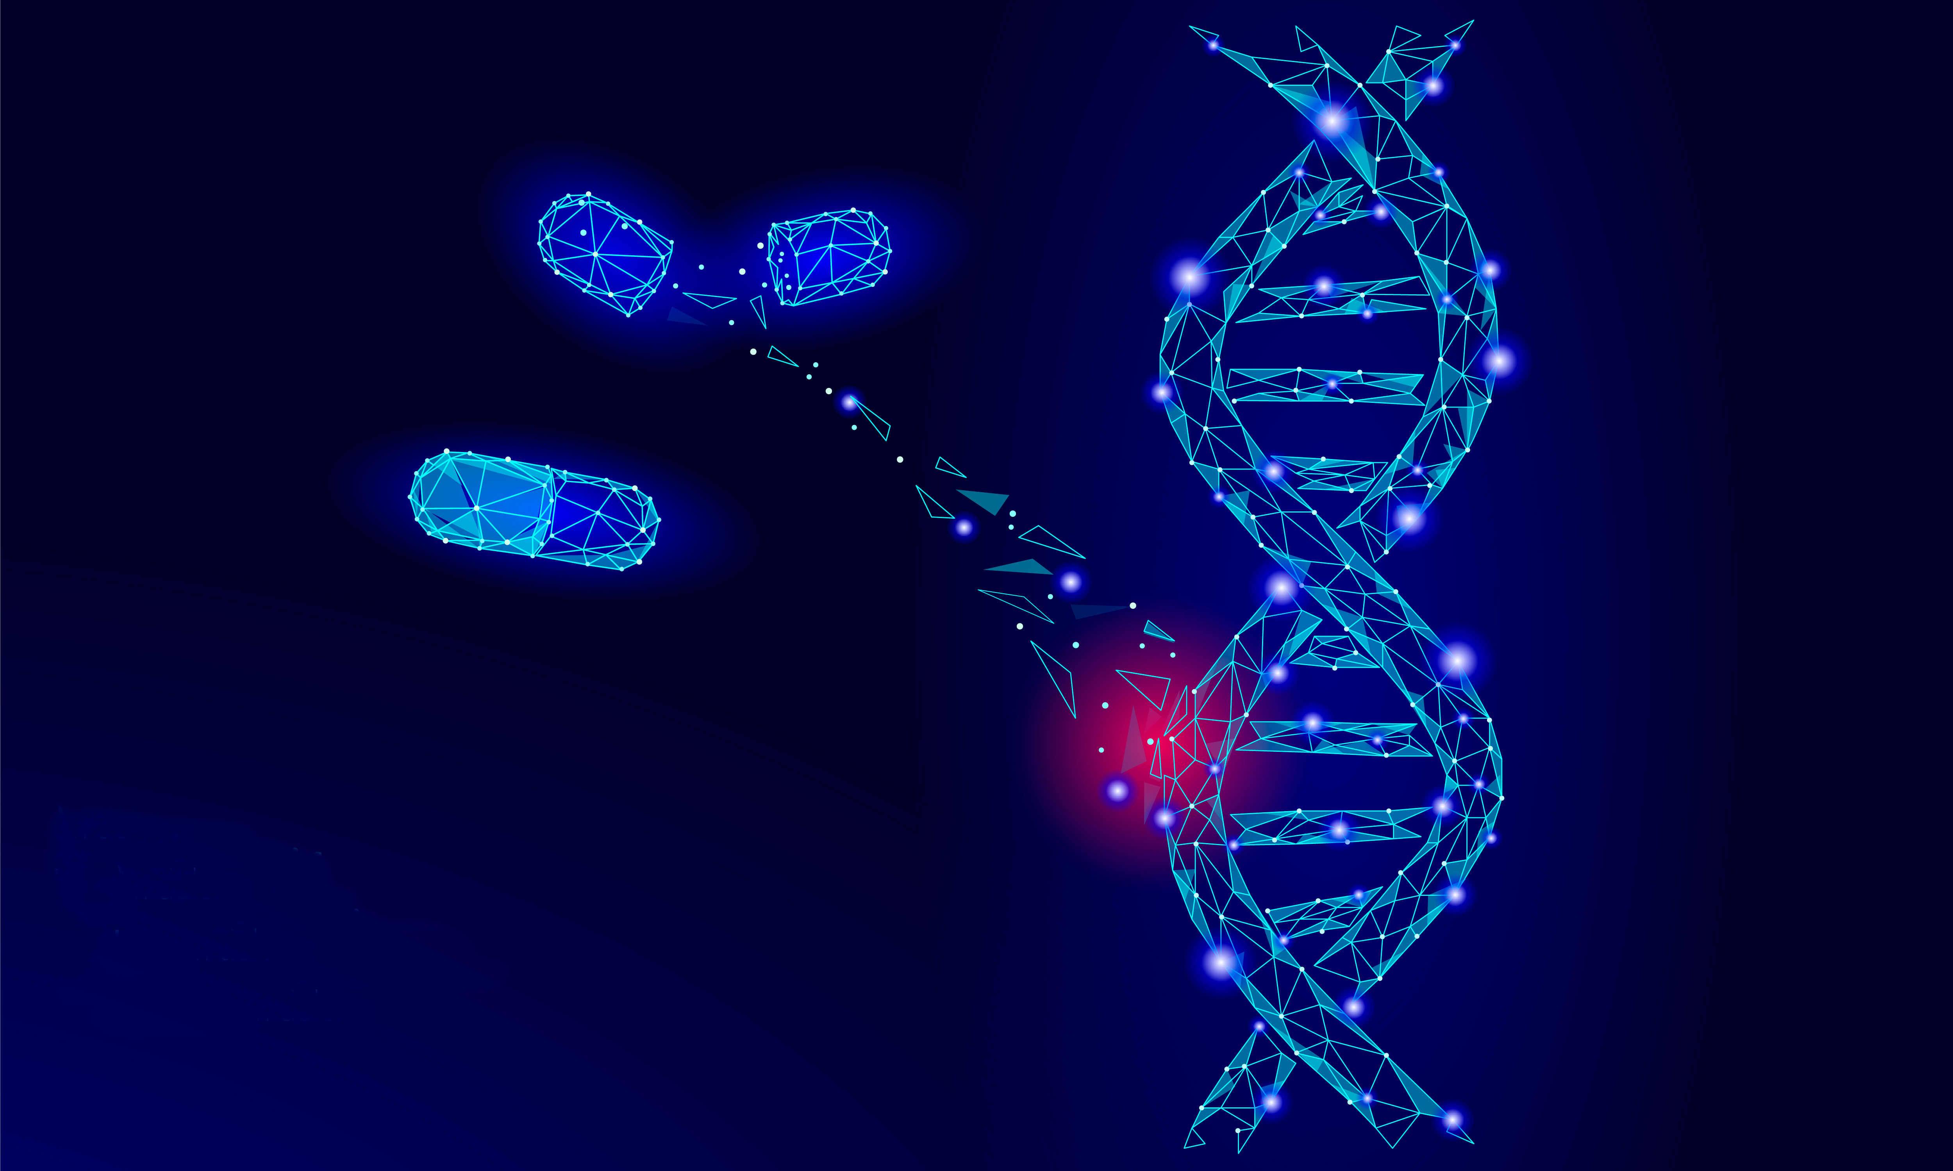
Gene Therapy
Potential to save lives is great, but much of gene therapy is still very experimental

Slide 33
BioEthics
Genetic engineering alters the natural genetic makeup of an organism. This is very controversial.
Things to consider…
Is genetic engineering ethical?
How far is too far?
Where do YOU draw YOUR line?

