Slide 1
Scientific method
A logical and systematic problem solving process

Slide 2
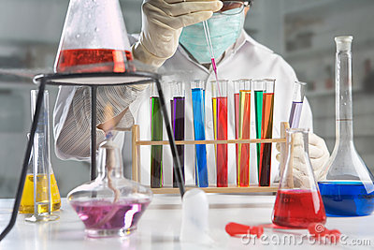
Scientific Method
The scientific method is….
  An organized series of steps to gather information in order to answer questions about the natural world.

Slide 3
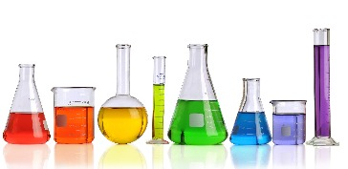
What is Science?
A process and way of learning
  Verb, not a noun. Action, not a thing.
Science allows us to test, challenge and question ideas.

Slide 4
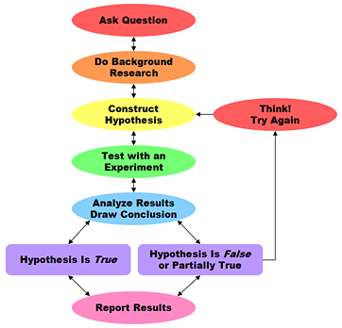
Scientific Method
The steps……
  Ask Question & Collect Information
  Form a Hypothesis
  Test the Hypothesis / Perform Experiment
  Collect, Record & Analyze Data
  Draw Conclusions and Share Findings
If needed, do more investigation!

Slide 5
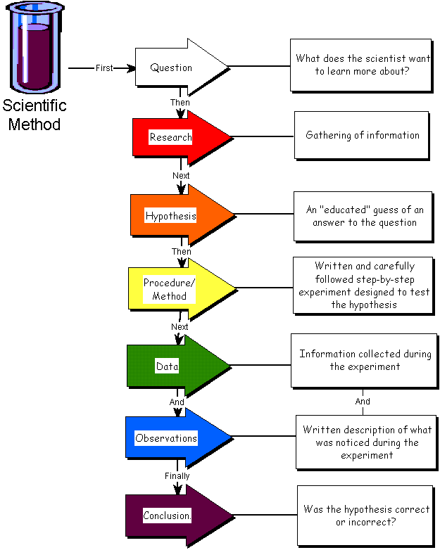
Scientific Method
What the scientific method looks like on paper…..

Slide 6
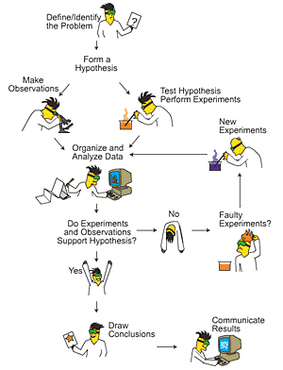
Scientific Method
What the
scientific method
looks like in
real life…….

Slide 7
Scientific Method
Let’s break each of these steps down into their individual components:
Ask Question
Do Background
Research
Construct
Hypothesis
Think!
Try Again
Test with an
Experiment
Analyze Results
Draw Conclusion
Hypothesis is True
Hypothesis is False
or Partially True
Report Results
Notes:
http://www.sciencebuddies.org/mentoring/overview_scientific_method2.gif

Slide 8
Scientific Method
An organized way of learning about the natural world
  1. Ask a question and collect information
  2. Form a Hypothesis
  3. Test the Hypothesis / Experimental procedure
  4. Collect, Record & Analyze Data
  5. Draw conclusions & Communicate Findings

Slide 9
Scientific Method
1.Ask a question and collect information
  Questions arise from scientific inquiry
    Inquiry….thinking about something!
  Inquiry begins with observations
    Observation: a direct method of gathering information
  The processing of information leads to inferences
    Inference: logical conclusions drawn from previously collected information (observations)

Slide 10
Scientific Method
1.Ask a question and collect information
  So why ask questions? To learn something!
  What if you observe that your neighbors flowers grow much better than your flowers…
    Observations: taller, fuller, more fragrant, more brightly colored
    Inference: your neighbor must take better care of their flowers.

Slide 11
Scientific Method
1.Ask a question and collect information
  These observations and inferences lead us to ask questions and collect information…
    What must I do in order for my flowers to grow better?
    Then you begin collecting background information on gardening and your ready to form your hypothesis!

Slide 12
Scientific Method
An organized way of learning about the natural world
  1. Ask a question and collect information
  2. Form a Hypothesis
  3. Test the Hypothesis / Experimental procedure
  4. Collect, Record & Analyze Data
  5. Draw conclusions & Communicate Findings

Slide 13
Scientific Method
2.Formation of a hypothesis
  A scientific and testable explanation based on observations and collected information
  So basically, an inference!
  Typically written in “If……then……” format
    If I do this, then this will happen.
    If I put fertilizer on my plants, then they will grow bigger

Slide 14
Scientific Method
2.Formation of a hypothesis
  Why form a hypothesis?
  The support or rejection of a hypothesis determines the validity of an experiment
    If the data supports the hypothesis: the investigation is accepted as valid
    If the data rejects the hypothesis: the hypothesis is rejected and additional investigations are conducted
  So is a “wrong” hypothesis still a good hypothesis?

Slide 15
Scientific Method
An organized way of learning about the natural world
  1. Ask a question and collect information
  2. Form a Hypothesis
  3. Test the Hypothesis / Experimental procedure
  4. Collect, Record & Analyze Data
  5. Draw conclusions & Communicate Findings

Slide 16
Scientific Method
3.Experimental procedure- designed to test the hypothesis
Split subjects you are testing into groups:
  Control Group-NO changed variable. The “comparison group”
  Experimental Group- Contains the changed variable.
  Constants- other variables that remain the same in all groups.
Experimental Group
Fertilizer
Control Group
No Fertilizer

Slide 17
Scientific Method
Must be a controlled, reproducible procedure
Testing effects of
only ONE manipulated
variable
Other scientists
need to be able to
reproduce it and
find same results.

Slide 18
Scientific Method
Variable-any factor in experiment that could be changed
  Fertilizer, sunlight, water, etc
  Independent variable- factor in experiment that is changed by the scientist
    fertilizer
  Dependant variable- factor that is measured by the scientist
    height and ?
Remember, only test ONE manipulated variable at a time, everything else should remain constant!

Slide 19
Experimental Set Up
EXPERIMENT
EXPERIMENTAL
GROUP
Difference is the
Independent variable
CONTROL
GROUP
Check the results
in time
Compare the
Dependent variable
Check the results
in time

Slide 20
Scientific Method
An organized way of learning about the natural world
  1. Ask a question and collect information
  2. Form a Hypothesis
  3. Test the Hypothesis / Experimental procedure
  4. Collect, Record & Analyze Data
  5. Draw conclusions & Communicate Findings

Slide 21
Scientific Method
4. Collect and record data
  As scientists test their hypotheses, they gather data.
    Data – information gained from observations.
  Data can be qualitative or quantitative
    Qualitative data -physical traits (qualities) that can be described
    Quantitative data -measurements (quantities) that can be taken

Slide 22
Scientific Method
4. Collect and record data
  Quantitative Data
    Examples: time, temperature, length, mass, area, volume, density, etc
    NUMBERS
  Qualitative Data
    Examples: descriptions of what our senses collect.
    Interpreted differently by different people
  Which type of data would you consider “stronger?”

Slide 23
Scientific Method
Common measurement system
  Metric system or (SI)- a measurement system used worldwide by scientists based on multiples of 10
    Mass-grams (g)
    Volume-liters (L)
    Distance-meters (m)
    Temperature- Kelvin (K) or Celsius (^{O}C)

Slide 24
Scientific Method
Results
Qualitative? Quantitative?
Experimental Group Control Group
fertilizer no fertilizer

Slide 25
Scientific Method
4. Collect and record data
  Analyze the data and state the results
  Pictures, tables, graphs
    Make patterns more easily visible
    Trends noticed
  State the results
    Should be a summary, not a conclusion

Slide 26
Scientific Method
An organized way of learning about the natural world
  1. Ask a question and collect information
  2. Form a Hypothesis
  3. Test the Hypothesis / Experimental procedure
  4. Collect, Record & Analyze Data
  5. Draw conclusions & Communicate Findings

Slide 27
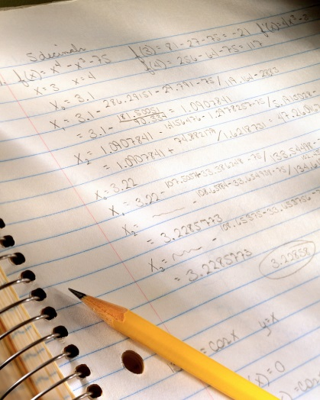
Scientific Method
5.Conclusions
  A good conclusion…
    Restates the results
    Addresses the hypothesis
    Forms a conclusion (answers the question and says what the data means)

Slide 28
Scientific Method
5.Conclusions
  Hypothesis is either supported or rejected. NEVER “PROVEN!”
  If supported
    Draw conclusions, publish findings, further testing
  If rejected
    Hypothesis is modified and tested again
  Can be partly supported
  Either way, findings are always useful!!!

Slide 29
Scientific Method
5.Conclusions
  After you state the results, the conclusion is the “therefore…”
  Example:
    According to the results, the flowers given fertilizer consistently grew taller and fuller; therefore, my hypothesis is supported. The use of fertilizer will lead to better growing flowers.

Slide 30
Communicate Results
Results of experiments are communicated formally in written reports published in scientific journals.
Other scientists can analyze the design and conclusions or repeat the experiment themselves.
Repeatability is a good check on correctness of scientific conclusions.

Slide 31
Now Let’s practice!

