Slide 1
Gregor mendel & genetics
How a monk learned about inheritance using a tasty vegetable!

Slide 2
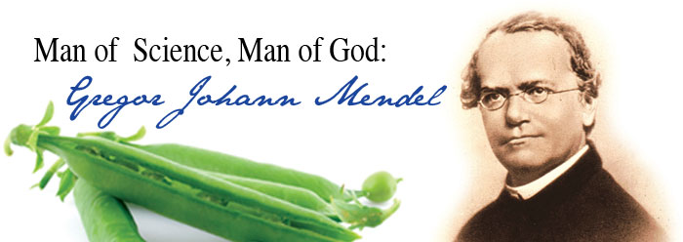
Gregor Mendel
Born in 1822
Austrian Monk
“Father of Genetics”
Worked in the gardens of the monastery
Most famous for his work studying the inheritance of pea plants

Slide 3
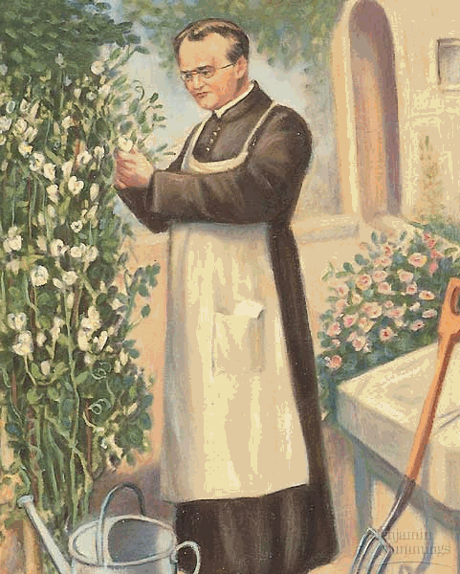
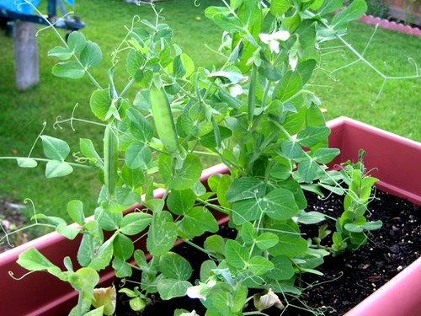
Gregor Mendel
Why peas?
Reproduce quickly
Produce large amounts of offspring
Can self pollinate
Can cross pollinate
Grown in small area
Have many observable traits

Slide 4
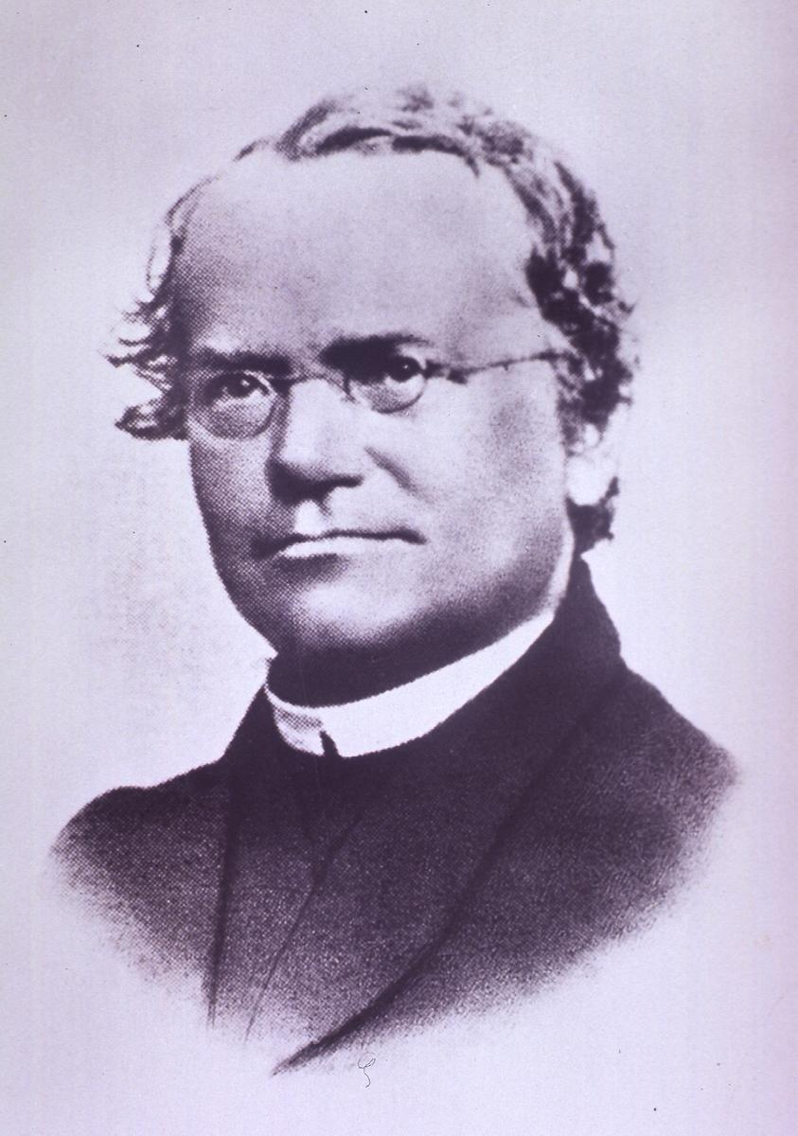
Gregor Mendel
Observed pea plant traits
Kept detailed records
Drew conclusions regarding how traits are passed down from parent to offspring (inheritance)
Genetics: the scientific study of heredity.

Slide 5
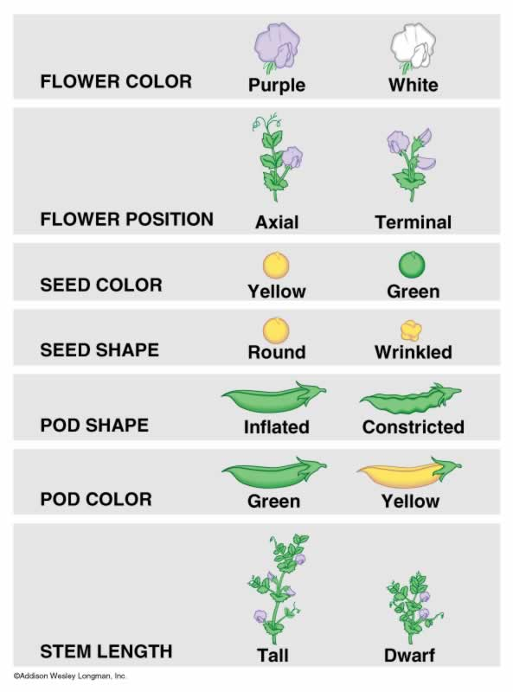
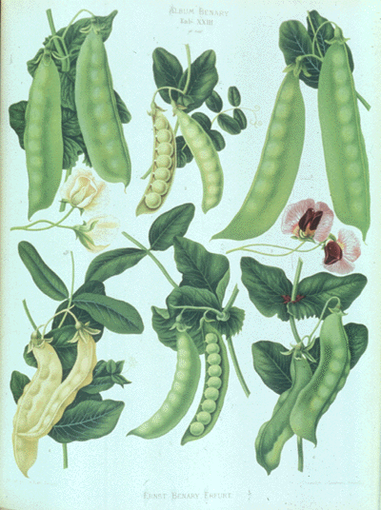
Gregor Mendel
Observed pea plant characteristics (ex: flower color) and their traits (ex: purple vs. white)

Slide 6
Gregor Mendel
Mendel’s Experiments
Started by creating purebreds
Allowed plants to self – pollinate so that they were pure for a single trait
Purebred parents always produce offspring with the same trait

Slide 7
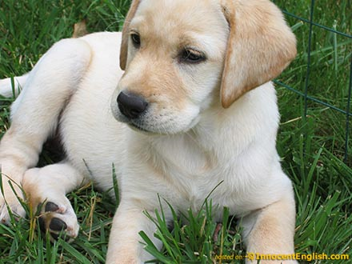
Gregor Mendel
How do you know if a trait is purebred?
When self-pollinated, all offspring have the same pure trait.
Pure purple flowers self pollinate, all offspring flowers are purple.
Pure white flowers self pollinate, all offspring flowers are white
P Generation – starting parent generation

Slide 8
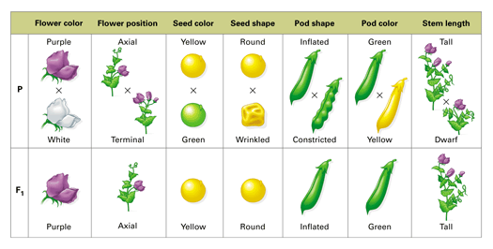
Gregor Mendel
Mendel’s Experiments
What if you cross two parents that are purebred for different traits?
Purple x White
Wrinkled Seeds x Round Seeds
Green Pods x Yellow Pods
Tall Plants x Short Plants
Labrador x Poodle

Slide 9
Gregor Mendel
P Generation – starting parent generation
Purebred parents with different traits
Allowed to cross – pollinate.
Purple x White
What do you think Mendel expected?

Slide 10
Gregor Mendel
F1 Generation – offspring of the P Generation
All had purple flowers!
This happened in all P generation crosses!
One trait “wins” out over the other

Slide 11
Gregor Mendel
Why does this happen?
Some traits are dominant and some traits are recessive!
Dominant: Trait expressed in F1 generation
Recessive: Trait masked in F1 generation
What happens if you cross two F1 generation plants??

Slide 12
Gregor Mendel
F2 Generation – offspring of F1 self pollination
F1 Purple x F1 Purple
~ 75% Purple Offspring
~25% White Offspring
Even though the F1 generation looked like purebred purple plants, they carried the trait for white flowers somewhere inside!
“Hybrids”

Slide 13
Genetic Inheritance
A gene is a segment of DNA that codes for a particular protein. The protein results in the trait.
So….. Each characteristic = One gene
For example:
There’s a gene for plant height
There’s a gene for seed color
There’s a gene for flower color
etc...

Slide 14
Genetic Inheritance
Each alternative (different) form of a gene is called an allele.
Examples:
The plant height gene has two alleles, tall and short.
The flower color gene has two alleles, purple and white
The seed texture gene has two alleles, wrinkled and smooth.

Slide 15
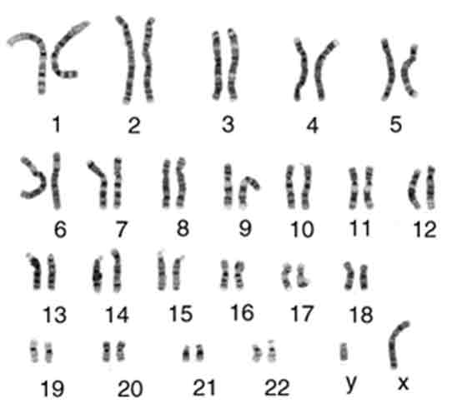
Genetic Inheritance
Traits are determined by the genes on chromosomes
Chromosomes come in homologous pairs (so genes come in pairs!)
Homologous chromosomes
Carry the same genes
not necessarily the same alleles!
One from mother
One from father
**You receive ONE allele from each parent. This is a result of meiosis!**

Slide 16
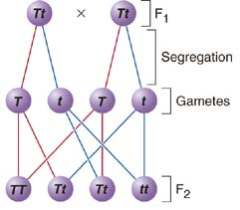
Genetic Inheritance
Mendel’s Conclusions
Law of Dominance
Some traits (alleles) are dominant over others
Law of Segregation
Each parent has two traits (alleles), but they are separated (during meiosis) and given to offspring one at a time.
Law of Independent Assortment
Traits are distributed to offspring independently (due to lining up in metaphase 1 and separating in anaphase 1)

Slide 17
Genetic Inheritance
Alleles are represented with letters
The combinations of alleles determine your traits!
Dominant – The allele/trait that is expressed (T)
Recessive – The allele/trait that is hidden (t)
Genotype – The allele makeup of a gene (TT, Tt, tt)
Phenotype – The physical appearance of a trait (Tall plant, purple flowers, etc)

Slide 18
Genetic Inheritance
There are three possible genotypes:
Homozygous Dominant (BB, TT, PP)
Homozygous Recessive (bb, tt, pp)
Heterozygous (Bb, Tt, Pp)
Homozygous: Has two of the same allele.
Heterozygous: Has one of each allele.

Slide 19
Genetic Inheritance
Law of Segregation
Each parent has two traits (alleles), but they are separated (during meiosis) and given to offspring one at a time.
Mendel’s work has allowed us to be able to predict possible offspring outcomes between two known genotypes.

Slide 20
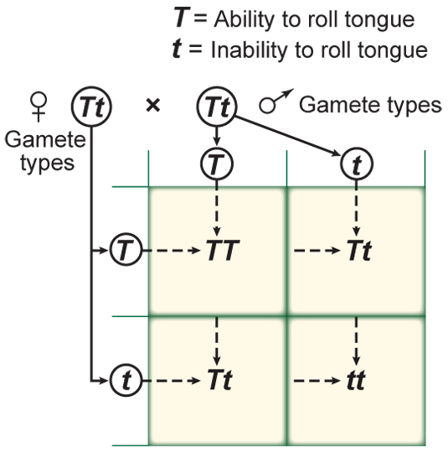
Genetic Inheritance
This prediction is illustrated through a punnett square.
The letters along the top and side
Represent the alleles given by the parents following meiosis
The letters in the four inner boxes
Represent the possible combinations of alleles in the offspring

Slide 21
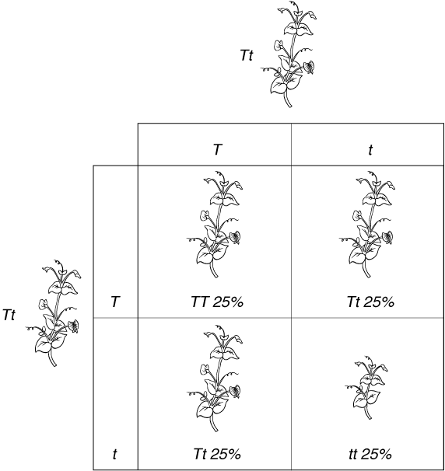
Genetic Inheritance
Two heterozygous tall plants are allowed to cross-pollinate.
Use a punnett square to predict the genotype and phenotype probabilities and ratios.

Slide 22
Genetic Inheritance
Genotype Probabilities
TT 25% - Tt 50% - tt 25%
Genotype Ratio
(Homozygous Dominant: Heterozygous : Homozygous Recessive)
1:2:1
Phenotype Probabilities
Tall 75% - Short 25%
Phenotype Ratio
(Dominant: Recessive)
3:1

Slide 23
Genetic Practice Problems
1. Black fur (B) is dominant to white fur (b) in mice. Show the cross between a homozygous dominant black mouse and a heterozygous black mouse.
What percentage of their offspring would you expect to have black fur?
2. Widow’s peak (W) is dominant over a straight hair line (w) in humans. Show the cross between two parents, both heterozygous for widow’s peak.
What percentage of their offspring would you expect to have a smooth hairline?
Give the phenotype ratio for this cross.
3. The tongue rolling ability (T) is dominant over non tongue rolling (t). Show the cross between a heterozygous parent and a homozygous recessive parent.
Give the expected probabilities (percentages) for each possible genotype.

