Slide 1
Sex-linked inheritance
Raise your hand if you personally know someone who is colorblind
Raise your hand if that person is a female
Raise your hand if that person is a male

Slide 2
Sex-linked inheritance
Up until now, all of the traits we have examined have been autosomal traits.
Autosomal Trait = Traits controlled by genes found on chromosome pairs #1 - 22

Slide 3
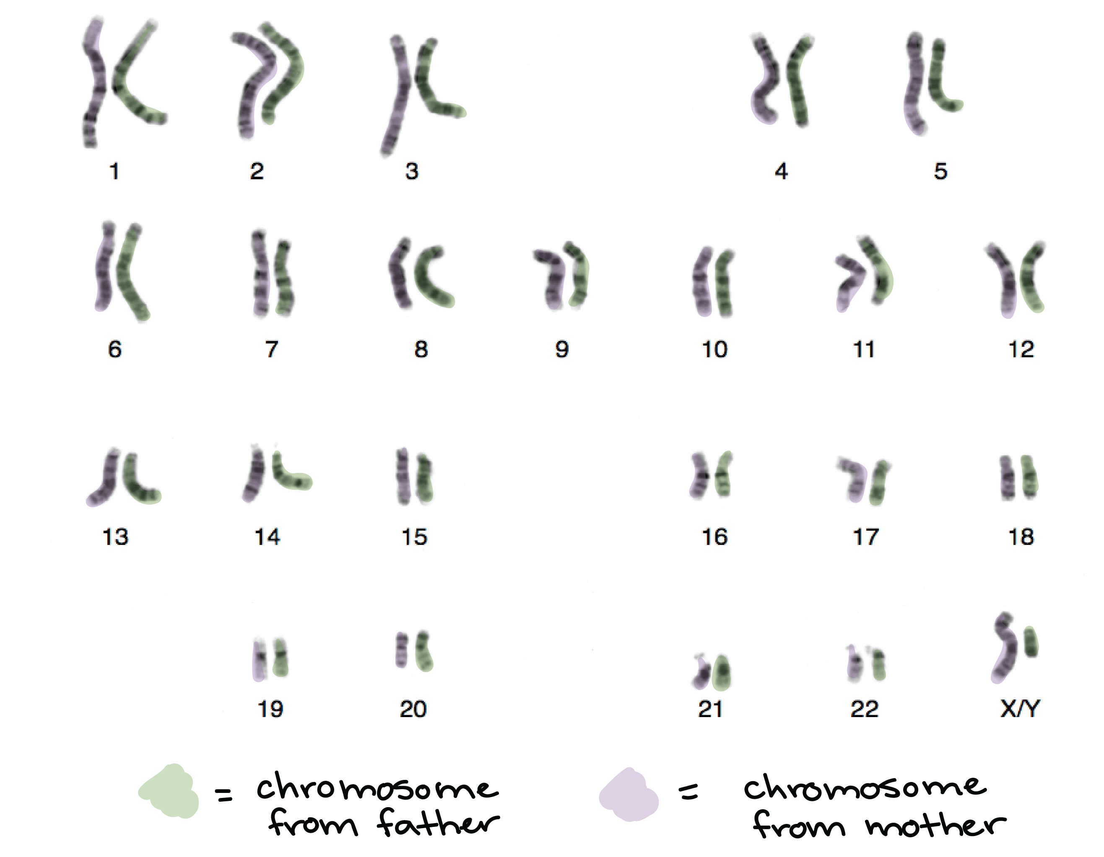
Sex-linked inheritance
The 23rd pair of chromosomes are the sex chromosomes
X X = Female
X Y = Male

Slide 4
Sex-linked inheritance
To complete sex-linked Punnett squares, you will need to…
Use X’s and Y’s with superscript letters to represent the carried alleles

Slide 5
Sex-linked inheritance
Colorblindness is a recessive, sex-linked trait carried on the X chromosome
“Normal” vision is dominant
C = Normal vision allele
c = Colorblind vision allele

Slide 6
Sex-linked inheritance
Genotypes and phenotypes for vision in females…
X ^{C} X ^{C}
X ^{C} X ^{c}
X ^{c} X ^{c}

Slide 7
Sex-linked inheritance
Genotypes and phenotypes for vision in females…
X ^{C} X ^{C} = Normal Vision
X ^{C} X ^{c} = Normal Vision (“carrier”)
X ^{c} X ^{c} = Colorblind Vision

Slide 8
Sex-linked inheritance
Genotypes and phenotypes for vision in males…
X ^{C} Y
X ^{c} Y
Why do we not place a letter (allele) on the Y chromosome???

Slide 9
Sex-linked inheritance
Genotypes and phenotypes for vision in males…
X ^{C} Y = Normal Vision
X ^{c} Y = Colorblind Vision
So why are there more colorblind males than females?

Slide 10
Sex-linked inheritance
Write the genotypes for the following…
Homozygous normal vision female
X ^{C} X ^{C}
Colorblind male
X ^{c} Y
Heterozygous Normal vision female
X ^{C} X ^{c}

Slide 11
Sex-linked inheritance
Show the cross between a carrier female and a normal vision male

Slide 12
Sex-linked inheritance
Show the cross between a carrier female and a normal vision male
X ^{C}
Y
X ^{C}
X ^{c}

Slide 13
Sex-linked inheritance
Show the cross between a carrier female and a normal vision male
X ^{C}
Y
X ^{C}
X ^{C} X ^{C}
X ^{C} Y
X ^{c}
X ^{C} X ^{c}
X ^{c} Y

Slide 14
Sex-linked inheritance
What is the probability of this couple having a child who is colorblind?
X ^{C}
Y
X ^{C}
X ^{C} X ^{C}
X ^{C} Y
X ^{c}
X ^{C} X ^{c}
X ^{c} Y

Slide 15
Sex-linked inheritance
X ^{C}
Y
X ^{C}
X ^{C} X ^{C}
X ^{C} Y
25%
X ^{c}
X ^{C} X ^{c}
X ^{c} Y

