Slide 1
Peer-led Research
The London Youth Experience

Slide 2
Why do peer-research?
For London Youth
Co-produce research with our key stakeholder
Peers can build trust and rapport in interviews
Young people more likely to be open with their peers leading to higher quality interviews
For Peer Researchers
Experience of research
Development of communication skills and confidence
Further opportunities such as speaking at events
Paid opportunity – including expenses
Notes:
Why do peer-research?
Peer research has benefits for both us, as an organisation and for Peer Researchers:
For London Youth:
Genuine and meaningful engagement with key stakeholder/ end user – young people. Co-produce research so that it is something that we do ‘with’ young people, not ‘to’ them.
Peers- more so that adult researchers- can build trust and rapport with interviewees
Result of this is that young people being interviewed are more likely to be open and honest in interviews. This leads to higher quality interviews.
For Peer Researchers:
Opportunity to get useful work experience of research outside of an educational context
Develop/ enhance communication skills and confidence in interacting with peers
Research project has future opportunities outside of the peer-research, such as speaking at events. This gives the peer-research more ownership of the research project and future opportunities to develop skills.

Slide 3
Approach to peer-led research
Writing Job Descriptions
2 weeks
Job Advert Out
4 weeks
Peer Researcher Interviews
1 week
DBS checks
3 weeks
Peer Research Training Sessions
2 weeks
Peer Interviews
5 weeks
Debrief and Analysis
1 week
Notes:
Approach to peer-led research:
London Youth has opportunity to recruit peer researchers from our wide range of members
Process – 18 weeks of work including:
Preparation: Writing job descriptions; advertising job; interviewing; DBC checks; training session that covered good practice in interviews, questioning techniques, ethics and safety.
Peer Interviewers ‘in the field’: 5 weeks of interviews
Finishing: Debrief from peer-researchers; analysis from their field notes
What worked:
· Training for the young people – start and end – include chance to practice what they will be doing
· Paying the young people including a contract and making it more formal – they liked being staff and took on responsibility
· Encouraging the young people to be flexible and use their own words/questions
· Using their iphones to record worked for the young people and allowed them to listen
· Giving a £10 voucher to participants (although in many cases said would have done without)
· Connecting to the youth clubs and youth workers to support the young people to deliver – space, time etc
· Giving a short set time frame in which to deliver the research – not letting it drag
Could be improved/think for next time:
· Ensure there is enough content / facilitation skills to encourage quieter young people to talk
· Be great to have young people involved in designing the questions or process
· Think about what we want the young people to do to know what ‘data’ will be produced and how we will then process it
· All interviewed at least 1 person not from their youth club and it seemed generally the youth club interviews were harder to arrange (a space, time to do, young people missing sessions) and not as long – need to be clear we want just young people from youth clubs
· Make the process as simple as possible – do young people need to sign anything – consent?
· Do we have an age bracket?
· Target the voucher at the community?

Slide 4
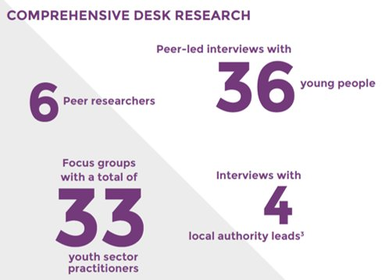
Peer-research is only one method
Notes:
Peer-research is only one method in our research. Results of peer-led interviews are triangulated with our data sources.
These are the research methods for our ‘Young People’s Capital of the World’ report:
6 peer researchers completed 36 interviews
Learning team at London Youth also completed – Focus groups with 33 youth sector practitioners, in-depth interviews with 4 local authority leads and comprehensive desk research including government data on demographics and deprivation

Slide 5
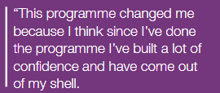
Research Results
Notes:
These are some of the quotations from the peer-led interviews. Demonstrates openness of interviewees

Slide 6
Research Reports
Notes:
These are the research reports that included peer-research:
A Space of Our Own – our youth organisations are working in their communities
Young People’s Capital of the World – young Londoners view of their changing city
Hard copies available
Key Learning?

Slide 7
Thank You
Any questions?
#hashtag

Slide 8
Keep in touch
Londonyouth.org/newsletter
@LondonYouth
@London_Youth
London Youth
/LondonYouth
#hashtag

