Slide 1


ENGAGING PATIENTS IN
CARE COORDINATION

Slide 2
BHN Overview
An independent not-for-profit that coordinates the collaborative efforts of providers, advocacy organizations, government leaders and community members that are dedicated to developing an accessible and coordinated system of behavioral health (BH) care throughout the Eastern Region of Missouri.
Creates a better safety-net system of care;
Encompasses concerns at all levels of severity and points on the service continuum;
Focus on services to the uninsured and underinsured residents of seven Missouri counties;
Address mental health and substance use disorders / services / health.

Slide 3
EPICC Overview
Community collaboration serving 149 clients during a pilot study funded through DMH.
SAMHSA funded through DMH and UMSL-MIMH STR/SOR.
Behavioral Health Network oversees project implementation.
Peer coach rapid-response to patients in ED post-overdose and expansion to serve EMS community patients.
Project has now served over 2,500 clients with an average 48% engagement.

Slide 4
EPICC Overview
PROJECT PARTNER | PARTNER ROLES
Behavioral Health Network | Project Management / Outcomes Reporting
Behavioral Health Response | -24/7 Crisis Hotline -Mobile Outreach/Dispatching for Recovery Coaches
Center for Life Solutions Community Treatment, Inc. (COMTREA) Gateway Foundation Preferred Family Healthcare Queen of Peace | -Dedicate 13 Recovery Coaches to engage patients with 24/7 availability -Substance use Treatment and MAT Access/Delivery
Missouri Institute of Health National Council on Alcoholism and Drug Abuse | -Opioid Overdose Education Training -Narcan Distribution
SSM Health Barnes Jewish Hospital Mercy | -Patient Stabilization -MAT Induction & Rx in ER, when app -Contact BHR for Project Referral

Slide 5
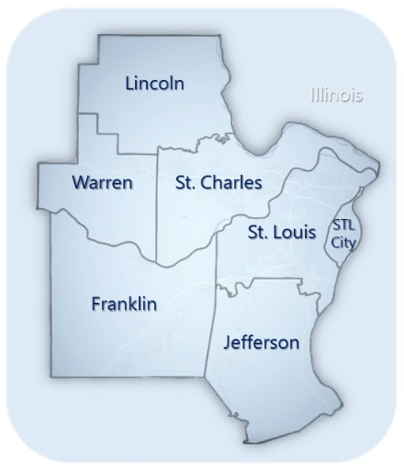
CATCHMENT TARGET
AREA POPULATION
    Age: ≥ 18
    Opioid Overdose
    Residency: Eastern Region
    Client presents as homeless in Eastern Region

Slide 6
KEY PROJECT GOALS & OUTCOMES
GOALS
OUTCOMES
Improve client recovery ambivalence
Increase SU Tx & MAT access via outreach/engagement
Provide Overdose Education & Narcan Distribution (OEND)
Increase MAT induction in ED’s
Increase medical staff willing to provide long term MAT
Outreach – connection to recovery support services
Engagement – connection to SU treatment from ED
Number of clients who receive OEND
SU TX retention – 30-days, 12-weeks, 6-months
MAT induction/retention

Slide 7
Referral Patterns
Trends show an increase over time

Slide 8
Homelessness
Since inception, EPICC has served nearly 600
clients experiencing homelessness (22%)

Slide 9
Demographics
Over 50% from 3 zipcodes:
63110
63136
63108
(Tower Grove to Jennings)

Slide 10
Characteristics
22% homeless at referral
73% report being un/under insured at referral
3% report current
substance use treatment

Slide 11
Impact
97% of all referrals were eligible and agreeable to engaging in EPICC
90% of eligible referrals received a face-to-face outreach by a Recovery Coach
Overdose Education provided to 90% of successful dispatches referrals
Narcan distributed to 81% of successful dispatches referrals

Slide 12
Comparison
90% agreed to participate in the program (90% overall).
39% were engaged 30 days post-outreach (40% overall).
23% were engaged 3 months post-outreach (25% overall).
For this typically difficult to reach population, similar outcomes to housed clients demonstrate the impact of peer and medication first models.
Note: Numbers reflect the number of individuals engaged at Initial Contact, minus those who are not yet due for a follow-up form at the subsequent time point.
Notes:
Admission to longer-term recovery support services is seen as an outcome of interventions provided via the Recovery Coach team. For the purposes of this project, connection to treatment is defined as enrollment in one or more Department of Mental Health (DMH) program (CIMOR enrollment).

Slide 13


Next Steps
Increased research on clients experiencing homelessness to best improve outcomes.
Housing partnerships for increased access to services.
Engagement Specialist for difficult to reach clients.
EMS Program as a large portion of overdoses are never seen in a hospital.

Slide 14



