Slide 1
Clickstreams and Video Engagement: Predicting User Interactions with Transcript Level Features
Amanda Boone
Neethu Renjith
David Lang
Stanford University
BAYLAN
March 2, 2019

Slide 2
How is Time Distributed in a Lecture?
Traditional Lecture
Video-based Lecture

Slide 3
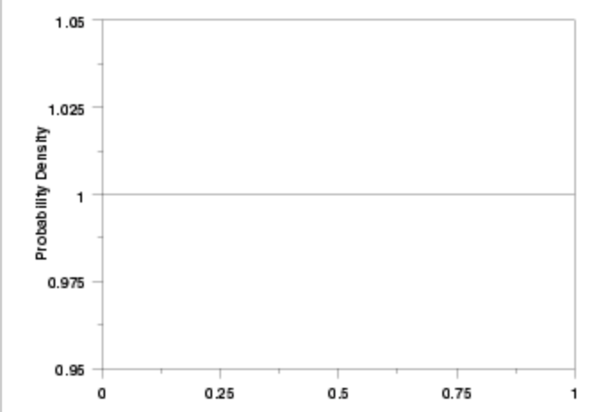
How is Time Distributed in a Lecture?
Traditional Lecture
Video-based Lecture

Slide 4
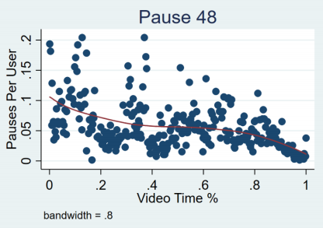
How is Time Distributed in a Lecture?
Traditional Lecture
Video-based Lecture

Slide 5
Facebook Uses this Engagement Graph as a type of Recommendation Engine
Graph identifies the most viewed/most engaging portion of a conversation
Education Applications:
Identify engaging content
Identify areas where students are confused
Task: Can we build this plot before students actually view a new video?

Slide 6
Prior Work
Guo et al (2015) Noticed that individual areas of focus tends to heap on slide/visual transitions
Leskovec (2014) Tried to model video interaction patterns as context free grammars
What people haven’t done is look at the actual words being spoken:
Why? Transcription costs were exorbitant and were unavailable during the rise and fall of MOOC mania

Slide 7
ADA Lawsuits to Rescue

Slide 8
Research Questions
Can we predict clickstream interactions as a function of video transcripts? (Pause,Play, Seeks to/from)
Which behaviors can be predicted?
Which features of a transcript are predictive?
Data:
-A Course in Statistical Learning 77 Videos (60/20/20) split
-14,000 Utterances
-More than 5000 students completed the course

Slide 9
Transcripts Are Very Salient

Slide 10
Feature Generation
Bag of words
LIWC (Pennebaker et al 2015)
Reading Level/Lexical Density
Cosine Similarity between lecture and quizzes

Slide 11
Model
Train a variety of shallow and deep methods using transcripts features
Loss Function Root-mean squared (RMSE)
Null model is a simple average

Slide 12
Transcripts: Can Improve Prediction of Seek Behavior

Slide 13
Glossary Like Terms are Most Predictive

Slide 14
Next Steps
Expand this approach
Cross-course training model
Subset this type of analysis by learner engagement type
Try and model more complex learner behaviors
More Complex Architecture
More training data

Slide 15
Thank You
David Lang
David.Nathan.Lang@Stanford.edu
The research reported here was supported in part by the Institute of Education Sciences, U.S. Department of Education, through Grant (#R305B140009). We also acknowledge Stanford University and the Center for Advanced Research in Online Learning (CAROL).

