Slide 1
AI for Adaptive Curriculum
Emma Brunskill
Assistant Professor, Stanford University, CS Dept.
With thanks to Tong Mu & Shayan Doroudi for slides

Slide 2
Average Person* Held 11.7 Jobs Over 30 Years
Bureau of Labor Statistics for person born between 1957-1964, between age 18 to 48 years https://www.bls.gov/nls/nlsfaqs.htm#anch41

Slide 3
Computers that
Learn to Help Us
Notes:
AI to automate humans

Slide 4
Intelligent Tutoring Systems Can Achieve Incredible Results...
Double Learning Outcomes
Time

Slide 5
Intelligent Tutoring Systems Can Achieve Incredible Results… Typically Very Resource Intensive
Double Learning Outcomes
Time

Slide 6
How Do We Democratize Adaptive Personalized Support for Learning & Training?

Slide 7
Potential Solutions to Scale Adaptive Personalized Training & Learning
- Authoring tools? (e.g. Cognitive Tutor Authoring Tools)
- Platforms that provide plug and play support for instructors? (e.g. Open EdX A/B tests)

Slide 8
Potential Solutions to Scale Adaptive Personalized Training & Learning
- Authoring tools? (e.g. Cognitive Tutor Authoring Tools)
- Relies on instructors to create specialized content
- Harder to provide adaptive guidance at curriculum pathways
Platforms that provide plug and play support for instructors? (e.g. Open EdX A/B tests)
- Typically relies on gathering data to inform item selection
- Not easy yet to provide adaptive pathways to students on day 1

Slide 9
Potential Solutions to Scale Adaptive Personalized Training & Learning
- Authoring tools? (e.g. Cognitive Tutor Authoring Tools)
- Relies on instructors to create specialized content
- Harder to provide adaptive guidance at curriculum pathways
- Platforms that provide plug and play support for instructors? (e.g. Open EdX A/B tests)
- Typically relies on gathering data to inform item selection
- Not easy yet to provide adaptive pathways to students on day 1

Slide 10
Today
- How do we provide adaptive personalized practice support for students on day 1?
Work lead by Tong Mu, with Shuhan Wang & Erik Andersen
- How can we provide learning support to improve performance support with no prior training materials?
Work lead by Shayan Doroudi, with Ece Kamar

Slide 11
Can we automatically create an adaptive algorithm for sequencing problems that can teach students, given no prior data,

Slide 12
Can we automatically create an adaptive algorithm for sequencing problems that can teach students, given no prior data,
better than a expert designed fixed progression?

Slide 13
Consider a set of “Tagged” Pedagogical Material
Color shape
Red triangle
Shape and shape
Circle and triangle
Numbers colors shapes
2 red triangles
& green circles
Notes:
First I will describe our domain, our domain is our Korean language learning webgame Katchi that teaches colors (red, green, white), shapes (circle, triangle, and square) numbers, 1, 2, 3 and combining them grammatically. Users complete the illustated phrase by dragging and dropping Korean words from a wordbank into the correct position. The goal of our game is for students to master the hardest level, number shape color and number shape color in all possible cominations of vocabulary. With this in mind, I will describe our methods

Slide 14
How Provide an Adaptive Pathway Through Material with No Prior Data? And does it help over Baseline?
Color shape
Red triangle
Shape and shape
Circle and triangle
Numbers colors shapes
2 red triangles
& green circles
Notes:
First I will describe our domain, our domain is our Korean language learning webgame Katchi that teaches colors (red, green, white), shapes (circle, triangle, and square) numbers, 1, 2, 3 and combining them grammatically. Users complete the illustated phrase by dragging and dropping Korean words from a wordbank into the correct position. The goal of our game is for students to master the hardest level, number shape color and number shape color in all possible cominations of vocabulary. With this in mind, I will describe our methods

Slide 15
Approach
- Automatically organize the existing pedagogical material into a graph given the labeled features / tags
- Progress a particular student through this graph

Slide 16
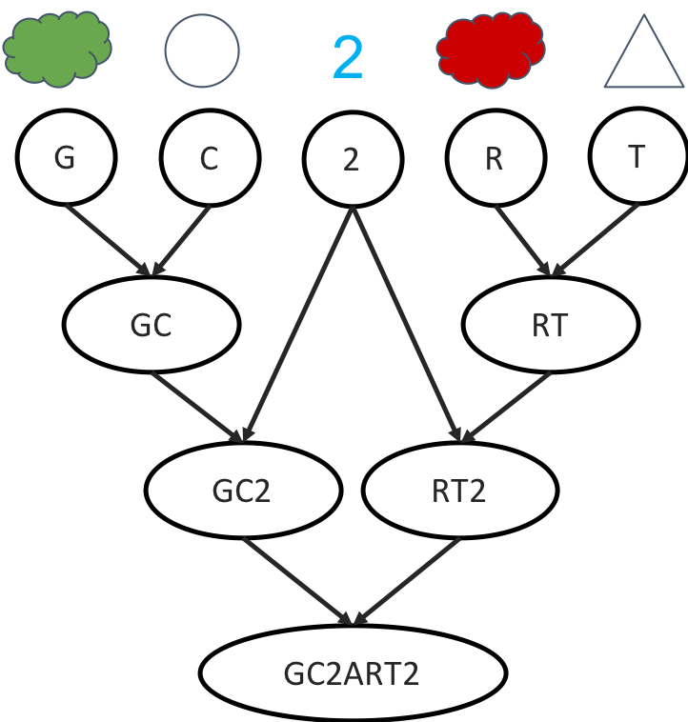
Relate Items By Their Features
[4] Shuhan Wang, Fang He, and Erik Andersen. 2017. A Unified Framework for Knowledge Assessment and Progression Analysis and Design.In Proceedings of the 2017 CHI Conference on Human Factors in Computing Systems. ACM, 937–948
Notes:
Each level that we already have can be described by a sentence. For example, the level on the previous slides is __
We can then order the sentences using a method shown effective to work by wang et all.

Slide 17
Automatic Item Graph Construction^{[4]}: Note full graph is larger!
[4] Shuhan Wang, Fang He, and Erik Andersen. 2017. A Unified Framework for Knowledge Assessment and Progression Analysis and Design.In Proceedings of the 2017 CHI Conference on Human Factors in Computing Systems. ACM, 937–948
Notes:
Each level that we already have can be described by a sentence. For example, the level on the previous slides is __
We can then order the sentences using a method shown effective to work by wang et all.

Slide 18
Leading Students Through a Sequence using Bandit-based machine learning^{[5]}
Legend
Mastered Problems
Problems Student is not ready for
ZPD, Problems currently presented to Student
[5] Benjamin Clement, Didier Roy, Pierre-Yves Oudeyer, and Manuel Lopes.2015. Multi-armed bandits for intelligent tutoring systems.JEDM-Journal of Educational Data Mining, (2015)
Notes:
EXP3 multi armed bandit algorithm. Nonstationary reward

Slide 19
Zone of Proximal Development (ZPD) ^{[5]}
Legend
Mastered Problems
Problems Student is not ready for
ZPD, Problems currently presented to Student
[5] Benjamin Clement, Didier Roy, Pierre-Yves Oudeyer, and Manuel Lopes.2015. Multi-armed bandits for intelligent tutoring systems.JEDM-Journal of Educational Data Mining, (2015)

Slide 20
Zone of Proximal Development (ZPD) ^{[5]}
Legend
Mastered Problems
Problems Student is not ready for
ZPD, Problems currently presented to Student
[5] Benjamin Clement, Didier Roy, Pierre-Yves Oudeyer, and Manuel Lopes.2015. Multi-armed bandits for intelligent tutoring systems.JEDM-Journal of Educational Data Mining, (2015)

Slide 21
ZPDES - Adaptive Sequencing^{[5]}
2 Hyperparameters for Graph
Correctness of answer the kth time the problem was presented
History Length
Legend
Mastered Problems
Problems Student is not ready for
ZPD, Problems currently presented to Student
[5] Benjamin Clement, Didier Roy, Pierre-Yves Oudeyer, and Manuel Lopes.2015. Multi-armed bandits for intelligent tutoring systems.JEDM-Journal of Educational Data Mining, (2015)

Slide 22
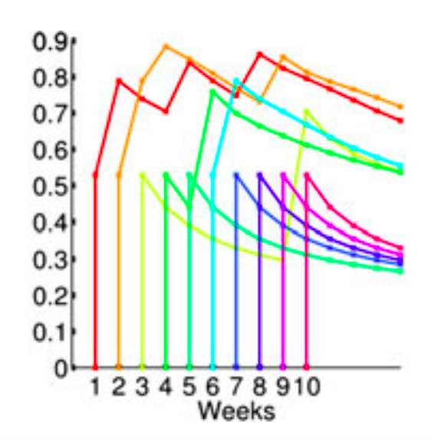
Modeling Forgetting - MCM^{[6]} (Mozer 2010)
Probability of Retention
Time
[6] Harold Pashler, Nicholas Cepeda, Robert V Lindsey, Ed Vul, andMichael C Mozer. 2009. Predicting the optimal spacing of study: Amultiscale context model of memory. InAdvances in neural information processing systems. 1321–1329.[24]Philip I Pavlik Jr and John R A
Notes:
Each time a problem is reviewed, a trace is left

Slide 23
Adaptive Student Support with No Prior Data in Katchi: Korean learning webgame.
Notes:
Resulting in a method that requires no prior data and minimum expert input

Slide 24
Katchi: Online Korean Language Learning Game
Color shape
Red triangle
Shape and shape
Circle and triangle
Numbers colors shapes
2 red triangles
& green circles
Notes:
First I will describe our domain, our domain is our Korean language learning webgame Katchi that teaches colors (red, green, white), shapes (circle, triangle, and square) numbers, 1, 2, 3 and combining them grammatically. Users complete the illustated phrase by dragging and dropping Korean words from a wordbank into the correct position. The goal of our game is for students to master the hardest level, number shape color and number shape color in all possible cominations of vocabulary. With this in mind, I will describe our methods

Slide 25
Experiments

Slide 26
Experiment 1: Adaptive V1 vs Fixed V1 (length: 43)
Fixed V1
Red represents repeated problems
Notes:
Fixed V1 was designed by experts to teach the same material, but for a different study from before our study was even formulated
Adaptive V1: 1. Each sentence was its own node
Posted on reddit

Slide 27
How do we define better?
Do people learn faster?
Do people learn more?
Notes:
Anita bowles

Slide 28
How do we define better?
Criteria for mastery:
Do people learn faster?
Do people learn more?
Correct on the first attempt and will give credit to all ancestors
Correct on the first attempt and will not give credit to ancestors
Completed the problem
All three criteria lead to the same results

Slide 29
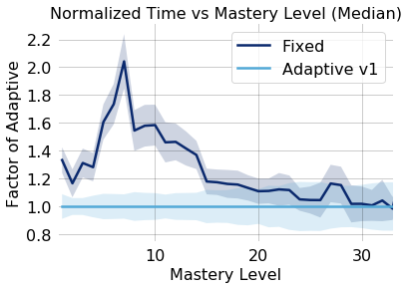
Results
Overall people did not learn faster in the adaptive progression.
Learn faster at first, but the gap closes.
Why?

Slide 30
Perhaps Review is not Necessary
Fit two IRT models:
Parameters from fixed data:
p(x): probability of correct on the first attempt
x: prerequisites correct on the first attempt
Trained parameters:
w₀: Bias
d_{i}: Difficulty of problem i
s_{j}: Ability of student j
w: weight on x
Both resulted in MSE of 0.0435

Slide 31
Perhaps Features Used Were Too Fine Grained
Color shape
Red triangle
Shape and shape
Circle and triangle
Numbers colors shapes
2 red triangles
& green circles
Notes:
First I will describe our domain, our domain is our Korean language learning webgame Katchi that teaches colors (red, green, white), shapes (circle, triangle, and square) numbers, 1, 2, 3 and combining them grammatically. Users complete the illustated phrase by dragging and dropping Korean words from a wordbank into the correct position. The goal of our game is for students to master the hardest level, number shape color and number shape color in all possible cominations of vocabulary. With this in mind, I will describe our methods

Slide 32
If Need to Show Performance on Each Item, Maybe Adaptivity Has Little Potential Benefit
Color shape
Red triangle
Shape and shape
Circle and triangle
Numbers colors shapes
2 red triangles
& green circles
Notes:
First I will describe our domain, our domain is our Korean language learning webgame Katchi that teaches colors (red, green, white), shapes (circle, triangle, and square) numbers, 1, 2, 3 and combining them grammatically. Users complete the illustated phrase by dragging and dropping Korean words from a wordbank into the correct position. The goal of our game is for students to master the hardest level, number shape color and number shape color in all possible cominations of vocabulary. With this in mind, I will describe our methods

Slide 33
Consider Coarser Structure
Color shape
Red triangle
Shape and shape
Circle and triangle
Numbers colors shapes
2 red triangles
& green circles
Notes:
First I will describe our domain, our domain is our Korean language learning webgame Katchi that teaches colors (red, green, white), shapes (circle, triangle, and square) numbers, 1, 2, 3 and combining them grammatically. Users complete the illustated phrase by dragging and dropping Korean words from a wordbank into the correct position. The goal of our game is for students to master the hardest level, number shape color and number shape color in all possible cominations of vocabulary. With this in mind, I will describe our methods

Slide 34
Consider Coarser Structure
Notes:
First I will describe our domain, our domain is our Korean language learning webgame Katchi that teaches colors (red, green, white), shapes (circle, triangle, and square) numbers, 1, 2, 3 and combining them grammatically. Users complete the illustated phrase by dragging and dropping Korean words from a wordbank into the correct position. The goal of our game is for students to master the hardest level, number shape color and number shape color in all possible cominations of vocabulary. With this in mind, I will describe our methods

Slide 35
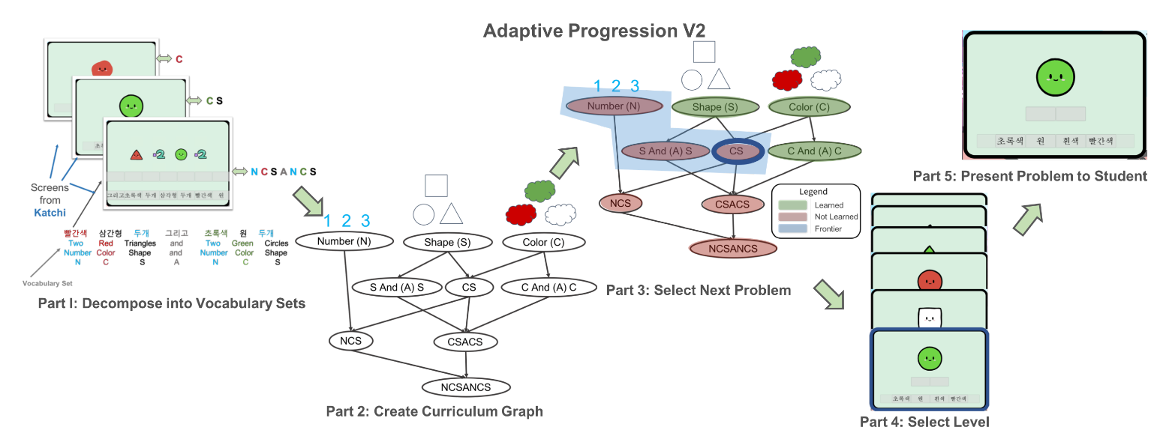
Adaptive Progression V2
Notes:
Fixed v2 had no repeats

Slide 36
Experiment 2: Adaptive V2 vs Fixed V1 vs Fixed V2
Fixed V2 : Fixed V1 with no repeated questions
Notes:
Fixed v2 had no repeats

Slide 37
Mastery Metric
A node and all problems that do not have credit corresponding to the node is considered mastered if a problem of the node was answered correctly on the first attempt
Individual problems are credited if they are answered correctly.

Slide 38
Adaptive Condition: Students Reaching Later Levels Faster!

Slide 39
How Much Faster? About 1.2-1.4x Faster to Reach Later Levels

Slide 40
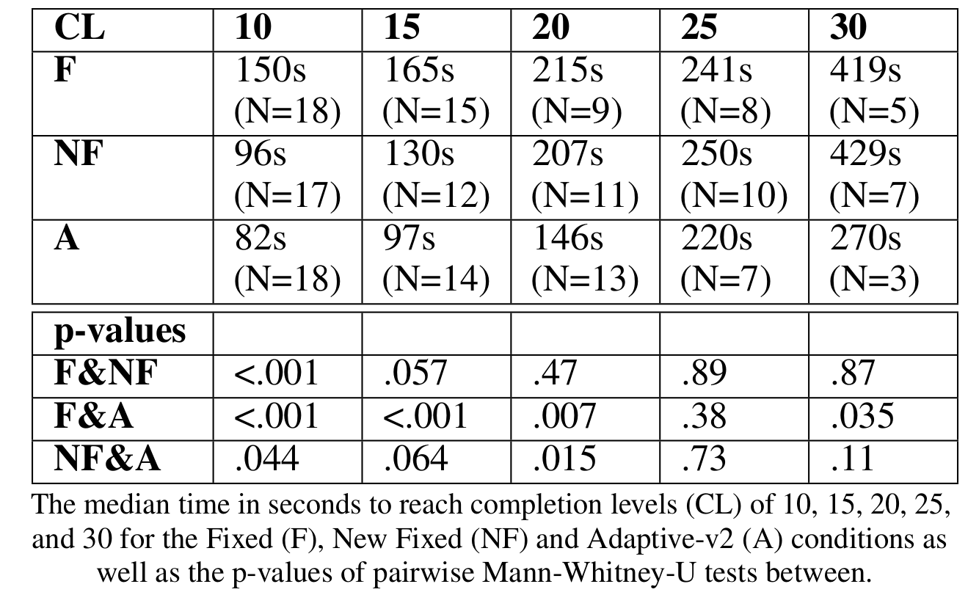
Small Data And ...
Median time to reach

Slide 41
Small Data And Significant at Multiple Levels
Median time to reach

Slide 42
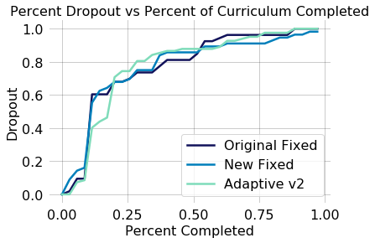
Evidence People Learned Faster with Adaptivity.
But People Did Not Learn More
Notes:
Efficacy vs enggement

Slide 43
Evidence People Learned Faster with Adaptivity.
But People Did Not Learn More
Essentially identical across conditions
People dropping out at same stage of curriculum
Notes:
Efficacy vs enggement

Slide 44
Summary & Open Issues
Preliminary evidence adaptivity usable from day 1, helped people learn faster
Right level of knowledge representation was important
Didn’t help people persist past more difficulty levels
How help them over that hurdles?

Slide 45
Today
- How do we provide adaptive personalized practice support for students on day 1?
Work lead by Tong Mu, with Shuhan Wang & Erik Andersen
- How can we provide learning support to improve performance support with no prior training materials?
Work lead by Shayan Doroudi, with Ece Kamar

Slide 46
Workers Generate Artifacts
Can we use these artifacts to train other workers?

Slide 47
Workers Generate Artifacts
Can we use these artifacts to train other workers?
Similar idea to learner sourcing
Taking artifacts created by learners to teach other learners (e.g. JJ Williams et al. 2016)
Here worker data for learning support

Slide 48
Example Task: Product Reviews

Slide 49
Example Task: Product Reviews

Slide 50
Use Prior Samples Generated By Work To Train Future Workers

Slide 51
Preliminary Results: Not All Examples Created Equal
No general effect of providing randomly selected past reviews in improving performance of later workers
High quality reviews may improve later performance

Slide 52
Preliminary Results: Performance May Not Equal Pedagogical Value
No general effect of providing randomly selected past reviews in improving performance of later workers
High quality reviews may improve later performance
But the most effective reviews in terms of training may be different than the highest quality reviews

Slide 53
Steps to Democratize Adaptive Personalized Support for Learning & Training
Use structure about pedagogical items to automatically personalize and adapt pathways-- can speed learning
Can leverage artifacts from workers to teach new workers
Lots of open questions:
Encouraging students to persist
Learning structure of items
Identifying when the set of interventions may have signal

Slide 54
Steps to Democratize Adaptive Personalized Support for Learning & Training
Use structure about pedagogical items to automatically personalize and adapt pathways-- can speed learning
Can leverage artifacts from workers to teach new workers
Lots of open questions:
Encouraging students to persist
Learning structure of items
Tutoring systems that are good from day 1, & improve w/data
Identifying when the set of interventions may have signal

