Slide 1

BALANCED DIET

Slide 2
What is balanced diet ?
A balanced diet is one which provides all the nutrients in required amounts and proper proportions. It can easily be achieved through a blend of the four basic food groups. The quantities of foods needed to meet the nutrient requirements vary with age, gender, physiological status and physical activity. A balanced diet should provide around 50-60% of total calories from carbohydrates, preferably from complex carbohydrates, about 10-15% from proteins and 20-30% from both visible and invisible fat.

Slide 3
Why a balanced diet is important
A balanced diet is important because our organs and tissues need proper nutrition to work effectively. Without good nutrition, our body is more prone to disease, infection, fatigue, and poor performance. Children with a poor diet run the risk of growth and developmental problems and poor academic performance, and bad eating habits can persist for the rest of their lives

Slide 4
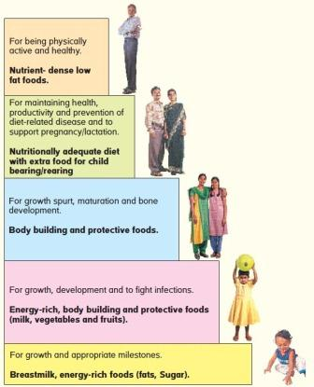
Importance of Diet during Different Stages of Life

Slide 5
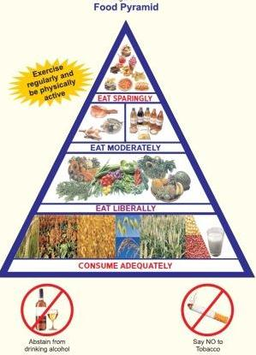
Why do we need nutritionally adequate food?
Nutrients that we obtain through food have vital effects on physical growth and development, maintenance of normal body function, physical activity and health. Nutritious food is, thus needed to sustain life and activity. Our diet must provide all essential nutrients in the required amounts. Requirements of essential nutrients vary with age, gender, physiological status and physical activity

Slide 6
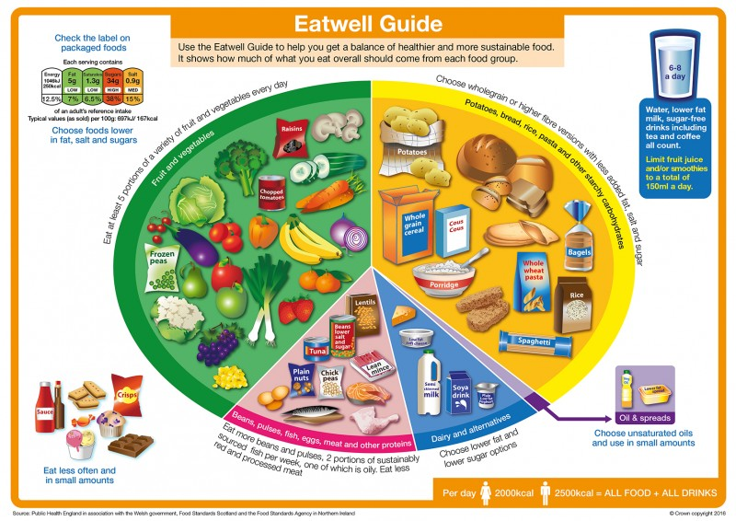

Slide 7
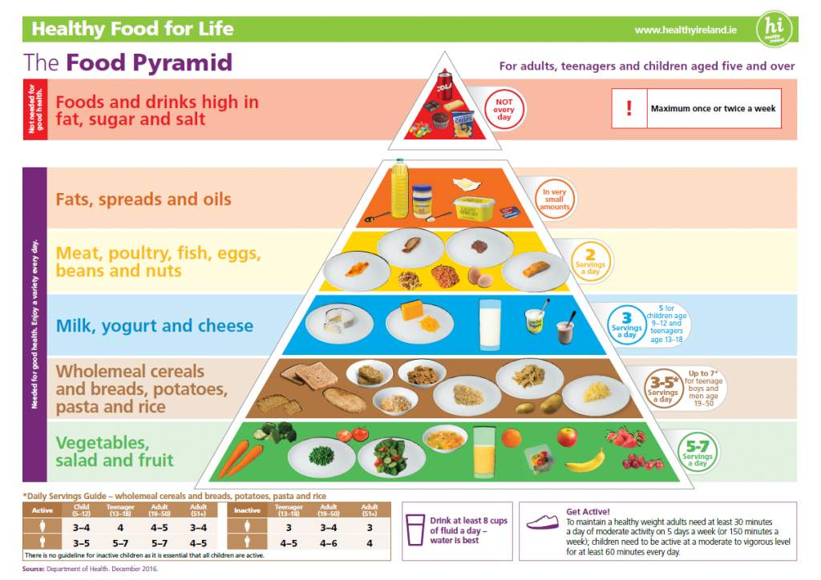

Slide 8
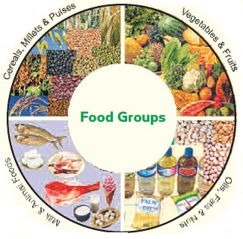
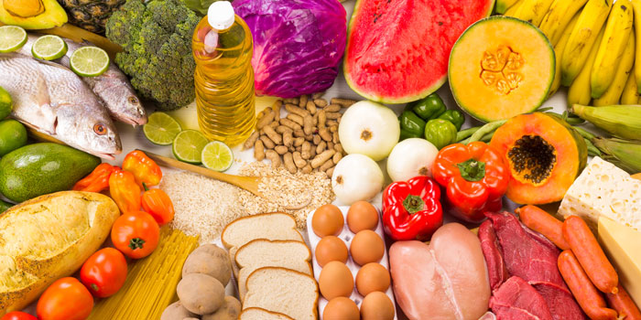
The 5 food groups
A healthful, balanced diet includes foods from these five groups:
vegetables
fruits
grains
protein
dairy

Slide 9
MY Healthy And Power Packed Today’s MENU

Slide 10
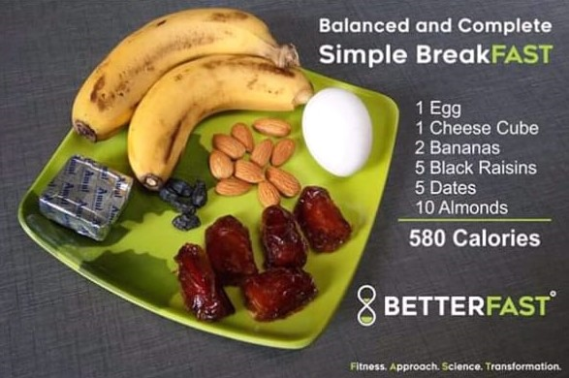

Slide 11


Slide 12

Healthy DINNER

Slide 13
THANK YOU

