Slide 1
Rebuilding what is broken down…

Slide 2
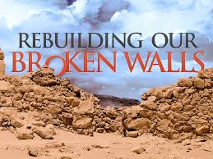
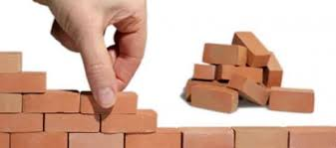
Rebuilding what is broken…
It can take a lifetime or significant effort build a house
But a careless or unfortunate season to destroy all that was built

Slide 3
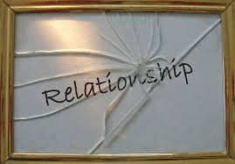
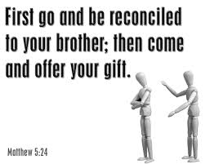

Rebuilding what is broken…
Relationships are built on trust but once trust is torn down the relationship is broken

Slide 4
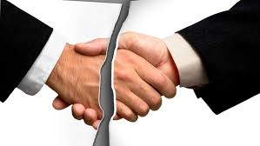
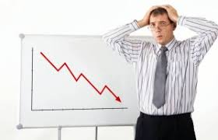
Rebuilding what is ruined…
Great careers take time to build but when you lose your job it can be hard to pick up the pieces
When disappointment occurs you are pushed to think your dreams may not come through

Slide 5
Who is Nehemiah
Nehemiah was a pleasant cup bearer ( Wine taster before the King of Persia)
Nehemiah was promoted to be as the Governor of Judea under Artaxerxes the Persian King
He was appointed Governor in Judea 444bc
Reappointed as Governor in 420bc
A man of God

Slide 6
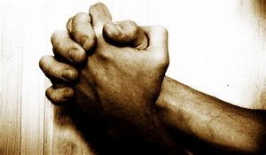
The case of Nehemiah 1:1-10 – Prayer for His people
When there are major problems to be fixed, or changes that need to be made
We either accept it and do nothing OR
We come to the Lord in Prayer

Slide 7

The case of Nehemiah 2:2-20 – Leap of Faith results in authority to rebuild
Bold request
Silent Prayer
Reflection on problem ahead
Face to face with your challenge
Appeal for help
Notes:
Reflection –
Be anxious for nothing - Philippians 4
Don’t let pride get in the way when broken or suffering
Don’t suffer in silence
Believe that God can take you through it Isaiah 59:1
Trust God – Prov 3:5-6

Slide 8
Nehemiah 3:1-32 Rebuilding what is broken – Making Change happen
He went to the most influential people first
Worked his way through to those who could make a difference
Tirelessly he was vigilant to rebuilding and growing
working hard, and inspiring people,
making partnerships,
gaining support day by day
People came together to help rebuild

Slide 9
Nehemiah 4:1-23 There are enemies to your progress- but you must have a plan against them
Stumbling blocks to your progress
It gets personal with those who are Jealous, those who hate – Here enters Sanballat, Tobiag and the Arabians
Trouble only wants to lead you back into the path you have left.
Seek God out to intervene
Don’t get caught up get focused
When complete victory is around the corner the battle gets hotter

Slide 10
Nehemiah 5:1-19 Your growth, rebuilding, or success is not just about you, but what God can do through you for others
Look at those who need help
Help those who are suffering
When you are fixing you don’t forget those who have helped you along the way

Slide 11
Nehemiah 6:1-16 – You are almost there don’t give up now the goal is in sight
Enemies will try to deceive you as a last attempt to destroy God’s plans for you
Reject the devil and he will flee
Believe in the promises and you will reach the promise land

Slide 12
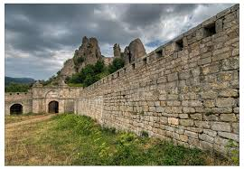
Rebuilt Walls of protection, of strength, of faith
Peace be within thy walls, and prosperity within thy palaces Psalms 122:7
Do good in thy good pleasure unto Zion: build thou the walls of Jerusalem Psalms 51:18

Slide 13
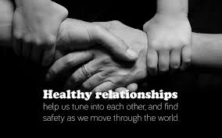
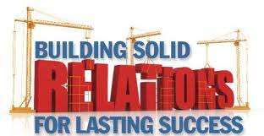
Rebuilding means: Reconciliation, renewed trust, strong relationships
And be ye kid one to another, tenderhearted, forgiving one another, even as God for Christ’s sake hath forgiven you! Ephesians 4:32

Slide 14

Thinking big and starting something new!
And Jabez called on he God of Israel, saying, Oh that thou wouldest bless me indeed, and enlarge my coast, and that thine hand might be with me, and that thou woudest keep me from evil, that it may not grieve me! And God granted him that which he requested.
1 Chronicles 4:10

Slide 15


Rebuilding what was broken achieving YOUR GOALS
The LORD shall open unto thee his good treasure, the heaven to give the rain unto thy land in his season, and to bless all the work of thine hand: and thou shalt lend unto many nations, and thou shalt not borrow
Deut 28:12

