Slide 1
Why Intellectual Property Rights matter to Thailand
Philip Stevens
Geneva Network
October 2019

Slide 2
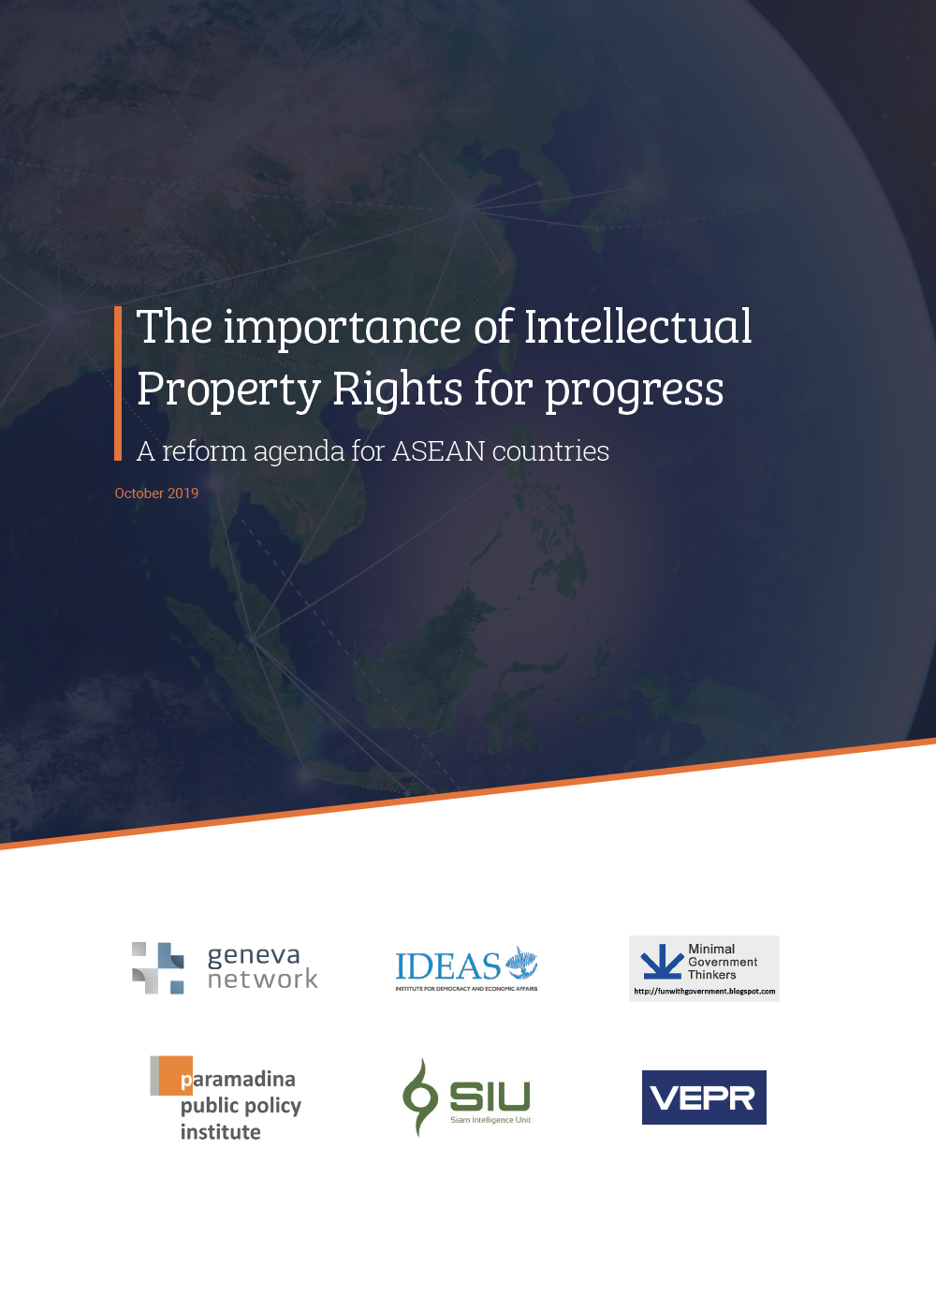
About our report
Collaboration between six think tanks from five ASEAN countries
Raise awareness of the importance of IPRs for economic progress
Set out principles for a high standard IP system

Slide 3
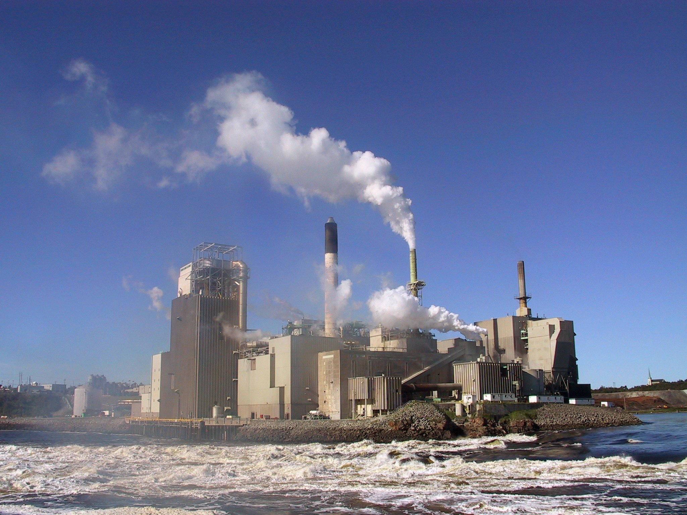
Old v new economy
Industrial Economy
Knowledge Economy
Manufacturing of physical goods
Export of natural resources
Subsistence farming
Unskilled labour
Middle income trap
The use of knowledge to create goods and services
High tech manufacturing
Research and development
Digital goods and services
Skilled labour

Slide 4
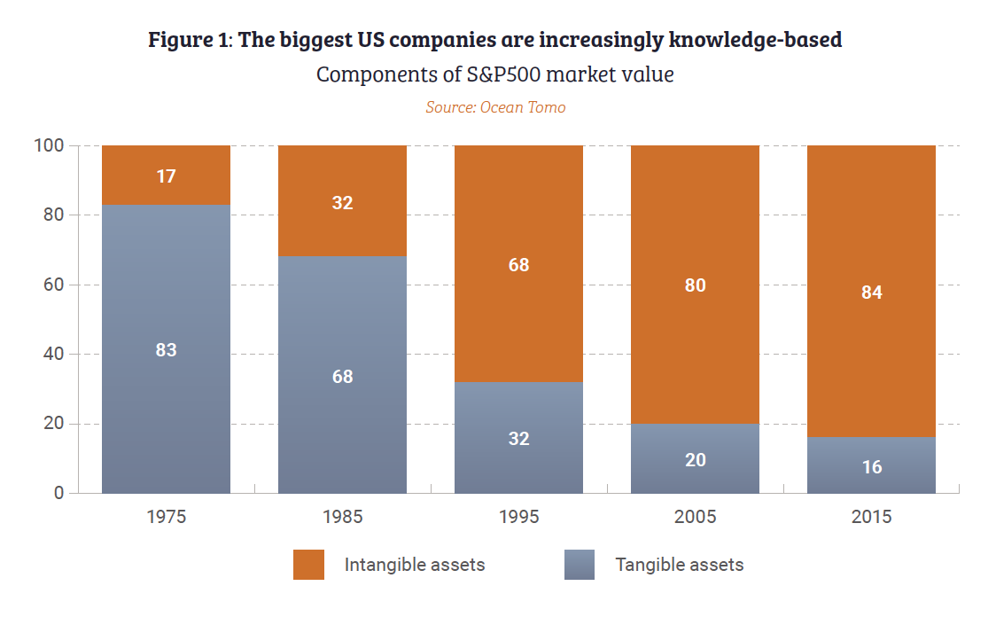
The rise of the intangible economy
Source: Ocean Tomo LLC
Source: Ocean Tomo LLC
Source: Ocean Tomo LLC

Slide 5
Intellectual property rights become more important in a knowledge economy
Networked innovation across borders
Global value chains are now IP-intensive

Slide 6
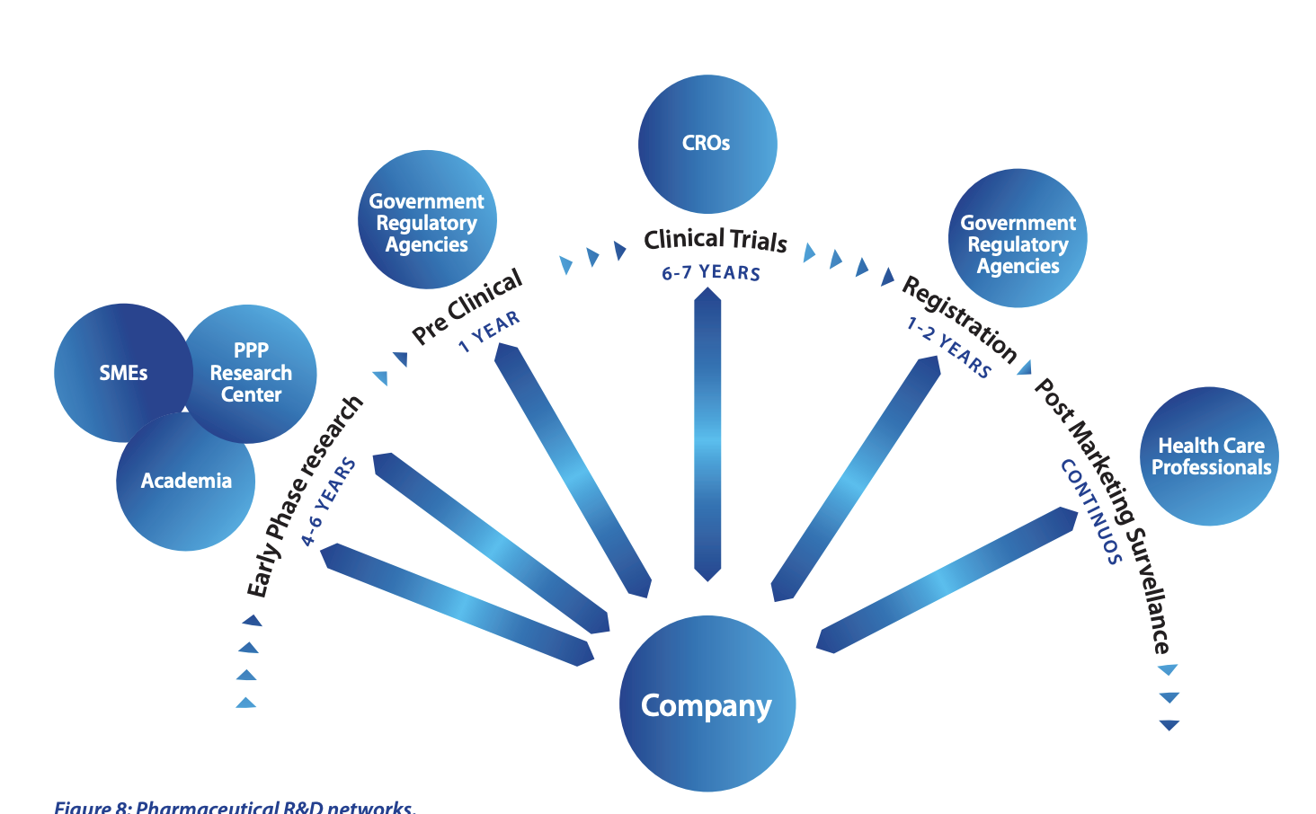
The importance of IP in a knowledge economy 1
Innovation is now global and networked
Old = vertically integrated R&D, where one company does everything from lab to market
New = networked innovation, multiple organisations, across borders

Slide 7
The importance of IP in a knowledge economy 2
Global manufacturing value chains are increasingly knowledge-intensive
One third of the value of manufactured products sold around the world comes from “intangible capital”
Notes:
According to the World Intellectual Property Organization (WIPO), one-third of the value of manufactured goods sold globally ($5.9tn), comes from intangible capital, underlining the importance of IP to today’s global economy.
Small businesses greatest opportunity is to integrate into global value chains, offering specialized services or manufacturing capabilities.

Slide 8
Thailand has started its innovation journey
Notes:
Conclusion. Need to change narrative to show importance of IP

Slide 9
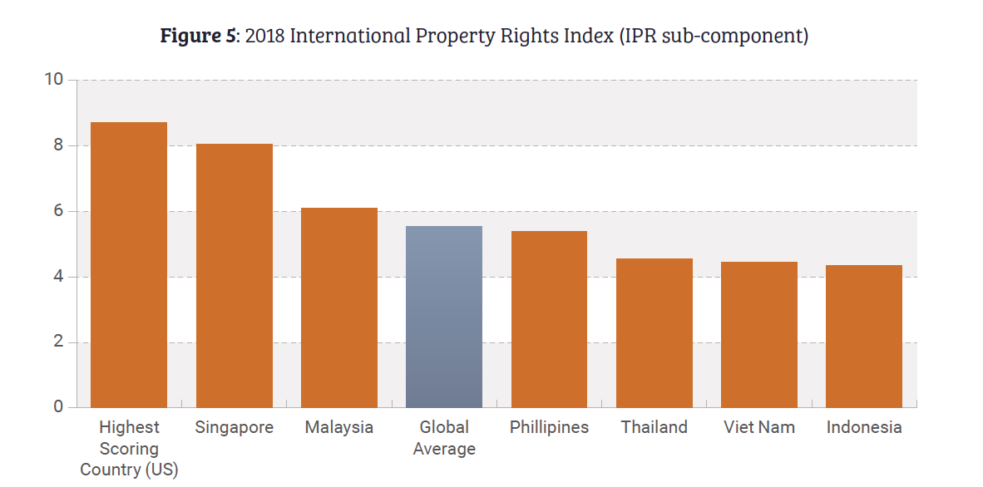
IP protection in Asia
Notable recent improvements in China and India

Slide 10
Areas of interest
Patents
Copyright / Piracy
Trademarks / counterfeiting
Trade secrets / confidential business information
Notes:
Conclusion. Need to change narrative to show importance of IP

Slide 11
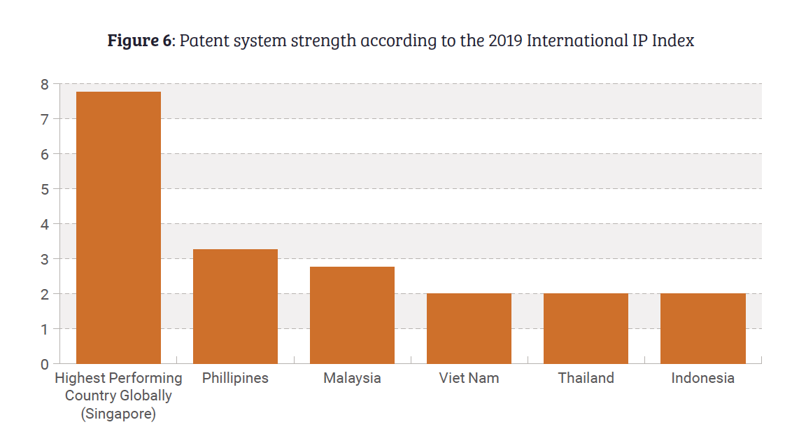
Patents
A strong framework of patent protection is essential for shift to knowledge-economy
Patents are central to business-models of highest value industrial sectors, including life sciences, semiconductors, electronic manufacturing and natural gas extraction
In EU, patent-intensive sectors worth 17% of employment and 15% of total GDP.

Slide 12
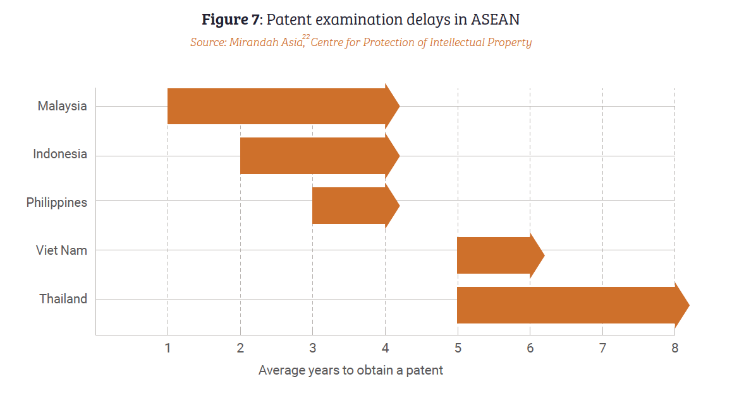
Challenges with patent protection in Thailand
Delays in granting patents (although govt has recently taken steps to clear the backlog)

Slide 13
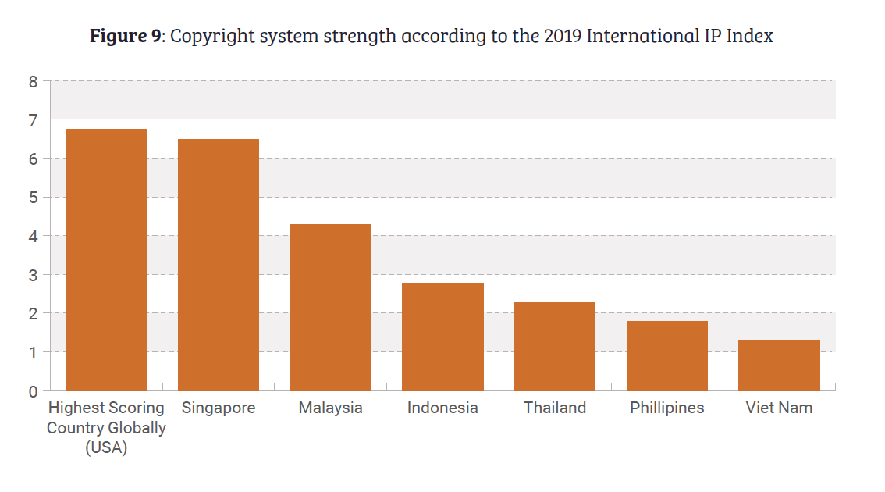
Copyright
Particularly important for Thailand, with creative industry particular growth area.
714 international films shot in Thailand in 2018, generating income of US$98m
Illegal distribution of music and film over the internet
73% of Thai internet users have illegally downloaded content.lhave streamed pirated content
Cloning of cloud-based internet software
“Camcording”
Thailand has recently amended Copyright Act to enable rights holders to work directly with ISPs to take down infringing content
Notes:
Progress being made with rights-holders able to work with ISPs to take down infringeing content.

Slide 14
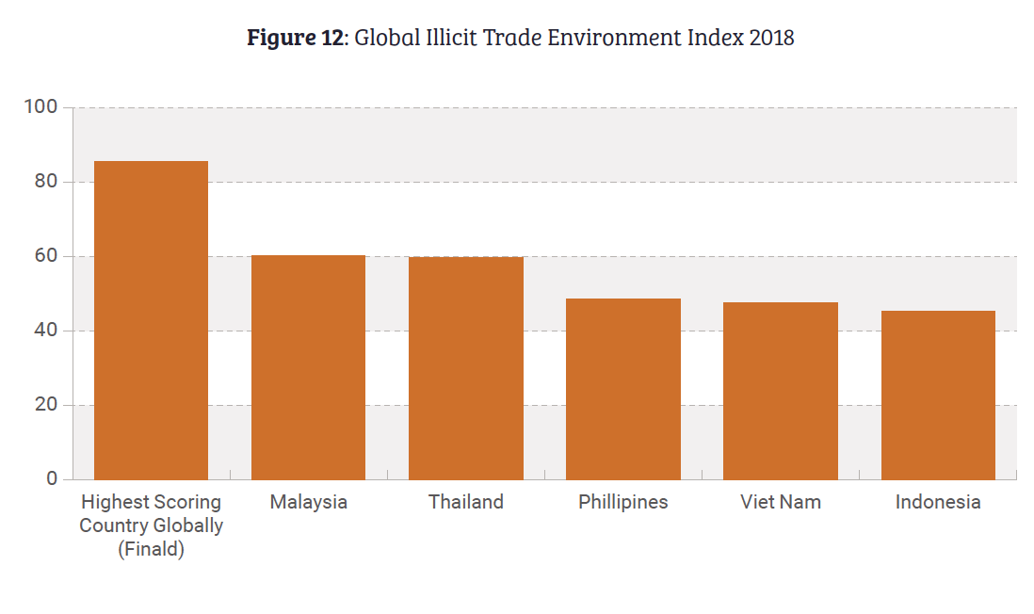
Trademarks
Trademark intensive industries are worth about 22% of Thailand’s GDP
Trademark protection is essential for investment by foreign companies and Thailand’s economic progress
Counterfeits are widespread:
Include medicines, machine spare parts, IT goods, luxury items, chemicals and food and drink
Thailand’s Dept of Intellectual Property has recently strengthened trademark protection laws

Slide 15
@genevanetwork www.geneva-network.com philip@geneva-network.com

