Slide 1



Humacao Sinks Merary Cruz Rivera, Alexis Boria Rodriguez, Rodney Gotay Pastrana
UPRH

Slide 2
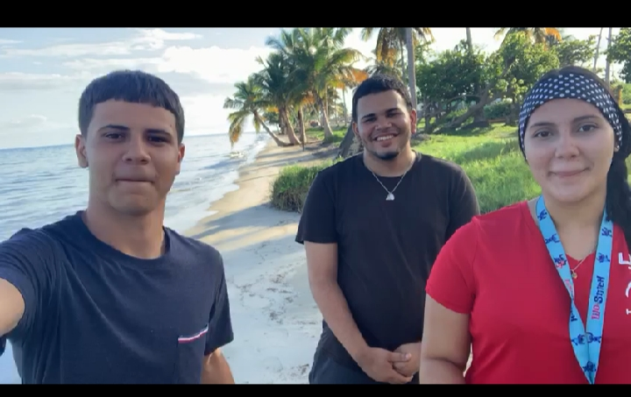

Slide 3


Slide 4
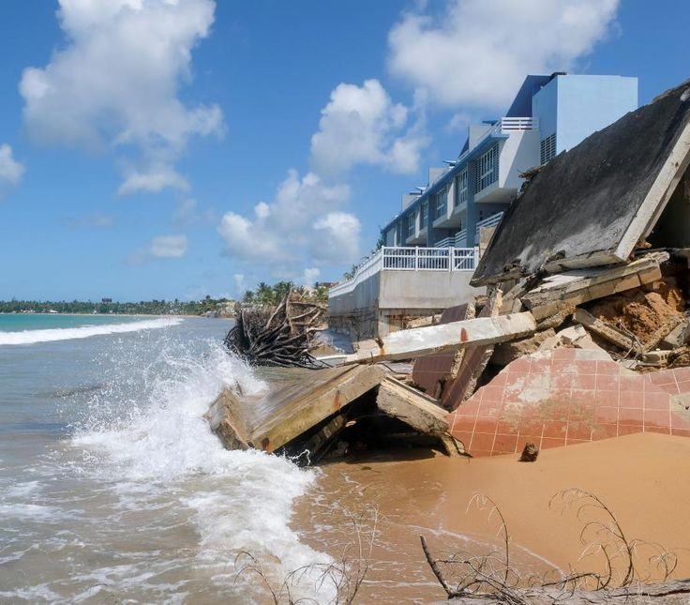

Slide 5
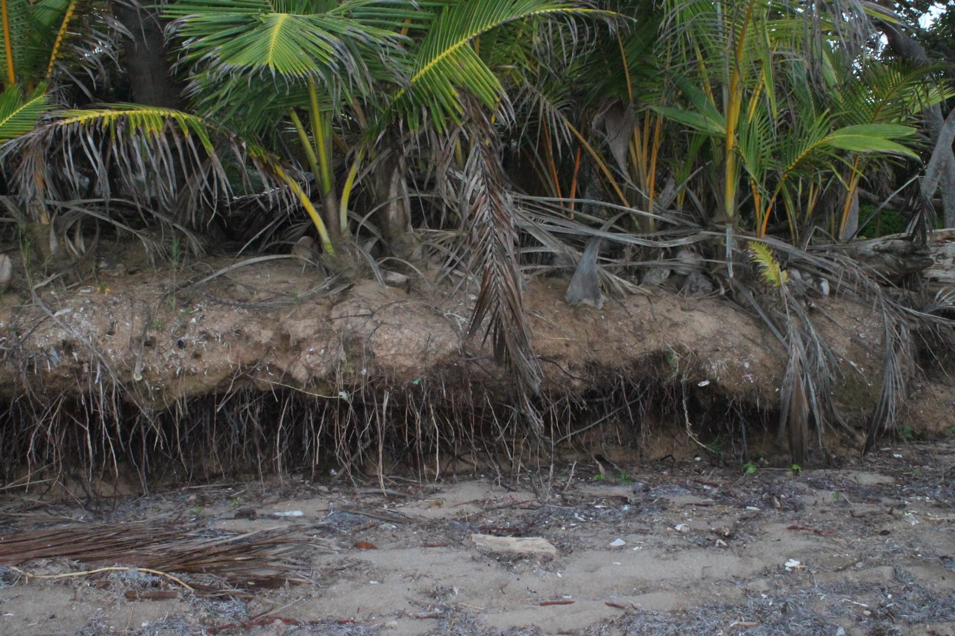

Slide 6
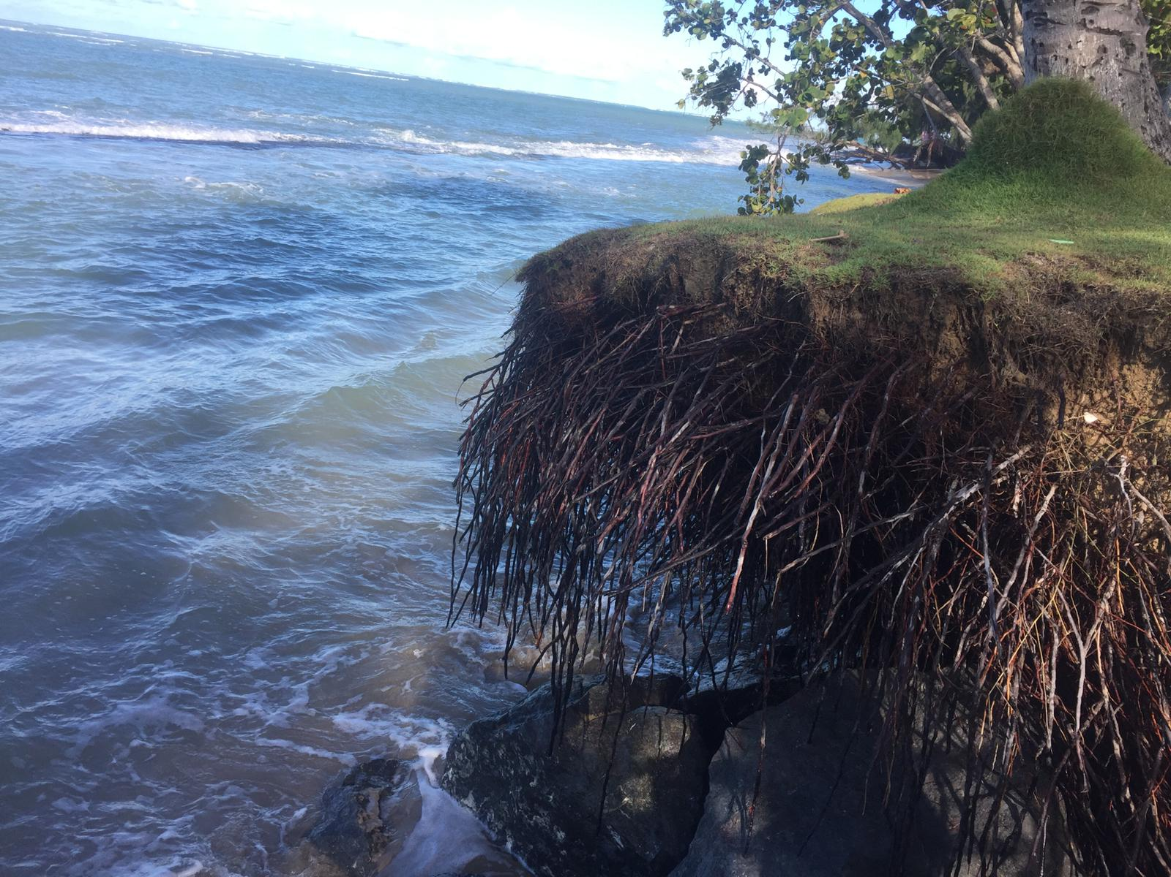

Slide 7
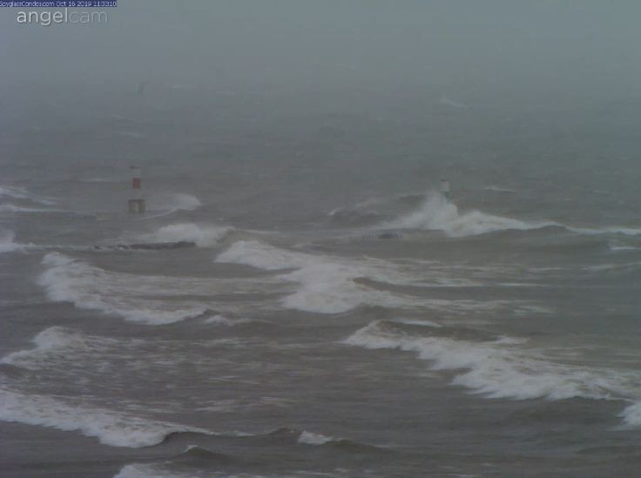

Slide 8
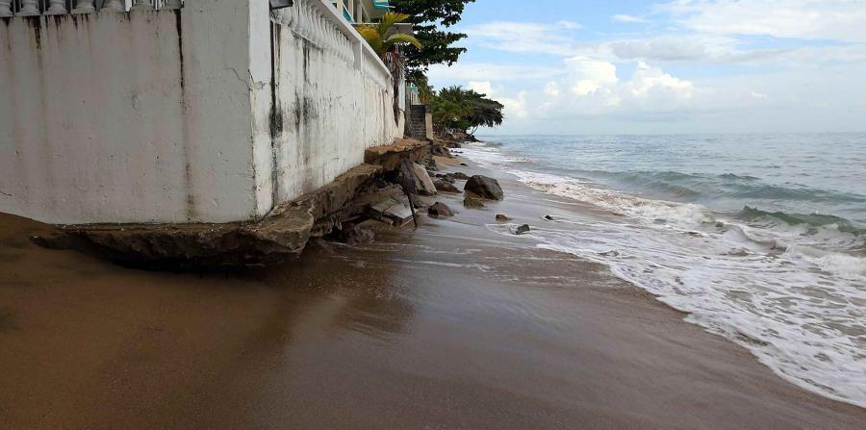

Slide 9
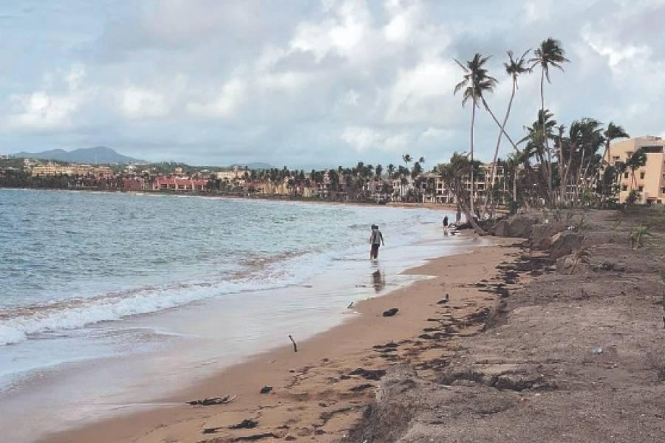

Slide 10
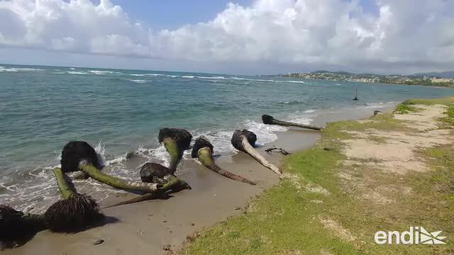

Slide 11
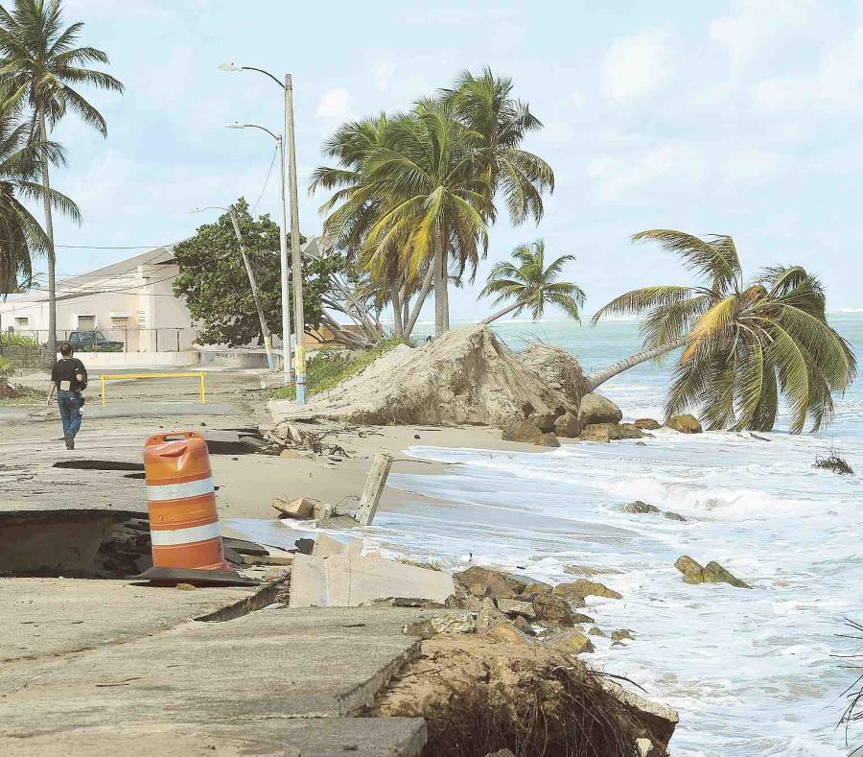

Slide 12
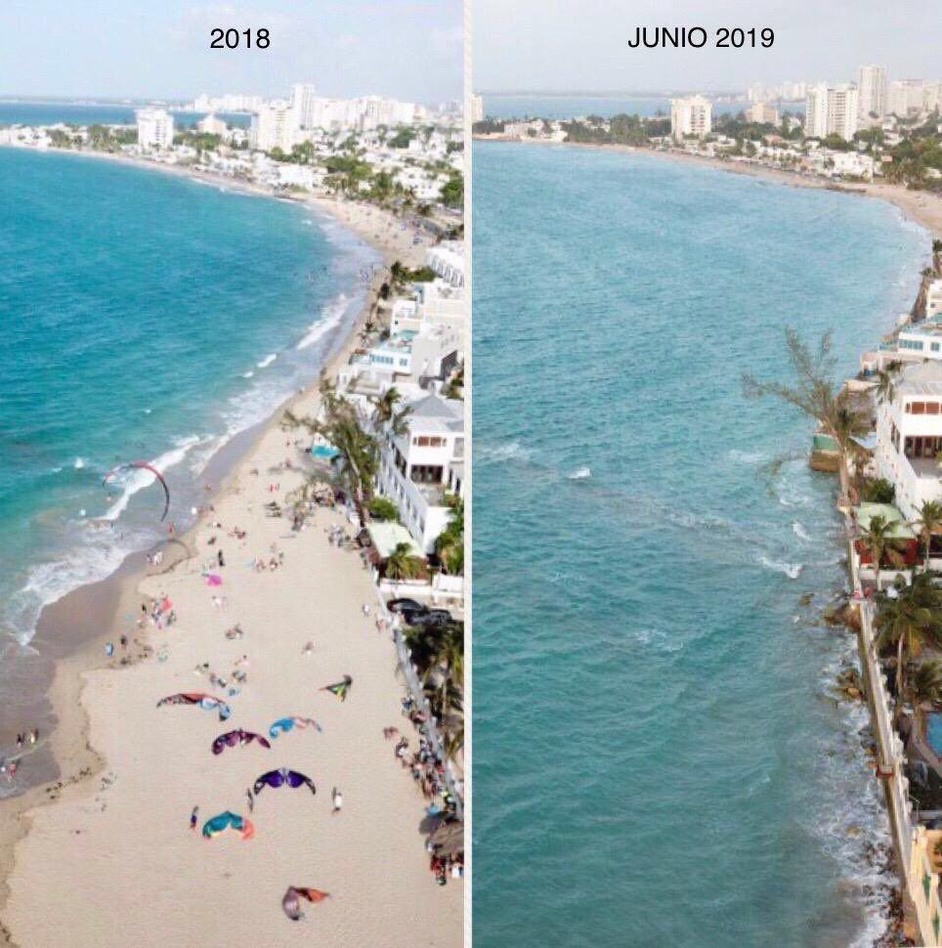

Slide 13
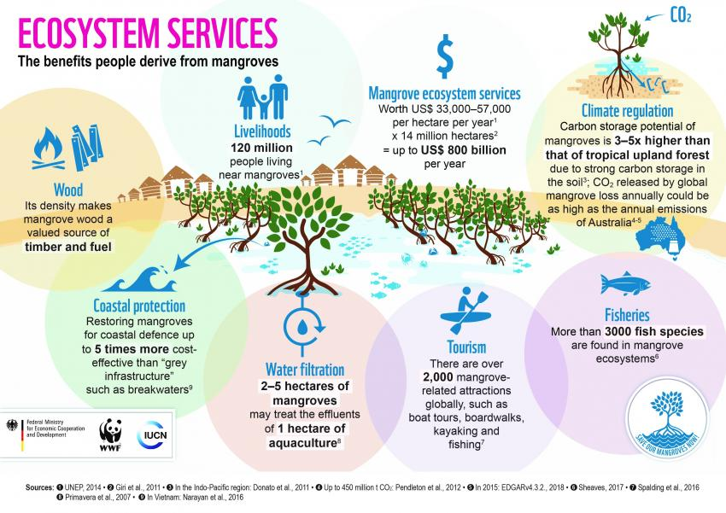

Slide 14
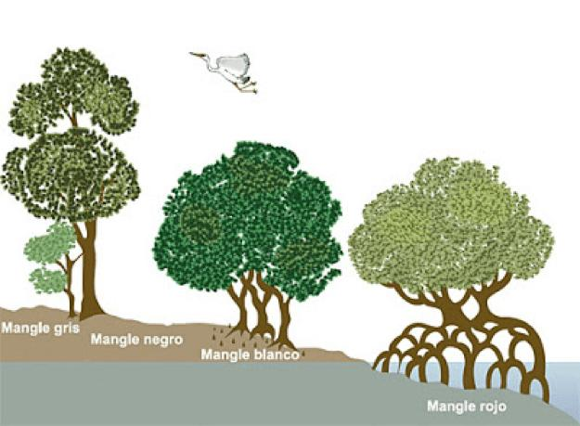

Slide 15
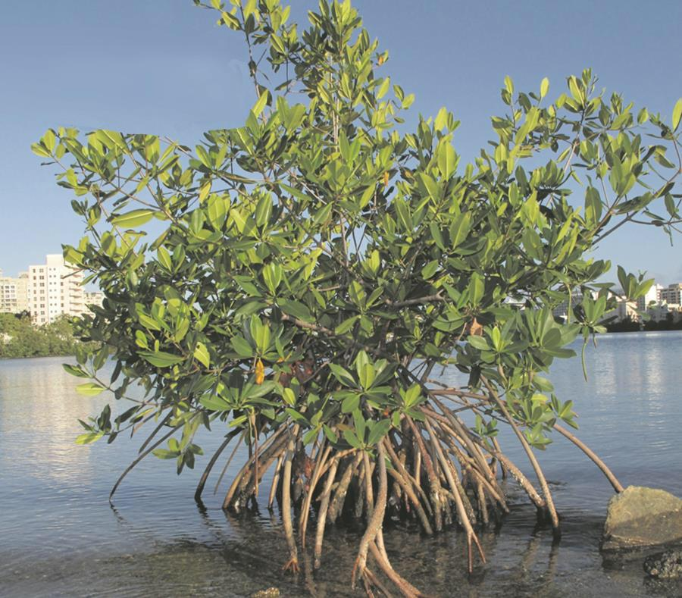

Slide 16
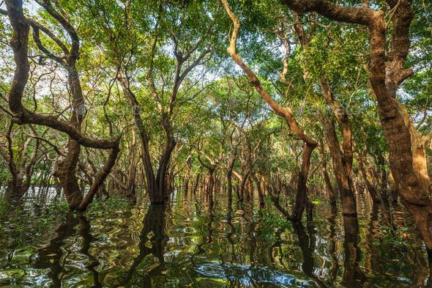

Slide 17
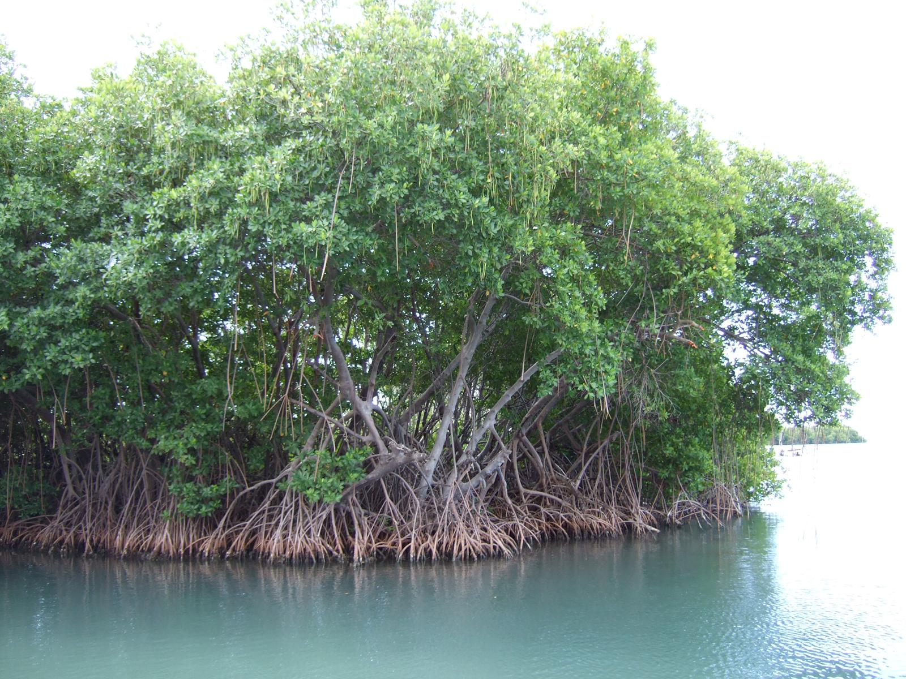

Slide 18
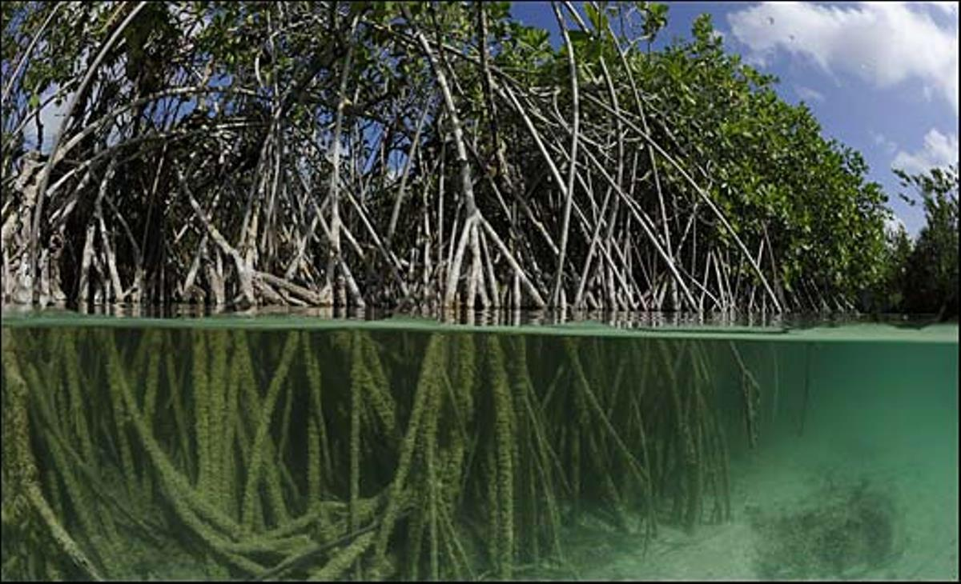

Slide 19
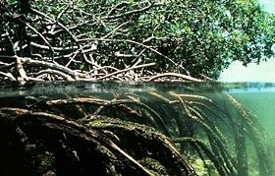

Slide 20
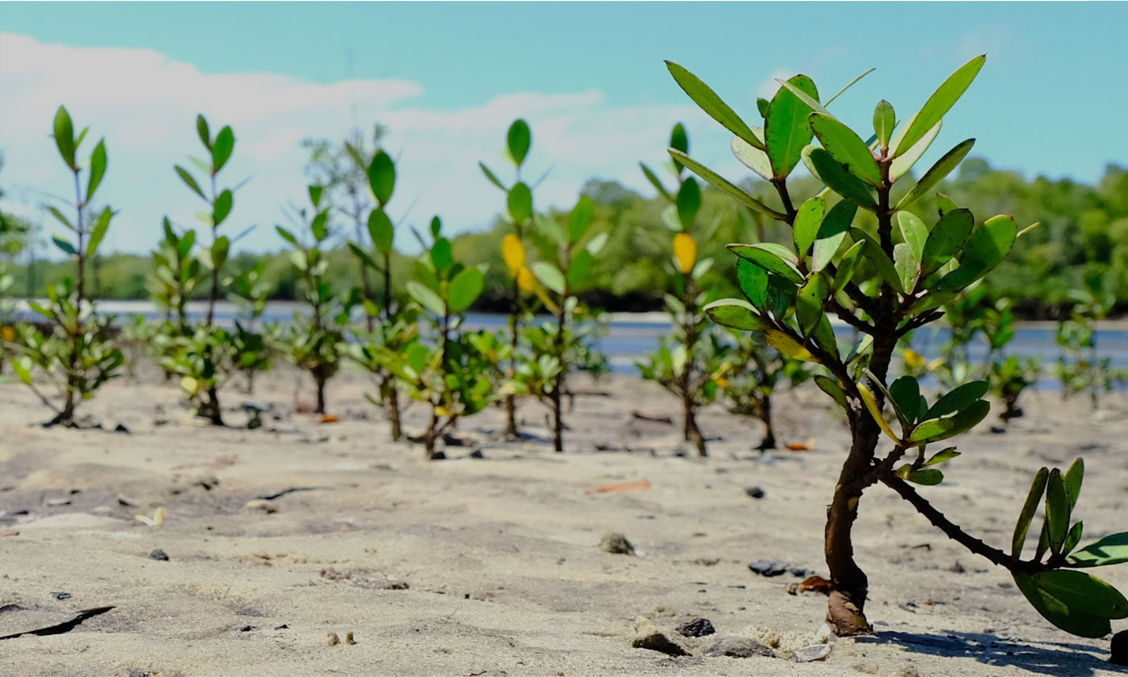

Slide 22

Sources & Credits
https://www.google.com/url?sa=i&url=http%3A%2F%2Fwww.mangrovealliance.org%2Fsave-our-mangroves-now%2F&psig=AOvVaw2grc7Ess62QzcSWFMo0DTu&ust=1575647355496000&source=images&cd=vfe&ved=0CAIQjRxqFwoTCNC2t4PunuYCFQAAAAAdAAAAABAZ
https://www.google.com/url?sa=i&url=https%3A%2F%2Fdailytimes.com.pk%2F452892%2Fwwf-pakistan-initiates-100000-mangroves-plantation-drive%2F&psig=AOvVaw2grc7Ess62QzcSWFMo0DTu&ust=1575647355496000&source=images&cd=vfe&ved=0CAIQjRxqFwoTCNC2t4PunuYCFQAAAAAdAAAAABAg
https://www.google.com/url?sa=i&url=http%3A%2F%2Fwww.mangrovealliance.org%2Fsave-our-mangroves-now%2F&psig=AOvVaw2grc7Ess62QzcSWFMo0DTu&ust=1575647355496000&source=images&cd=vfe&ved=0CAIQjRxqFwoTCNC2t4PunuYCFQAAAAAdAAAAABA1
6:40
https://www.google.com.pr/search?q=punta+santiago+erosion&client=safari&bih=622&biw=414&hl=es-419&prmd=inmv&sxsrf=ACYBGNSEVRxiQPoMk96OJHZTGJUjoXAk_Q:1575511294604&source=lnms&tbm=isch&sa=X&ved=2ahUKEwiumbf4tJ3mAhWkrVkKHT8TATYQ_AUoAXoECAsQAQ
https://www.google.com.pr/search?q=mangle+rojo&tbm=isch&ved=2ahUKEwjXkuatsZ3mAhWLg1MKHYVaAf0Q2-cCegQIABAC&oq=mangle+rojo&gs_l=mobile-gws-wiz-img.3..0l5.178743.180554..181596...2.0..1.230.1184.6j4j1......0....1.......5..35i362i39j35i39j0i67.C1-qiYQqnLE&ei=PGHoXdeEL4uHzgKFtYXoDw&bih=622&biw=414&client=safari&prmd=imnv&hl=es-419
UPRH

