Slide 1

Campus Forum
October 29, 2019
Notes:
Becca -Welcome

Slide 2

Agenda
Where did we start?
  Understanding the problem
Where are we going?
  Goals, Accomplishments, and Next Steps – Working group updates
Feedback and Gaps – Share your feedback
Every Oredigger is Everyone – Get involved!
Closing
Notes:
Becca

Slide 3
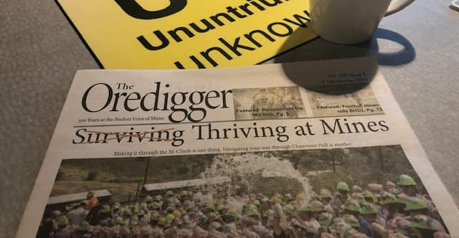
From Surviving to Thriving:
Where did we start, and are we there yet?
Notes:
Becca

Slide 4
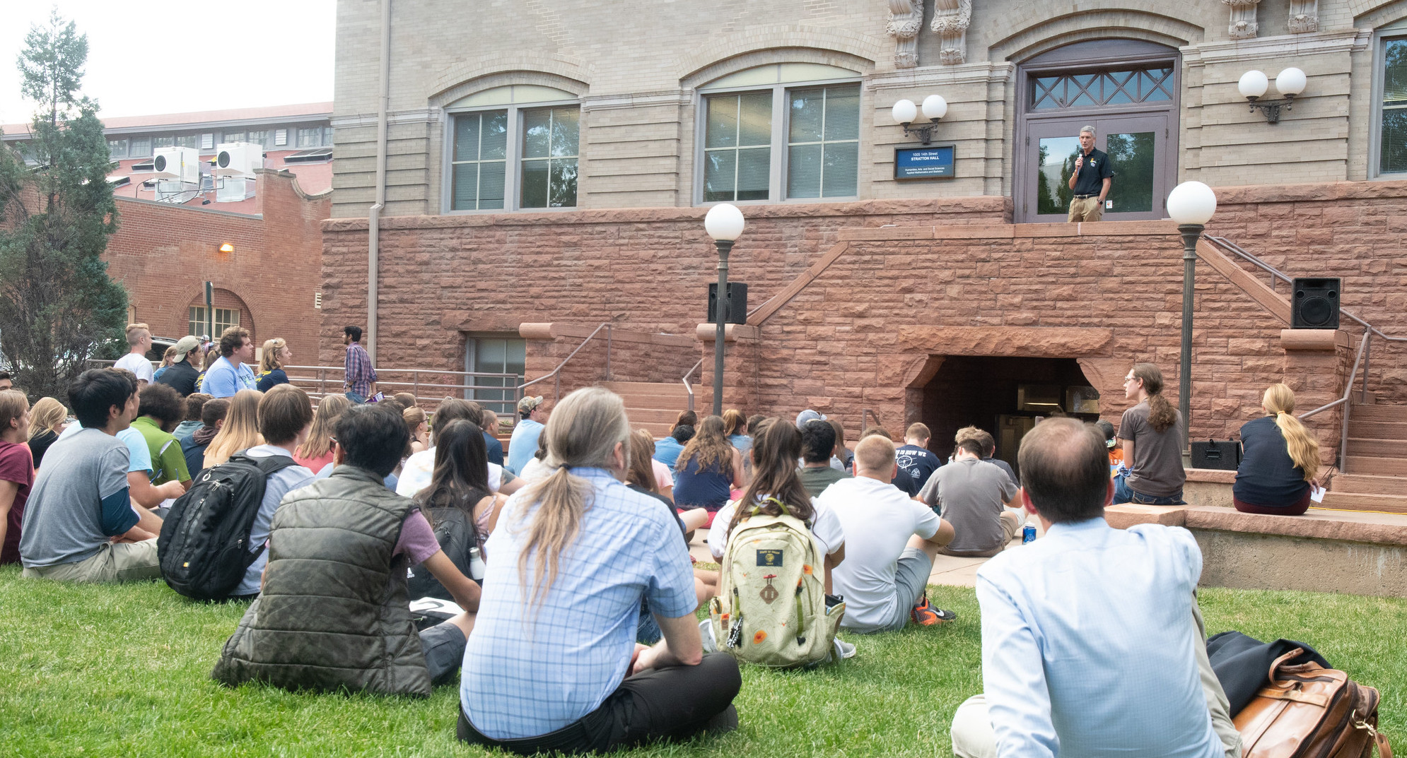
Understanding the problem
Each and every suicide is a devastating loss.
But the challenge is broad, and the problems are complex.
Notes:
Becca-
From Spring 2018 to Fall 2018 - lost 5 students
Spring 2019 - lost an employee

Slide 5
Understanding the problem
Colorado is in top 10 states for highest suicide rates.
Half of states, including Colorado, have seen over 30% increase in suicide rate since 1999.
Suicides per 100,000 in the U.S.
References: CDC.gov, Washington Post
Notes:
Becca

Slide 6
Understanding the problem at Mines
Fall 2018:
Task force led campus-wide assessment to understand Mines’ needs and strengths related to suicide, mental health, and resilience
Serve as Campus Champions
Contribute to Implementation Team
Provide Recommendations
Oversee Needs & Strengths Analysis
Notes:
Derek

Slide 7
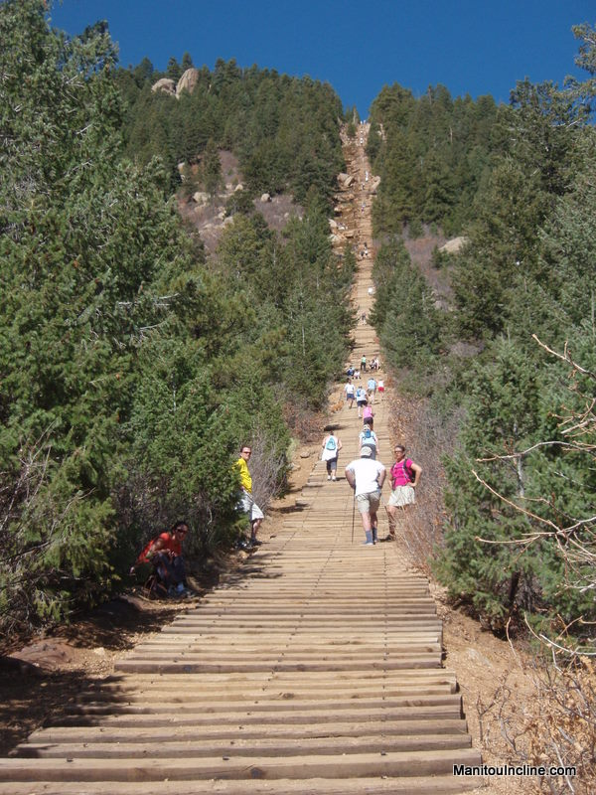
Results: Our Challenges
Exposure to Suicide
Culture of Suffering is Connected to Despair
Disconnection, Loneliness, and Marginalization
Campus Resources for Students Perceived as Inadequate
“Tsunami” of Mental and Emotional Challenges Coming in the Door
Sleep Deprivation, Exhaustion and Defeat —Among Students and Student Support Services
Culture of STEM and Faculty Expectations
Notes:
Derek:
25% had thoughts of suicide last year
Only 43% feel confident and competent in ability to start a conversation about suicide

Slide 8
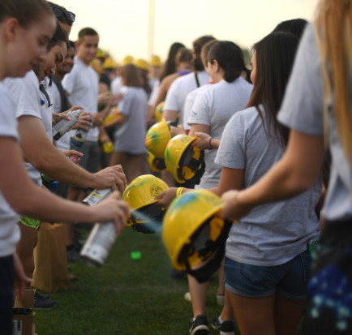
Results: Our Strengths
Mental Health/Suicide Recognized as Concern by Leadership and Wider Mines Community
Engagement in Student Well-Being by Faculty, Staff, and Students
Pride and Love for Community (also genuine sadness and concern)
Culture is Changing
Many Practices to Enhance Well-Being are In Place and Working
Notes:
Derek
2/3 of the mines community has reached out to at least one person over the last 12 months
83% would be willing to reach out if I notices someone struggling

Slide 9
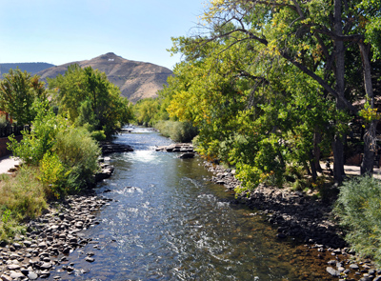
Recommendations
Upstream
prevention
Midstream
identify emerging risk & connect
Downstream
respond to crisis
Notes:
Derek
Build protective factors – base training – resiliency – sharing stories
Screenings, promote and normalize help seeking, advance training
Communicating what has happened; providing care for the community

Slide 10
Where are we now?
Fall 2018:
Task force led campus-wide assessment to understand Mines’ needs and strengths related to suicide, mental health, and resilience
Spring 2019 to now:
Implementation team began work on recommendations
Program Evaluation team
Campus-wide culture change
Direct services
Campus support network & training
Policy & Procedures
Communi-cations
Serve as Campus Champions
Contribute to Implementation Team
Provide Recommendations
Oversee Needs & Strengths Analysis
Notes:
Becca

Slide 11

Where are we going?
Working group updates
Goals
Accomplishments
Next Steps
Notes:
Becca

Slide 12
Communications: Goals
  Develop a strong brand identity for the mental health/suicide prevention initiative, to increase student/faculty awareness and buy-in
  Ensure suicide prevention/mental health messaging is “in the water” on campus, available to everyone – whenever and wherever they need it
    Help normalize failure and rejection and encourage resilience among our high-performing students, faculty and staff.
    Increase awareness of mental health services available on campus.
    Encourage self-care among students, faculty and staff all the time, not just when we’ve had a loss on campus.
    Help normalize mental illness for help seekers/high-risk groups and for those who may be called upon to be help givers.

Slide 13

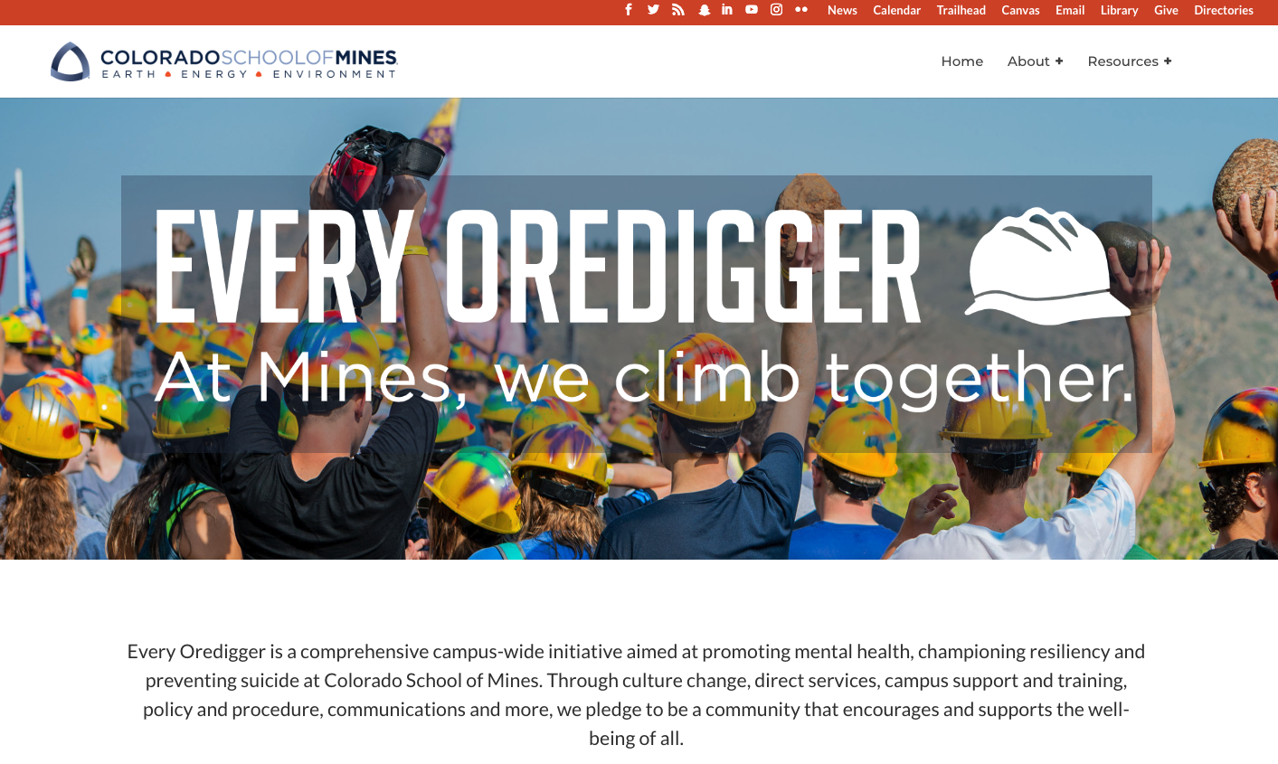
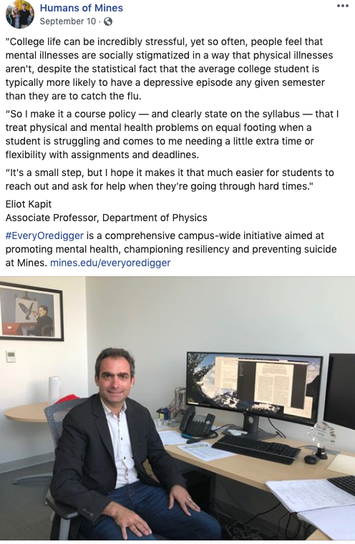

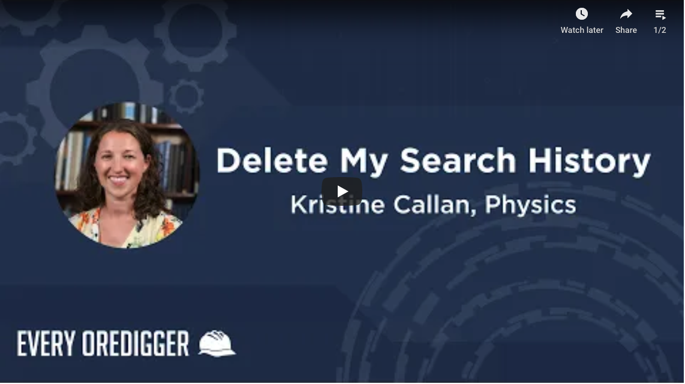

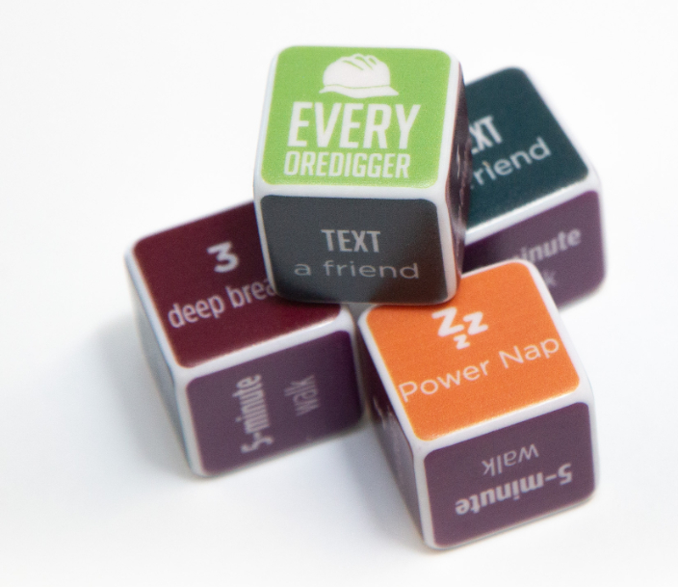
Communications: Accomplishments

Slide 14
Communications: Next Steps
How Do You Self-Care posters and digital signage
Every Oredigger office placards
- Interactive Every Oredigger app for new touch screens in Brown and Student Center (with help from Computer Science students)
Counseling Center website improvements
Share our story with local media
QUESTION: Would you or someone you know be willing to talk about their personal mental health journey? Let us know!

Slide 15
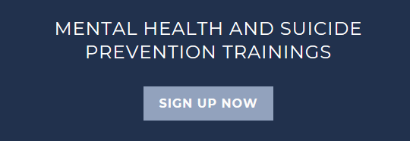

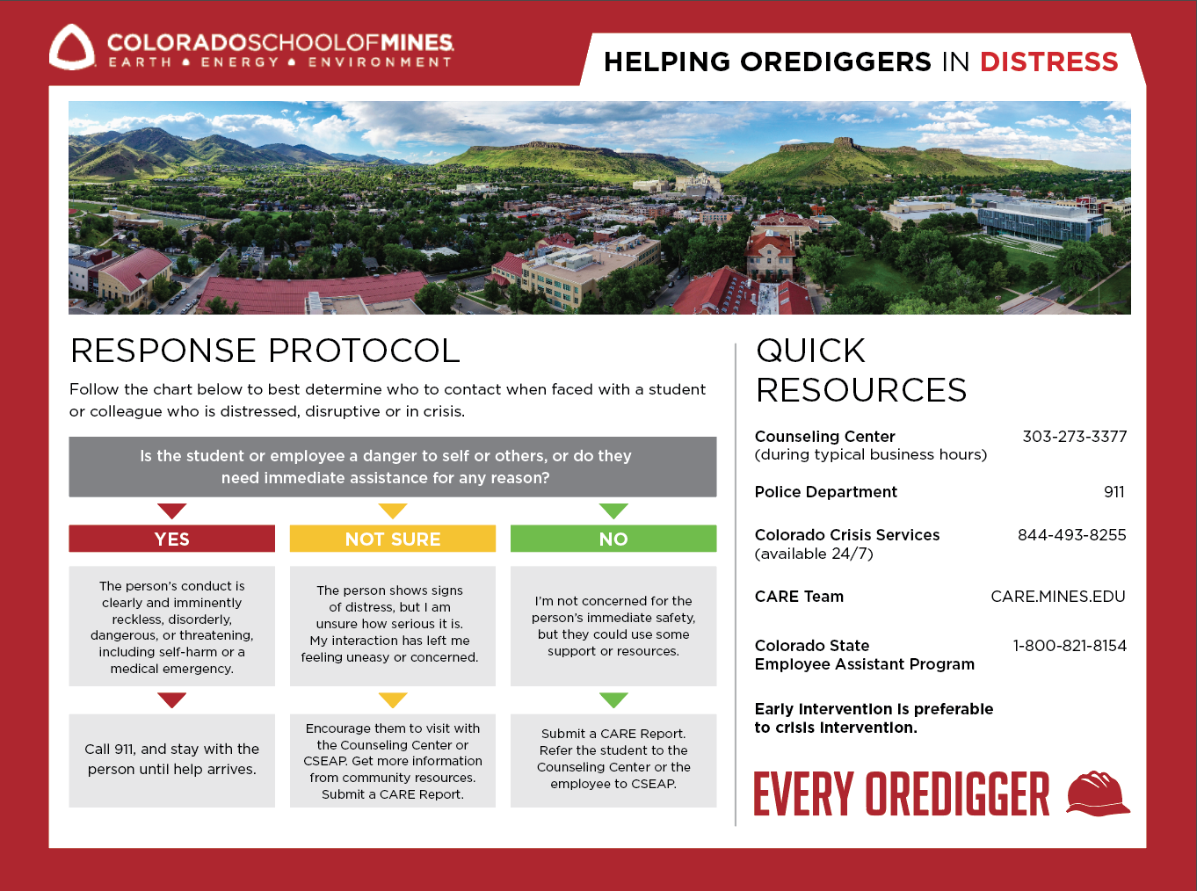
Campus Support Network and Training

Slide 16

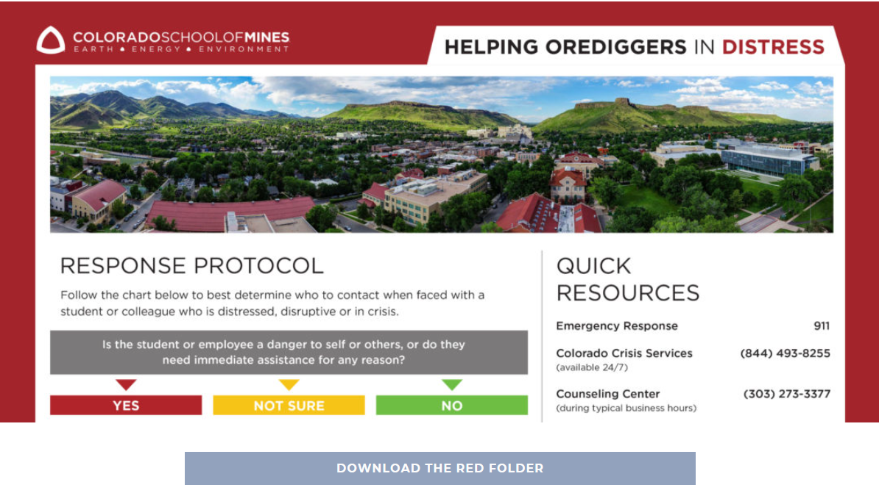
Goals and Accomplishments
Create clear, coordinated, and structured system of mental health, suicide prevention, and resiliency trainings which involve every student, faculty, and staff in at least one level.
Each semester, offer at least 1: ASIST, QPR for students, QPR for faculty/staff, Suicide Prevention Refresher, Resilience for students
Fall 2019, over 125 students, faculty, and staff trained
ASIST training includes representatives from 12 academic departments
Peer Educators are doing Resilience Trainings across campus
QPR feedback: “Just talking about the topic helps break down the stigma!”
Enhance referral protocols; create and provide an emergency folder for all faculty and staff to reference that includes appropriate campus and community resources.
Red Folder created with support from Marketing, Student Life, Counseling Center, Public Safety
750 Red Folders distributed
PDF file available online
Notes:
Create clear, coordinated, and structured system of mental health, suicide prevention, and resiliency trainings which involve every student, faculty, and staff in at least one level.
Each semester, offer at least 1: ASIST, QPR for students, QPR for faculty/staff, Suicide Prevention Refresher, Resilience for students
Fall 2019, over 125 students, faculty, and staff trained
ASIST training includes representatives from 12 academic departments
Peer Educators are doing Resilience Trainings across campus
QPR feedback: “Just talking about the topic helps break down the stigma!”
Enhance referral protocols; create and provide an emergency folder for all faculty and staff to reference that includes appropriate campus and community resources.
Red Folder created with support from Marketing, Student Life, Counseling Center, Campus Safety
750 Red Folders distributed to classrooms, academic spaces, departmental offices, and individual staff
PDF file available online

Slide 17
Campus Support Network and Training:
Next Steps
Create sustainability plans
  The Red Folders
  Continual building of the Mines Support Network
  Consistent outreach for trainings
Complete placard for training attendees
  To indicate they are approachable and supportive
Compile a public-facing list of Mines ASIST attendees
  To be referenced by those who need support

Slide 18
Direct Services: Needs & Challenges
Awareness of Resources
Access to Resources
Service Breadth and Expansion
Support for Faculty and Staff
Perception
Web-based alternatives
Campus Partnerships
Training

Slide 19
Direct Services: Accomplishments
Robust weekly walk-in skills groups and workshops
Counseling Center campus outreach
Clinical internship program and peer educators
Full implementation of the Stepped-Care model
Student satisfaction survey
Specialized suicide-prevention training for counselors
Embedded counseling pilot program with oSTEM
Staff reconfiguration and increased range of expertise
Notes:
Robust offerings of walk-in skills groups and workshops for students each week at the Wellness Center.
Counseling Center meetings with campus partners, student groups and academic departments to improve communication and awareness.
Implementation of clinical internship and peer educator programs to support education, training and enhanced services for students.
Full implementation of the Stepped-Care model to provide a broader range of service options for students.
Implementation of a student satisfaction survey to assess perceptions of service accessibility and experience.
Specialized suicide-prevention training for professional counseling staff.
Piloting of embedded counseling support in partnership with o-STEM.
Reconfiguring positions to increase the range of professional expertise in the Wellness Center.

Slide 20
Direct Services:
Work in Progress Next Steps
Continued marketing of C-SEAP services for employees
PA wellness-related course content
Additional embedded counseling support for vulnerable populations
Promote web-based mental health screening and educational tools
Enhanced case management and partnerships with telehealth and community resources.
Campus partnerships for holistic wellness support and assistance
Research of crisis response models
Recommendations for expanded Wellness Center services
More positive wellness practices for Mines employees
Notes:
Works in Progress:
Continued marketing of support services for Mines employees through C-SEAP.
Partner with the PA instructors to include wellness-related content in class materials.
Identify other areas on campus to provide embedded counseling support for vulnerable populations.
Robust promotion of web-based mental health screening services and educational tools for the campus.
Enhancement of the case management experience and partnerships with telehealth and community resources.
Next Steps:
Broader based partnerships and support across campus to offer more holistic wellness support and assistance.
Research of models to address increased need for crisis response on campus.
Recommendations for increased coverage for the Wellness Center, to include more hours for psychiatric care and additional part-time counseling roles to broaden expertise and crisis response.
Explore more ways to support positive wellness practices for Mines employees.

Slide 21
Policy & Procedures: Goals
Research:
  Synthesize charge from Mental Health and Resiliency Initiative/Group.
  Repository of best practices with wellness-related practices/policies identified at peer and aspirant schools.
  Digested relevant research, including: JED Framework for Developing Institutional Protocols for the Acutely Distressed or Suicidal College Student
Self-Assessment:
  Mines self-assessment of policies and procedures against JED Framework, with consideration to health/existence of policy, practice, and student-awareness.
  Identification/Discussion of Mines-specific opportunities for improvement with policy and procedures.

Slide 22
Policy & Procedures: Next Steps (Ten Efforts)
Outreach Process for Affected Parties Impacted by Distressed Student (Down-stream)
Decision/Action Process for At-Risk Student Identified (Mid-Stream)
Grade Replacement and/or Grade Forgiveness Policy (Up-Stream)
Return from Hospitalization or Crisis Protocol (Down-Stream)
Academic Department Lead/Role for Support of Students/Faculty (Up-Stream and Mid-Stream)

Slide 23
Policy & Procedures: Next Steps (Ten Efforts)
Creation of PhD to Master’s Pathway (Mid-Stream)
Communication Plan for Departed Student Community (Down-Stream)
Reentry Process For Previously Distressed Student (Up-Stream)
Establishment of Partnerships for Non-Hospitalization Support (Mid-Stream)
Graduate-specific Policies Including Leave, Withdrawal, Support (Mid-Stream)

Slide 24
Campus-wide culture change:
Goals and Accomplishments/Next Steps
The Mines@150 goals explicitly include wellness
  Work with Pres. Johnson to rephrase Mines@150 text
  Articulation of campus values, and publish these across campus
Student and faculty think of Mines as having a “culture of growth and development”
  Develop and offer training for faculty and staff
  Have departmental wellness-coordinators
  Create a “best-practices for wellness” document/website for different groups on campus (students, staff, faculty, advisors, RA’s, etc.)

Slide 25
Campus-wide culture change:
Goals and Accomplishments/Next Steps
3. Regular opportunities exist, and are being used, for the community to gather together in healthy ways
  Food truck events
  Create “inspiring places” on campus, and places to meet informally
  Create and expand places for faculty/staff to meet
4. Mines has developed and implemented broader strategies to promote personal resiliency and self-care beyond counseling
  Include resiliency and self-care in all PA classes
  Fun weekly exercise opportunity at Kadafar
  Include standard text of wellness for every course syllabus

Slide 26
Campus-wide culture change:
Goals and Accomplishments/Next Steps
5. Campus members feel safe to speak to speak openly and confidently about mental health issues
Identify social norms from campus climate surveys and spread these across campus (website, posters, etc)
Dispel the myth that we are always doing great; ask campus members to share their challenges
Please send your suggestions to Roel Snieder ( rsnieder@mines.edu )

Slide 27
Program Evaluation: Goals
Develop overall assessment plan for Every Oredigger initiative, in order to show longitudinal changes and impact of campus-wide efforts.
Provide expert consultation to each working group to identify measurable outcomes and metrics.

Slide 28
Program Evaluation:
Accomplishments Next Steps
Groundwork laid with the Fall 2018 assessment
Outcomes and assessment advising for working groups
Advisory groups - January (Nominate a student or colleague today!)
Campus-wide survey 2020 – Jan.
Ongoing assessment support for the Every Oredigger effort

Slide 29
Programming (New!)
Goals:
Event planning support for Every Oredigger initiative
Annual campus-wide remembrance event
Notes:
Becca

Slide 30
Discussion:
Opportunities and Gaps?
Areas for improvement or gaps in the Every Oredigger initiative?
What’s missing from our plan?
Notes:
Becca & Derek

Slide 31
Discussion: Every Oredigger is Everyone!
Ways you want to contribute to the Every Oredigger vision or goals
Nominate a fellow student, faculty, or staff member to serve on Every Oredigger advisory groups for future focus group feedback.
Notes:
Derek

Slide 32
Questions & Closing
Thank you!
Please leave your worksheets or send them later.

Slide 33
Campus Forum
October 29, 2019

