Slide 1
Dominate the Pipes
Anna Gabrielle, Rachael Kalinyak, and Georgia Esipila

Slide 2
Description
Strategy board game where water company rivals fight to take control of the pipes that run through the Montgomery and Prince George’s counties
Target Audience:
Ages 8 and up
Anyone interested in water pipe DOMINATION :)

Slide 3
Quick Summary
Players claim routes with pipes to complete destinations
To increase their dominance players must pay for workers and scientists to build water towers and water filtration centers.
The player who has the most points has dominated the pipes!

Slide 4
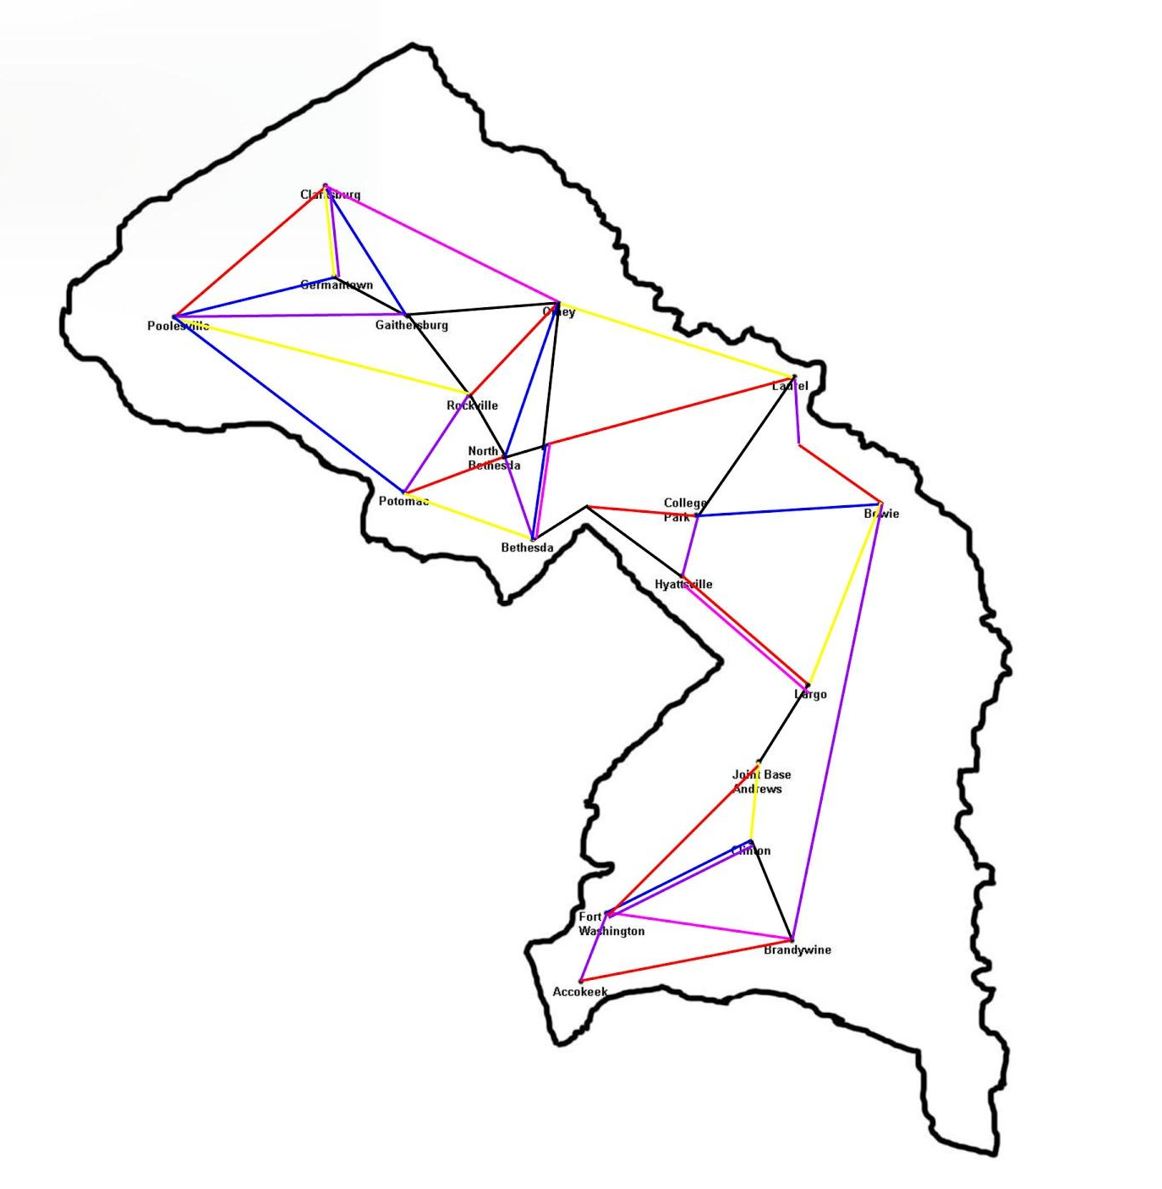
Map

Slide 5
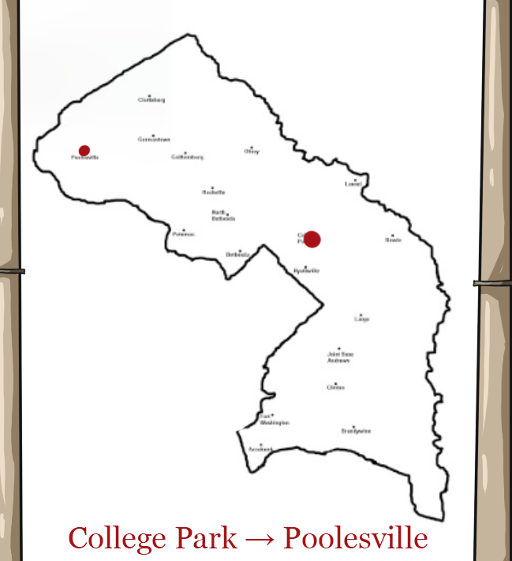
Cards
Destination Cards:
Provide each player with a goal- accomplish a pipe route connecting each of the 2 cities/towns mentioned to gain the extra points on the card.

Slide 6
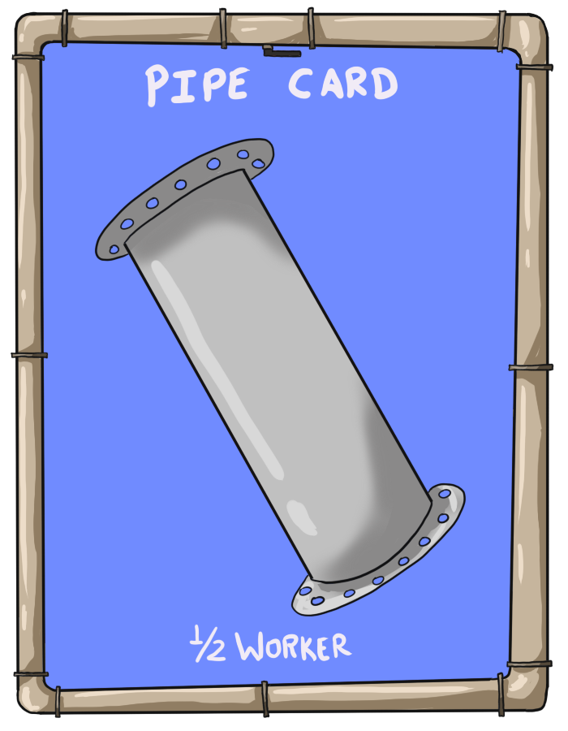
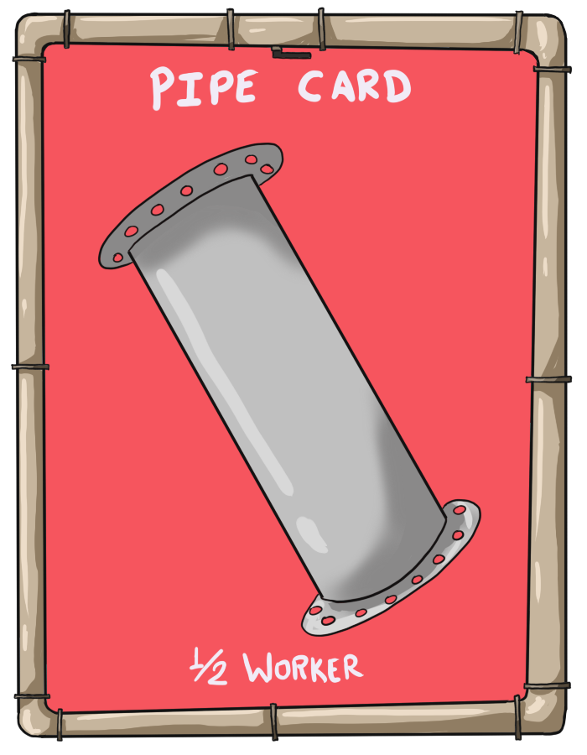
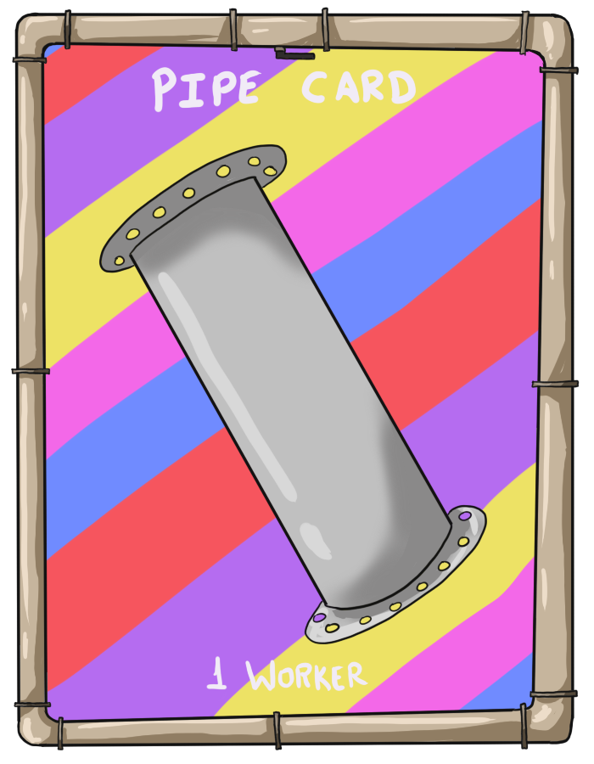
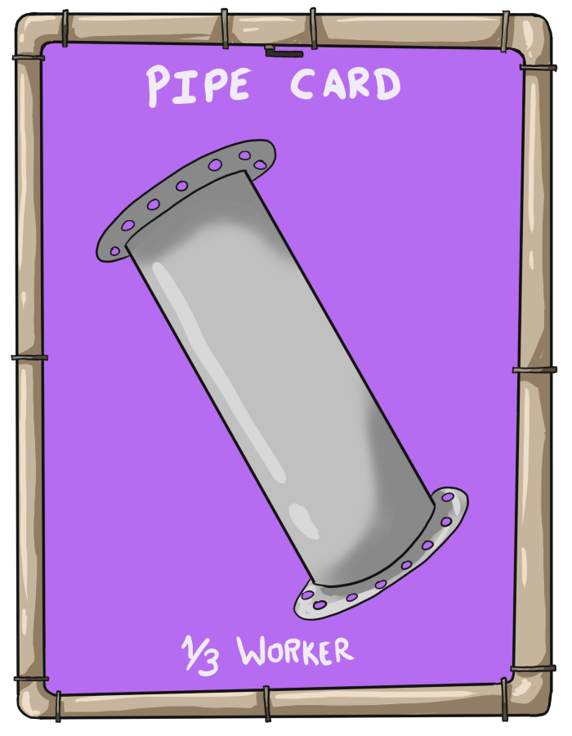
Cards
Pipe Cards:
These colored pipes will remain in your hand until they can be used to claim a route or sold.

Slide 7
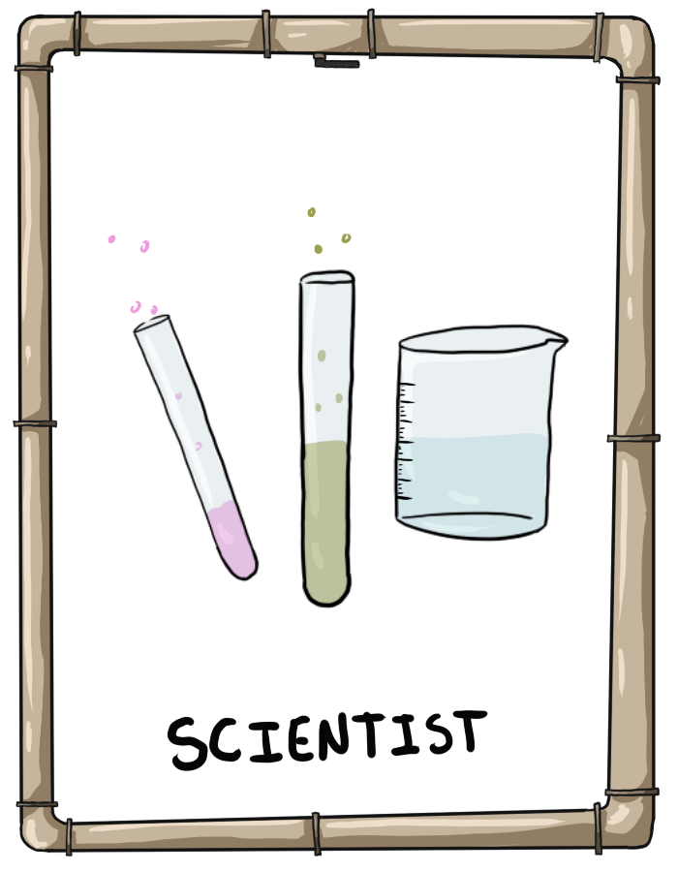
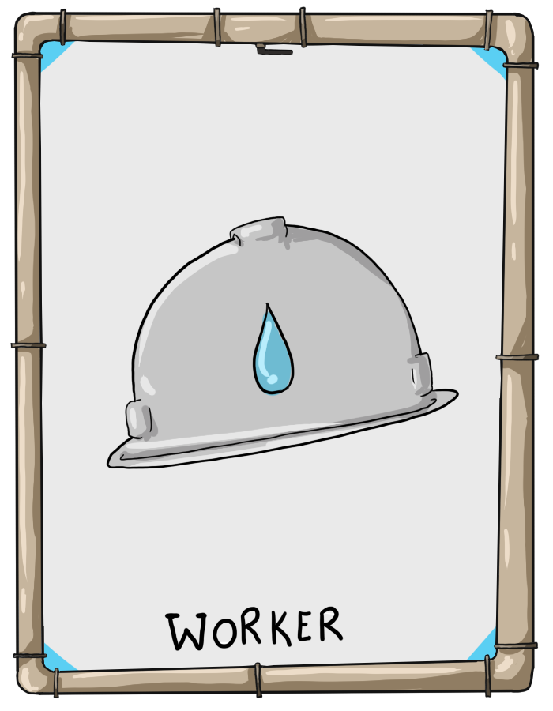


Cards
Worker and Scientist Cards:
Players can sell pipes for workers and eventually sell 2 workers for 1 scientist on their turn.
You obtain these to build water towers and filtration centers to gain more dominance/points

Slide 8
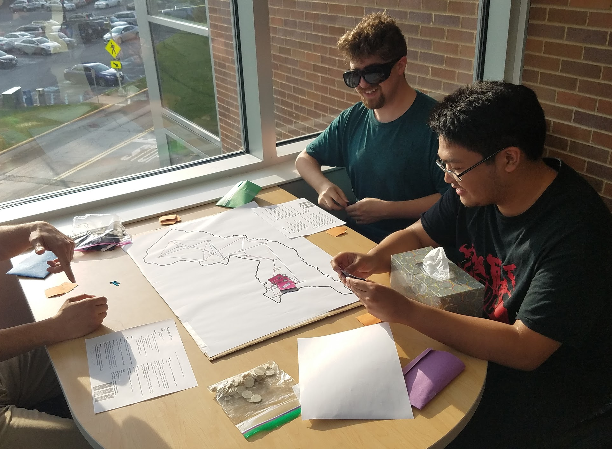
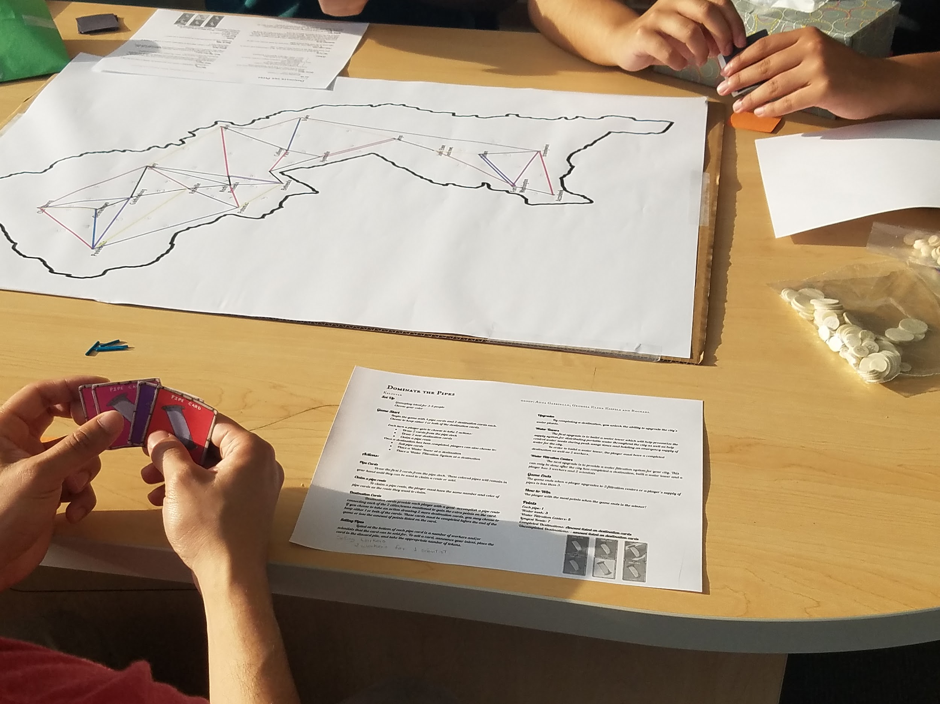
GamePlay

Slide 9
Changes
Made more reachable/possible destinations
Which player starts the game
Added selling workers section in rules
  Sell 2 workers for a scientist
Action Cards:
  Attack and defense cards, example:
    Employee poaching - steal other player’s worker
    Zinc-Coated Ductile Iron Pipe - prevent rusty pipes (can only be used once)
Changed pink pipe lines to green

Slide 10
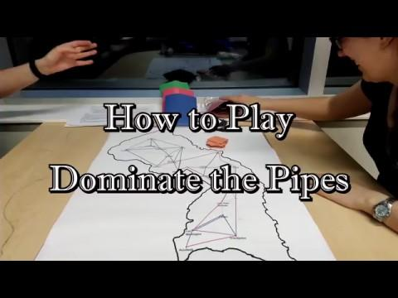
Video

