Slide 1
Suffragists vs. Room
Anna Gabrielle, Rachael, Jennifer, Alex, Gio, Shawn

Slide 2
Description
You, the players, are an apprentice lawyer. Your mentor, Edward Davis, has been working hard--day and night-- on his latest project, no real surprise there-- Mr. Davis is known for getting into his work. But lately, Mr. Davis has been showing some strange behaviors-- he has been growing more erratic, more paranoid, more... strange.
One day you come in to work and he is gone. The only thing remaining is a strange video telling you about his latest project and the need for this project to be completed-- the need for you to complete this project. It is now your job to put together the clues, find the hidden pieces of the Presidential Speech to the Senate, and begin to change the foundation of the United States, giving women the right to vote.
This game celebrates the 100th anniversary of the 19th Amendment-- the right for women to vote. Players are presented with various puzzles and educational materials that allow for a fun, interactive, learning experience for groups of 6 players, ages 13+.

Slide 3
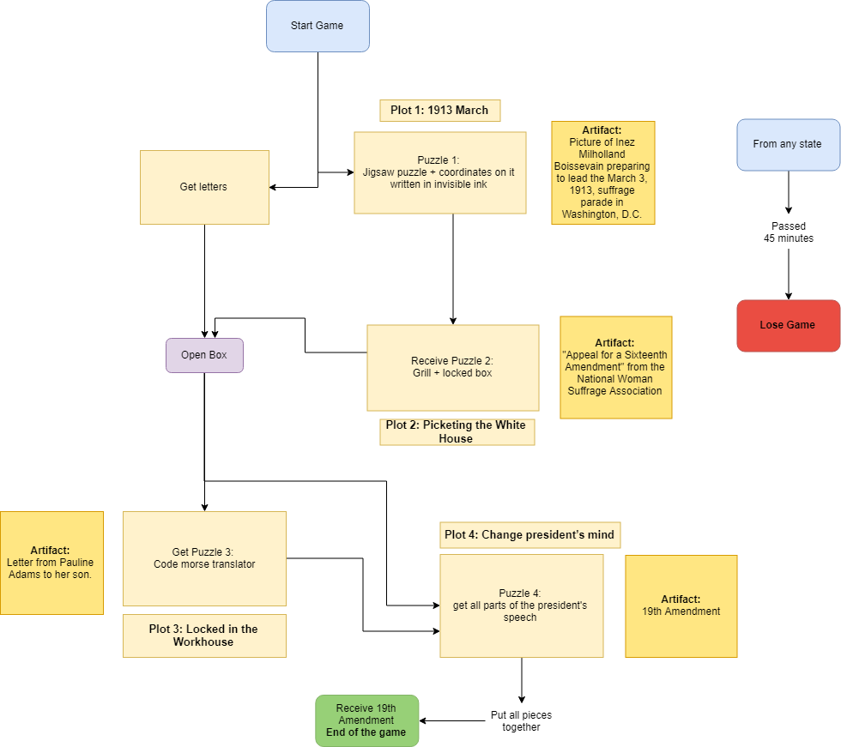
FlowChart

Slide 4
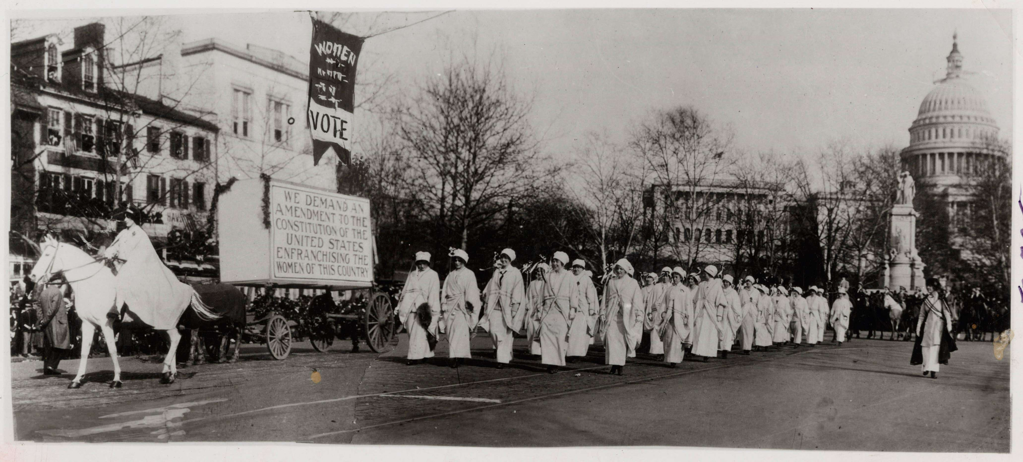
1913 March
Artifact:

Slide 5
Puzzle 1
Jigsaw puzzle with coordinates in invisible ink

Slide 6
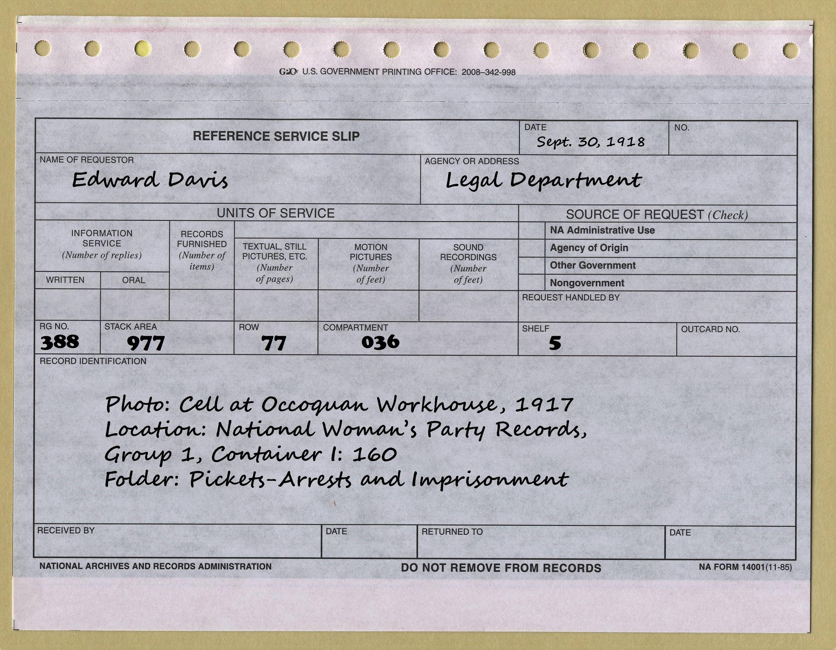
Puzzle 1
Fill out parts of archive slip with the coordinates to give to the Archivist
Outcome: Locked box, documents and grill

Slide 7
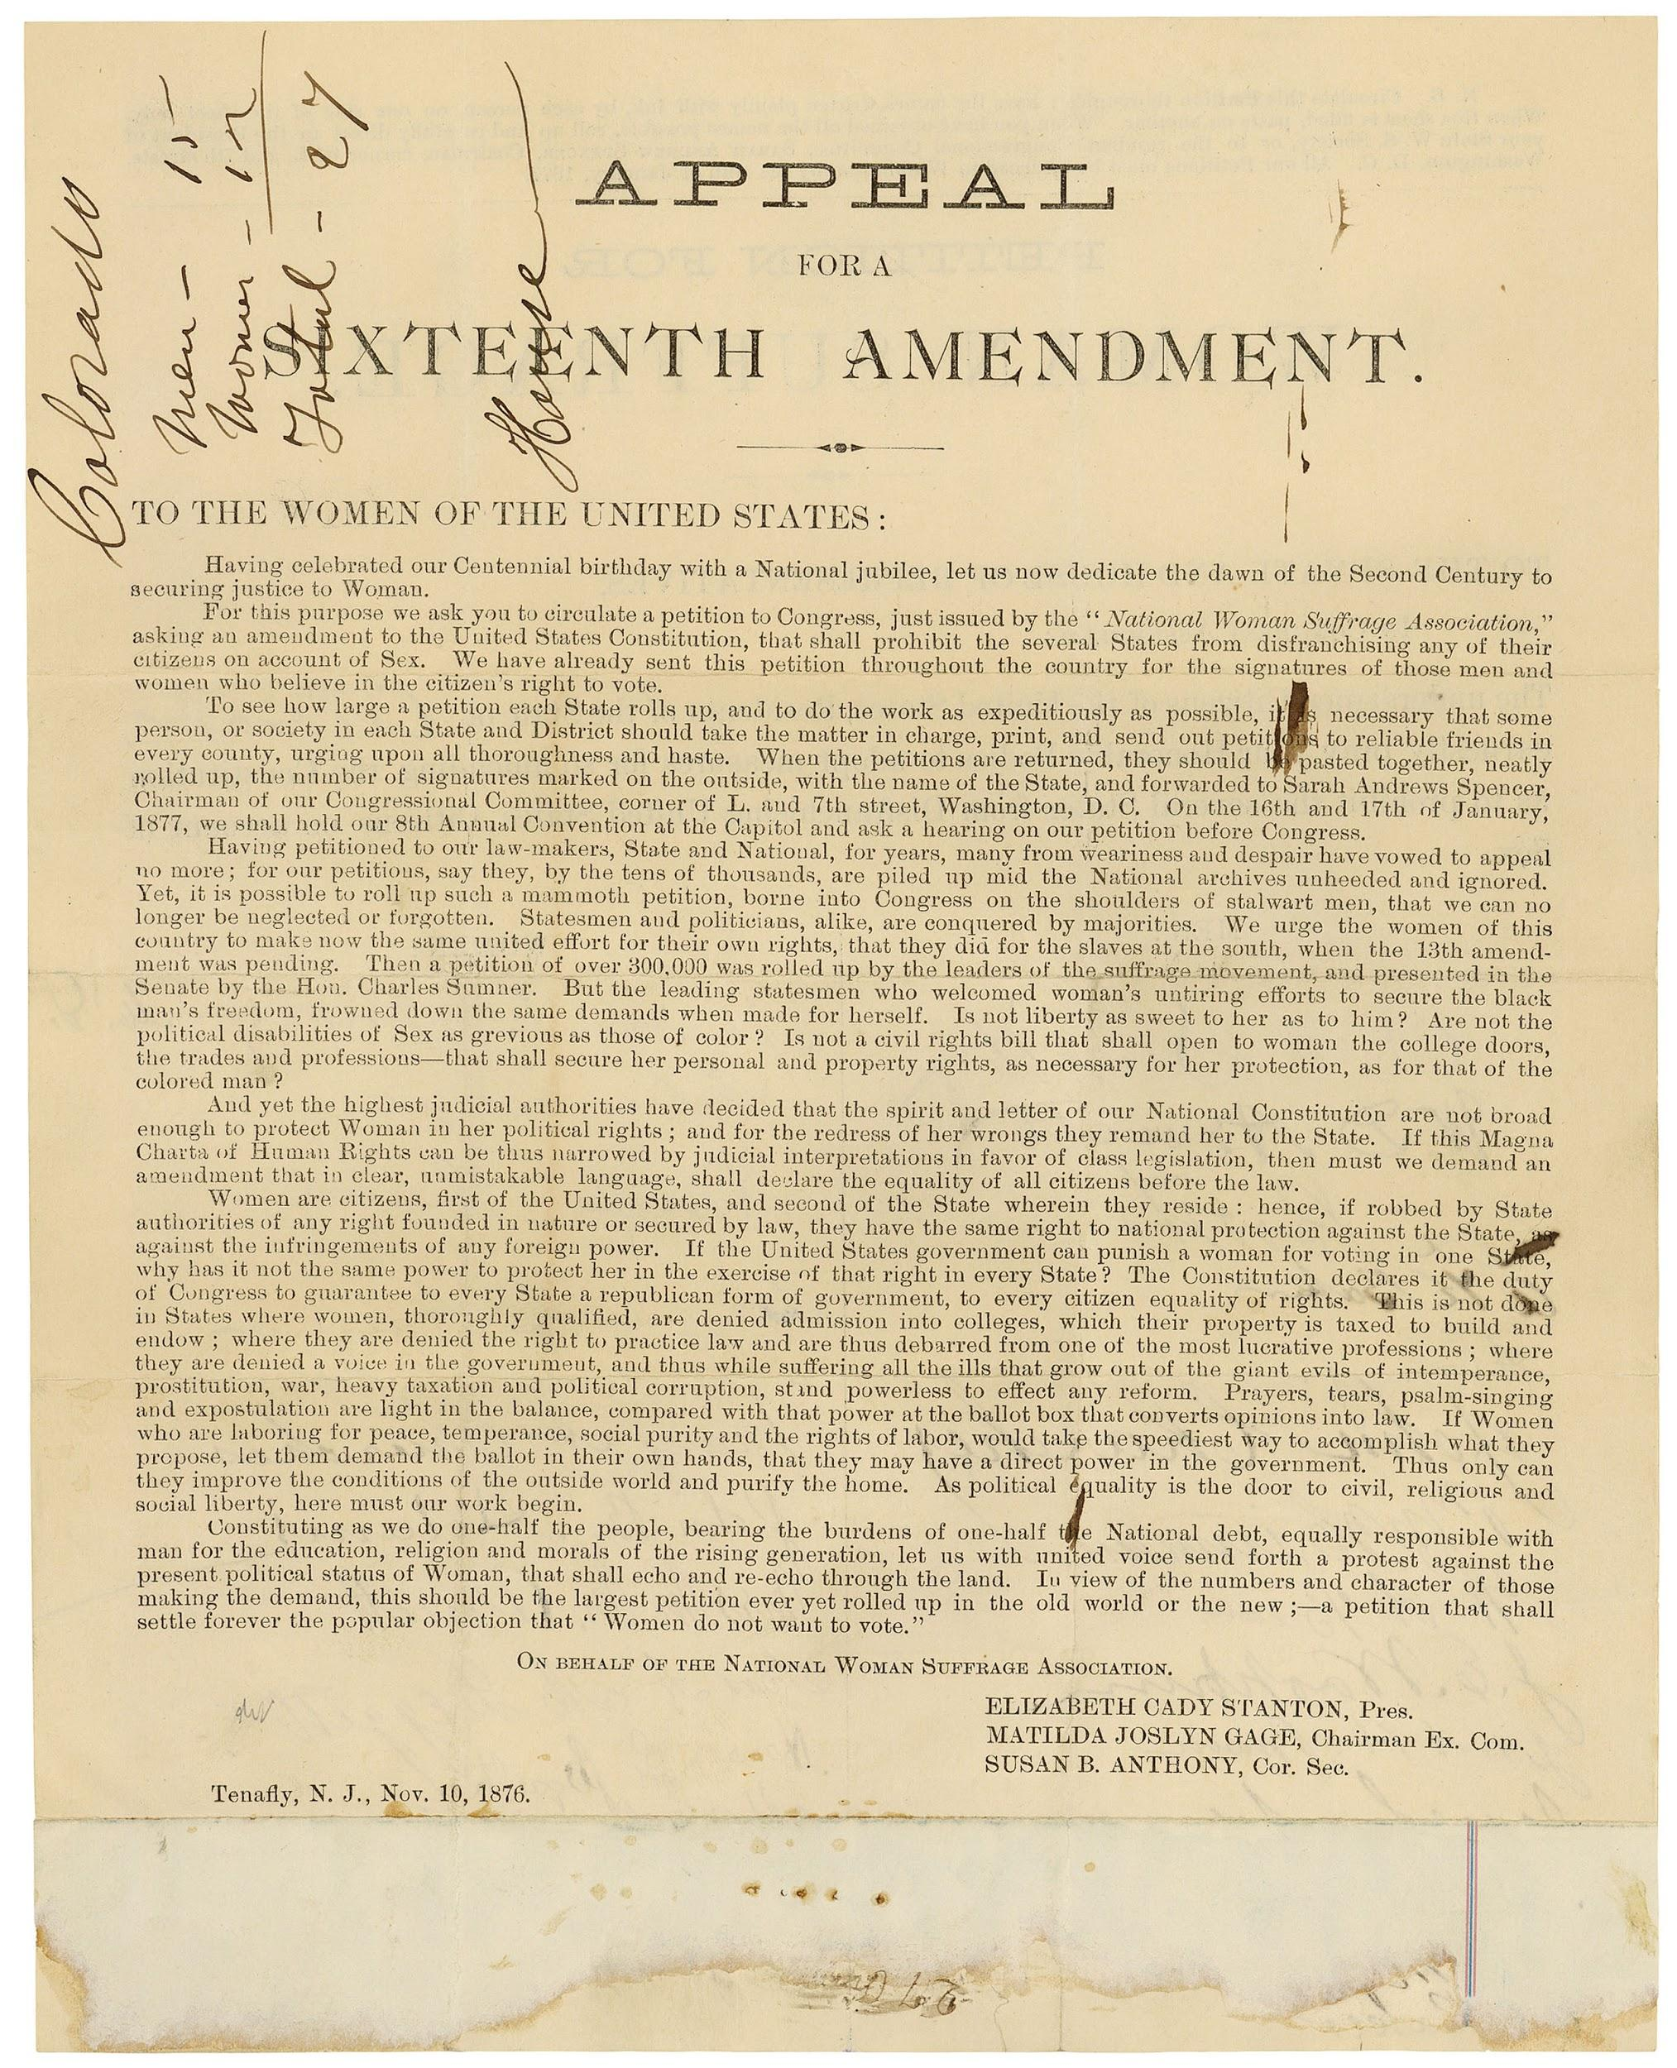
Picketing the White House
Artifact:

Slide 8
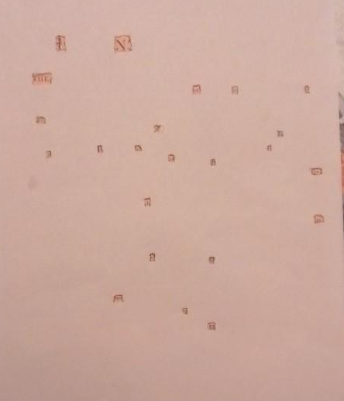
Puzzle 2
Use grill on the Appeal to find the message:
“In the letter to Walter, find the date we move.”

Slide 9
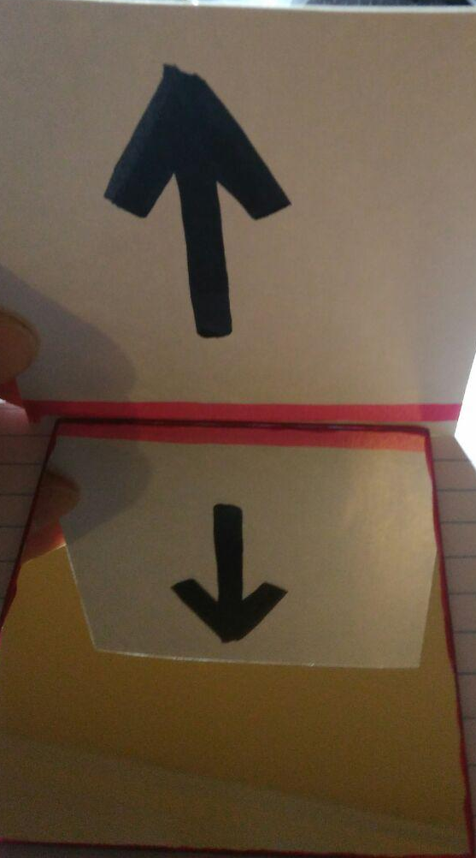
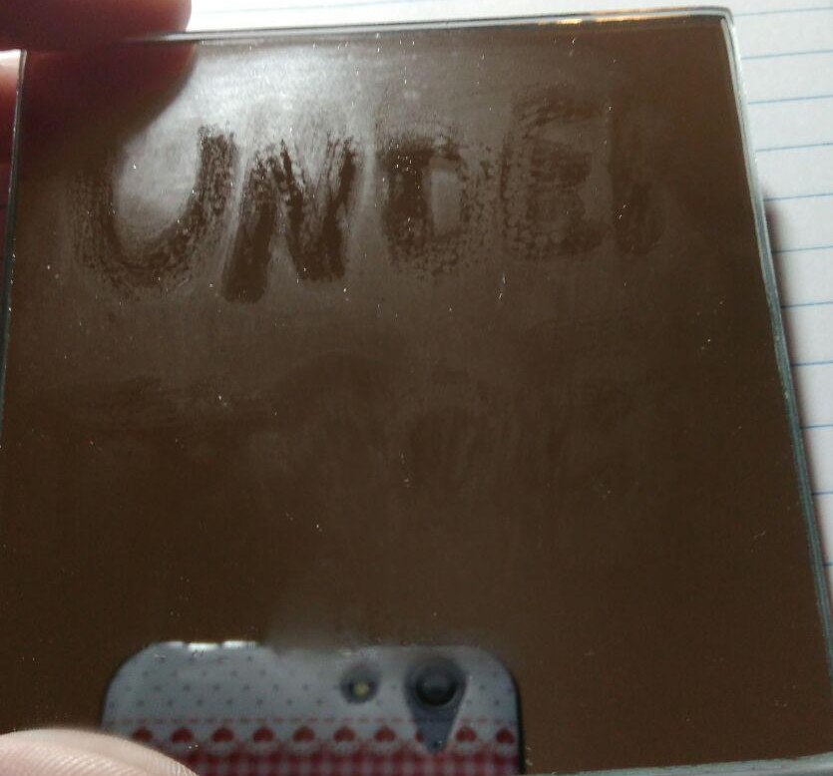
Finding the letters
3 ways to find:
Looking under the table without any hint
Breathing on mirror on the table to find the message: Under Table.
Combining the paper with the arrow with the mirror: pointing under the table.

Slide 10

Puzzle 2
Find the date:
Dec. 1st.
Combination to unlock box: 121
Outcome: Open box, morse code translator and hints

Slide 11
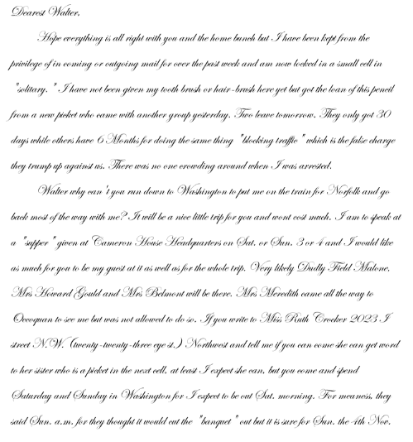
Occoquan Women's Workhouse
Artifact:

Slide 12
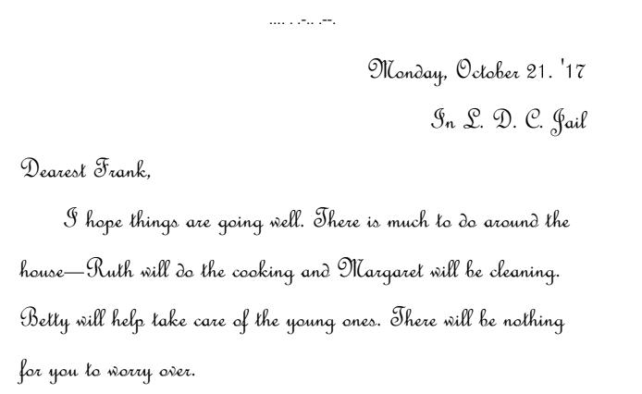
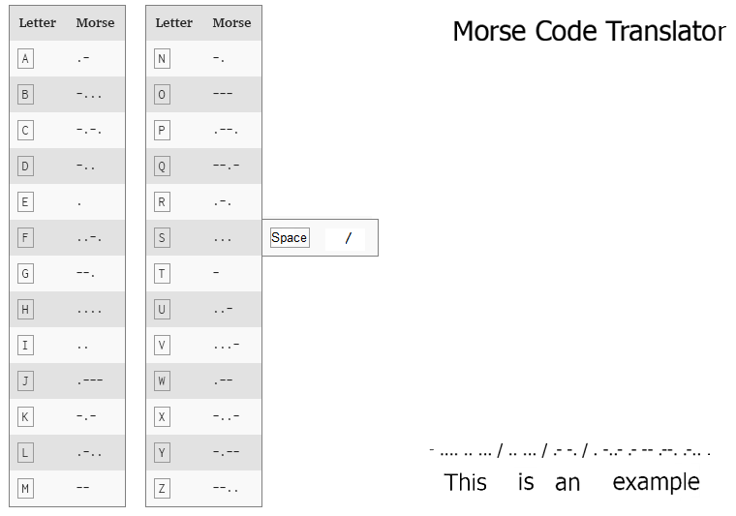
Puzzle 3
Translate morse code found on letters

Slide 13
Puzzle 3
The important messages are:
The person with a tie wants a password
Password I will use my get out of jail free card now

Slide 14
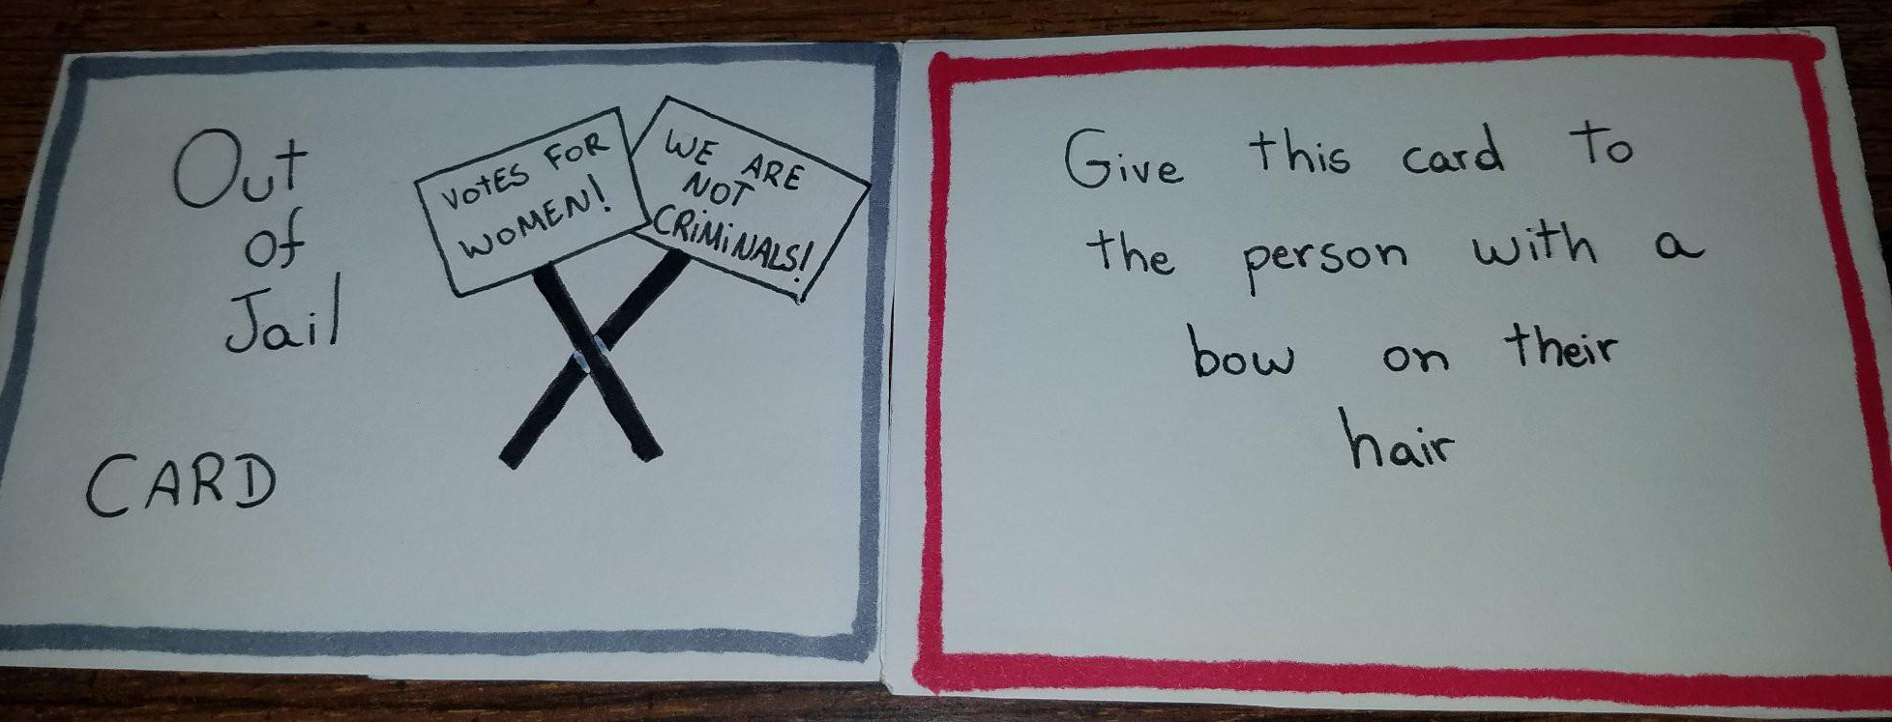
Puzzle 3
Give Password to the specific person, receive card.
Follow instructions on card
Outcome: Hints for puzzle 4

Slide 15
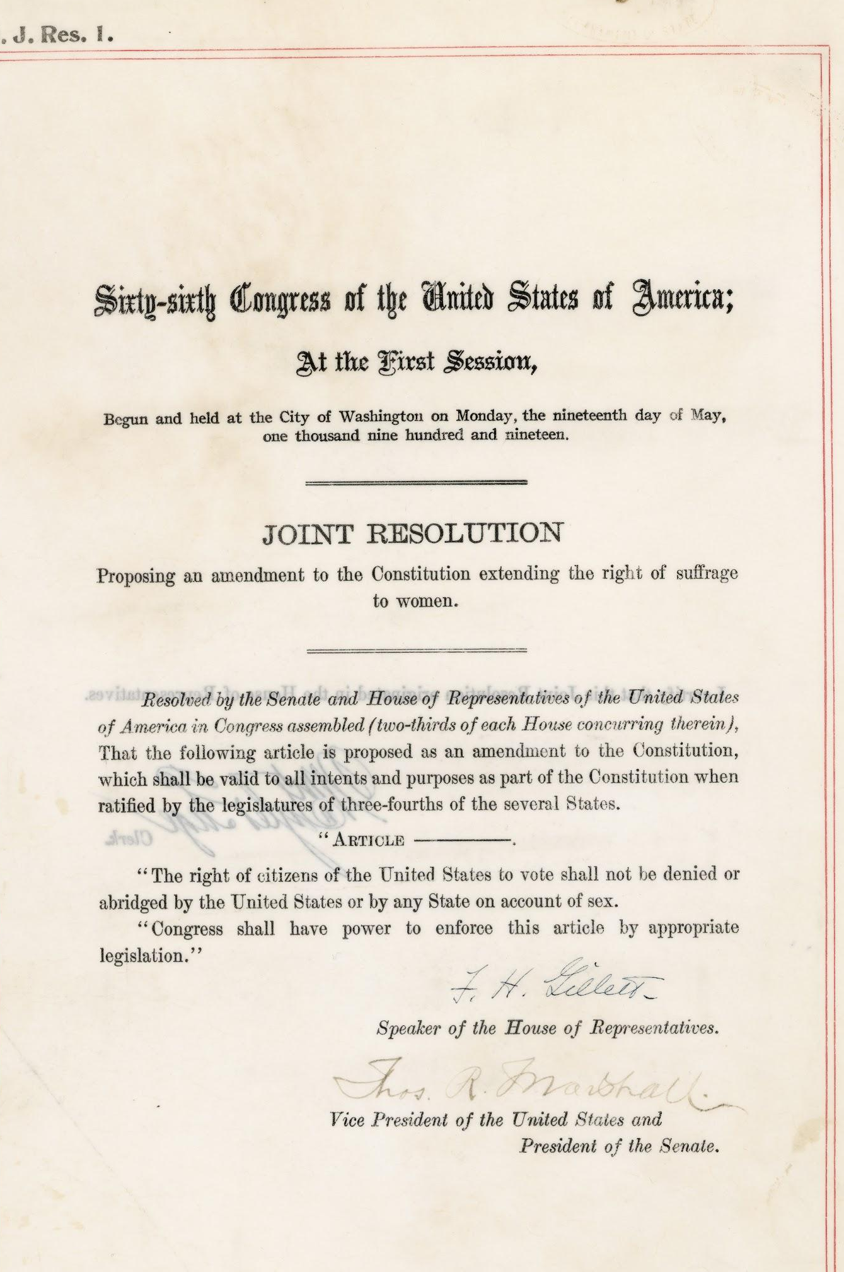
Sept. 30, 1918
President Wilson Addresses the Senate
Artifact:

Slide 16
Puzzle 4
Find all pieces of President Wilson’s speech.
Places:
Under keyboard (Hint as outcome of puzzle 3)
Inside Sculpture of Play-Doh on a shelf (hint inside locked box)
Inside a pen (that is on the table)
Under one chair (riddle inside the box)
Outcome: Receive the 19th Amendment and win the game

Slide 17
Win Condition
Put all pieces of President Wilson’s speech together.
Receive the 19th Amendment!

Slide 18
Lose Condition
Run out of time.

Slide 19
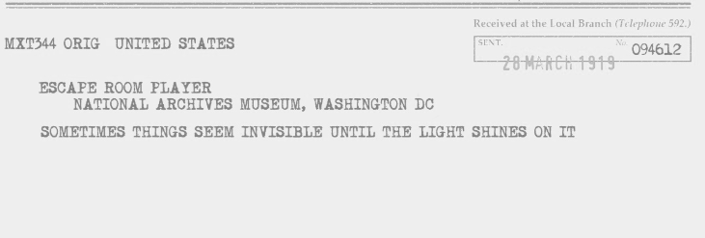
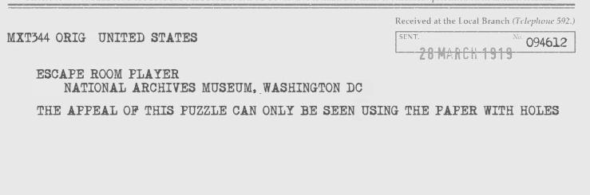
Hints
In form of telegrams

Slide 20

Introduction Video

Slide 21
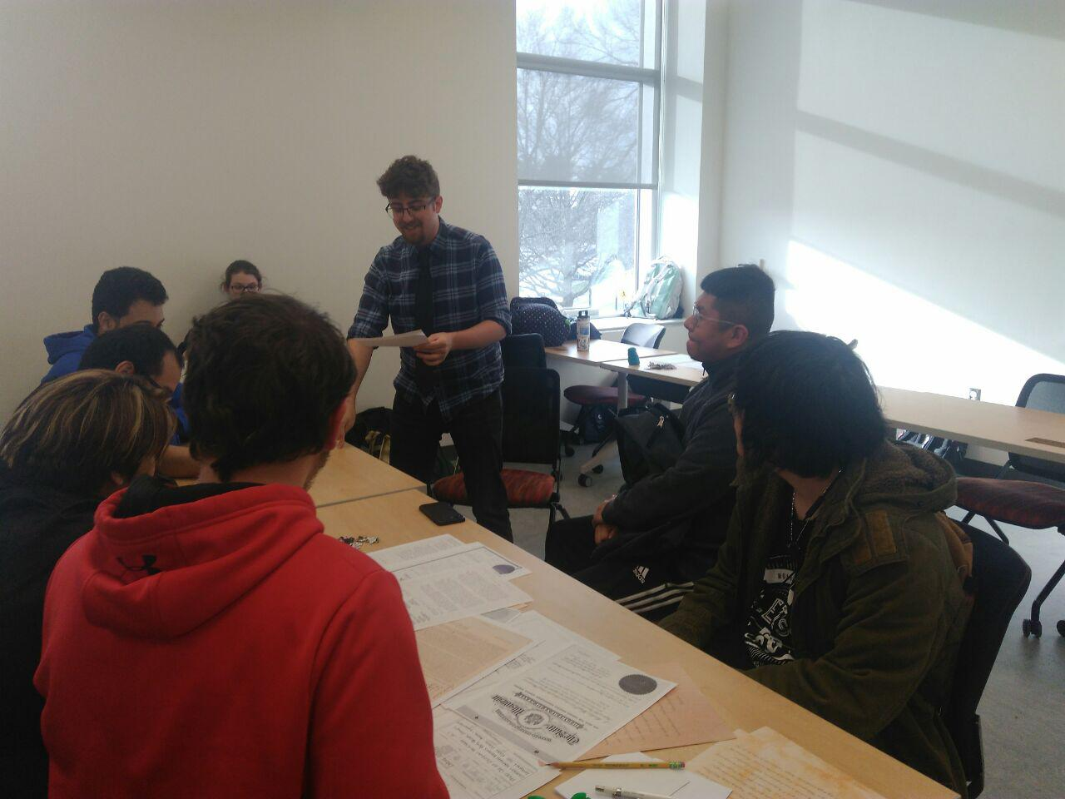
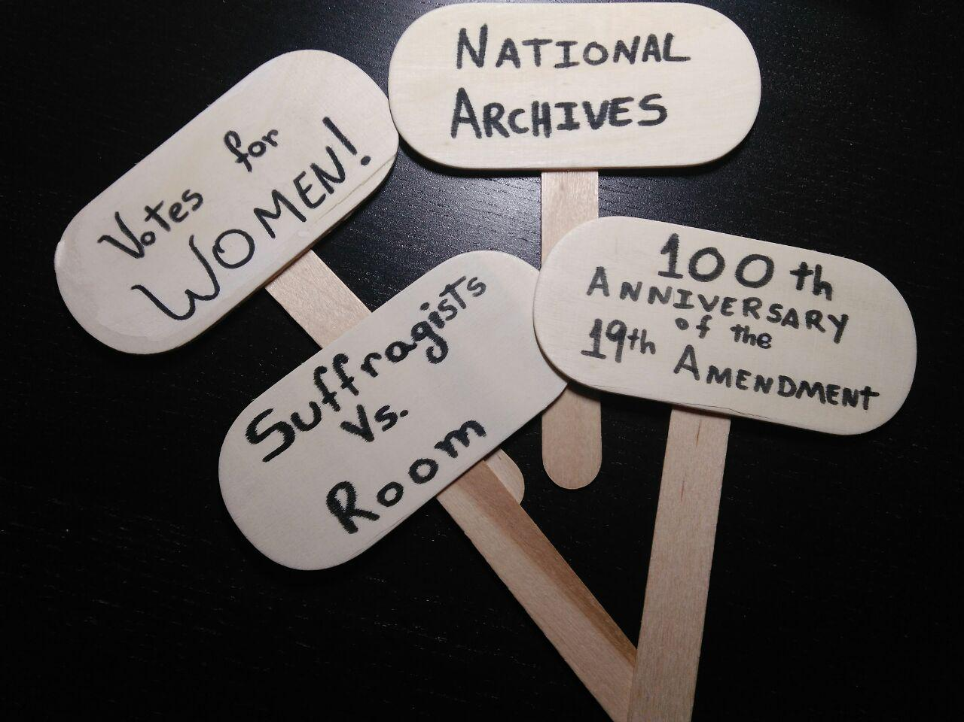

Slide 22
National Archives Materials:
Letter to Edwin Webb from Pauline Adams Urging Passage of the Susan B. Anthony Amendment
https://catalog.archives.gov/id/74884169
Women Marching in Suffrage Parade in Washington, DC (Picture)
https://www.docsteach.org/documents/document/marching-suffrage-parade-dc
"Appeal for a Sixteenth Amendment" from the National Woman Suffrage Association
https://catalog.archives.gov/id/306647
Nineteenth Amendment to the United States Constitution
https://catalog.archives.gov/id/596314
Certificate from the State of Wisconsin Ratifying the 19th Amendment to the Constitution
https://catalog.archives.gov/id/1633882
Newspaper Clippings Sent to Missouri Senator McLean
https://catalog.archives.gov/id/74884381
Minnesota's Ratification of the 19th Amendment
https://catalog.archives.gov/id/595448
Petition from Minnie Fisher Cunningham of the Texas Woman Suffrage Association for Passage of the "Susan B. Anthony Amendment"
https://catalog.archives.gov/id/306659

Slide 23
Other Sources:
Cell at Occoquan Workhouse and Pauline Adams in Prison Garb, Photographs, 1917
https://www.loc.gov/resource/mnwp.160046
Pauline Forstall Colclough Adams Wrote to her son from Prison, October 23, 1917
http://edu.lva.virginia.gov/online_classroom/shaping_the_constitution/doc/letter?_ga=2.44186336.575798124.1553555110-1862929153.1553555110
International Morse Code
https://morsecode.scphillips.com/morse2.html
Woodrow Wilson Papers: Series 7: Speeches, Writings, and Academic Material, 1873-1923; Subseries B: Messages to Congress, 1913-1921; 1918, Sept. 30-1921, Mar. 3
https://www.loc.gov/item/mss4602900770/

