Slide 1
Monkey See, Monkey Do!
Jennifer Otzoy
Rachael Kalinyak
Giovanni Saravia

Slide 2
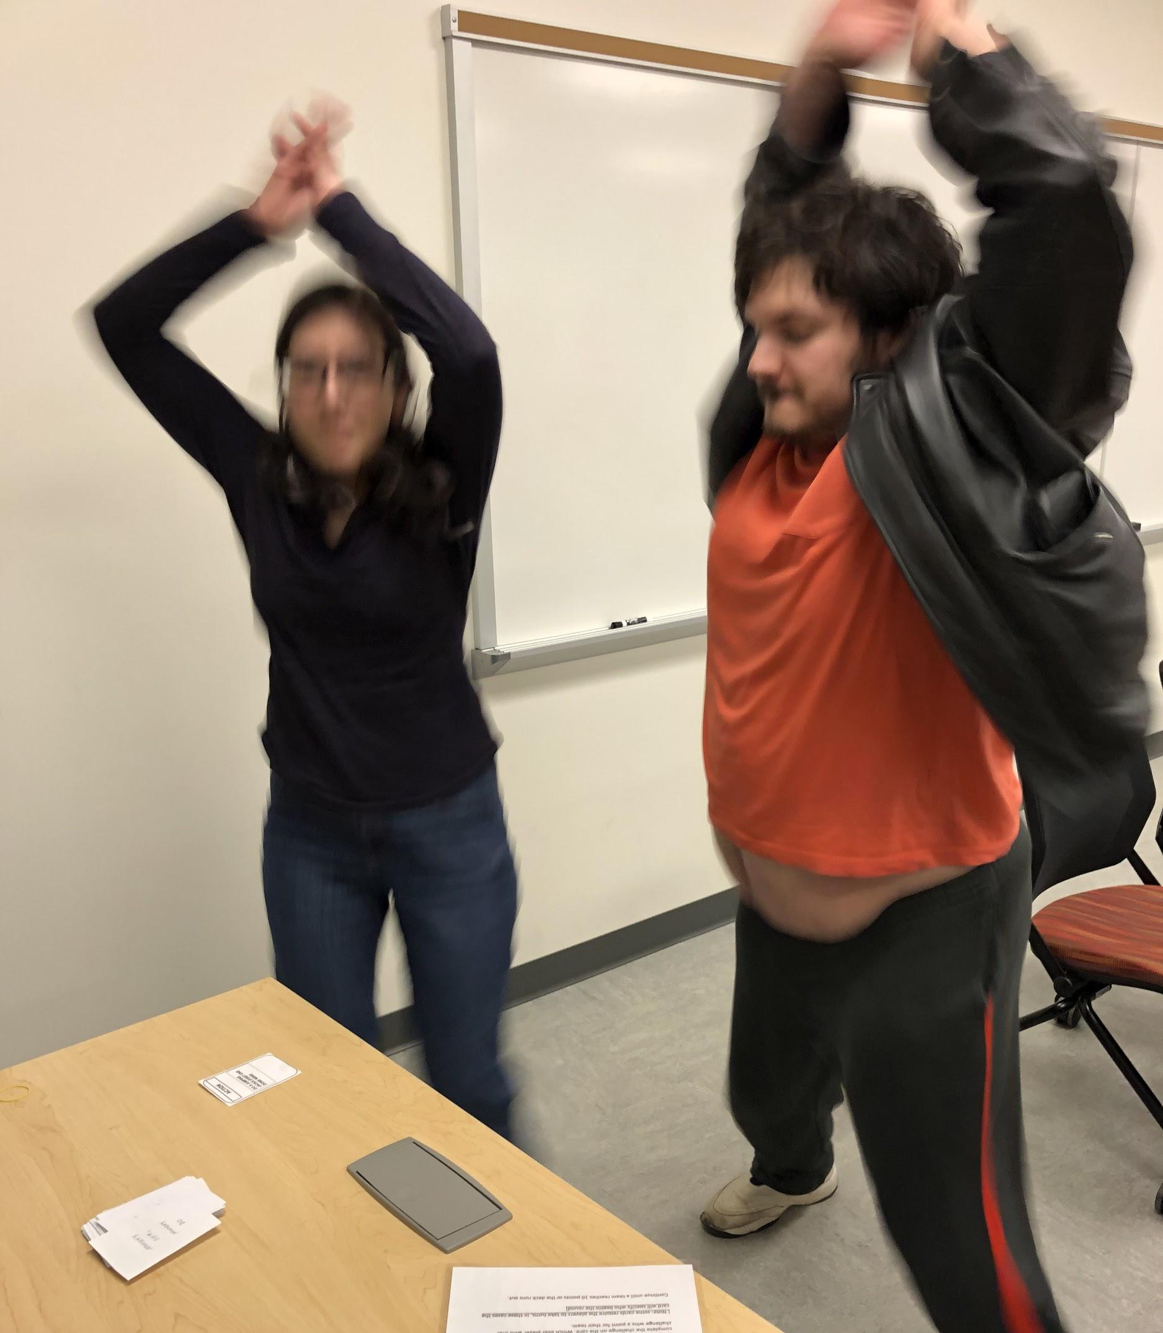
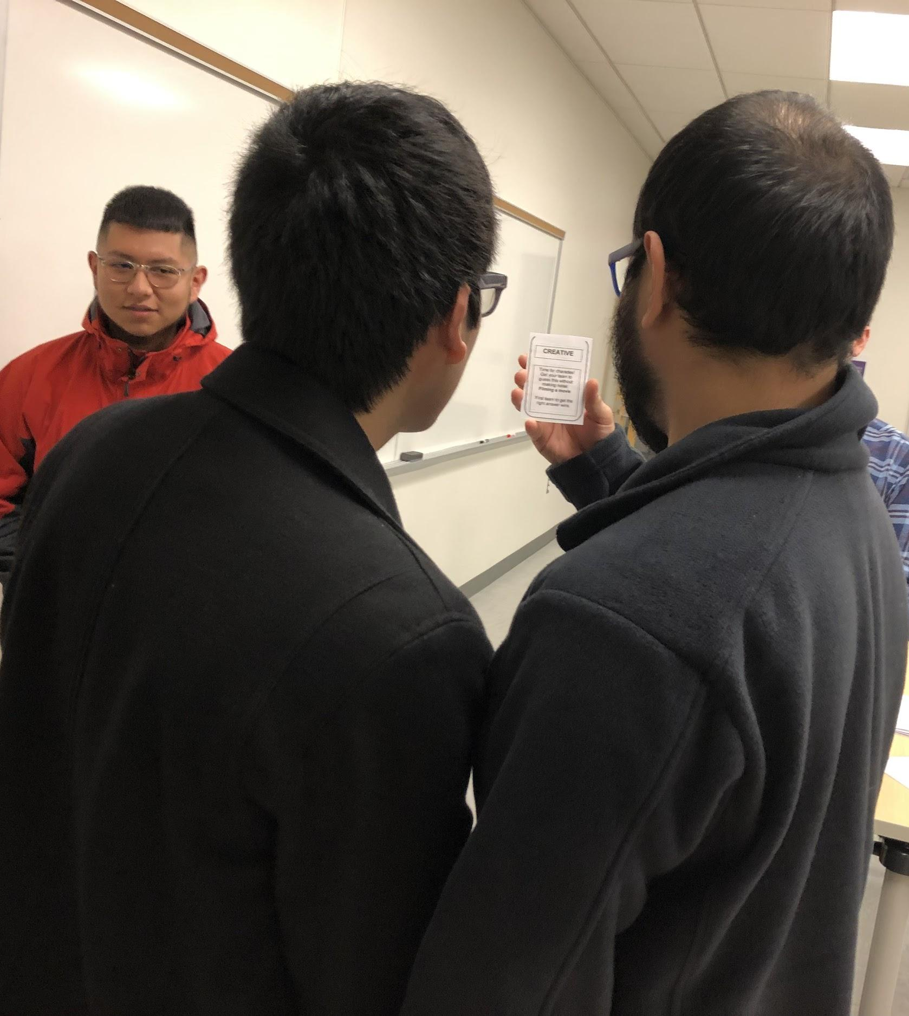
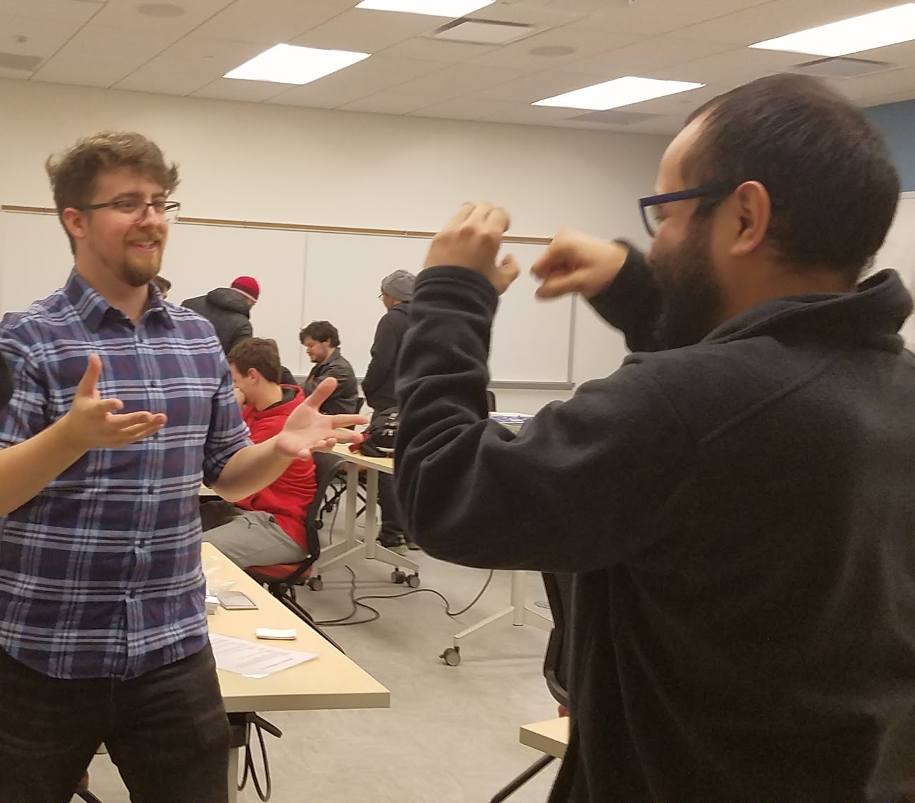
Description
Get ready to pump up your heart rate, get those neurons firing, and those creative skills flowing with “Monkey See, Monkey Do.”
Each card gives a new challenge providing the perfect solution to those awful introductions and awkward meetings.
For ages 10 and up!

Slide 3
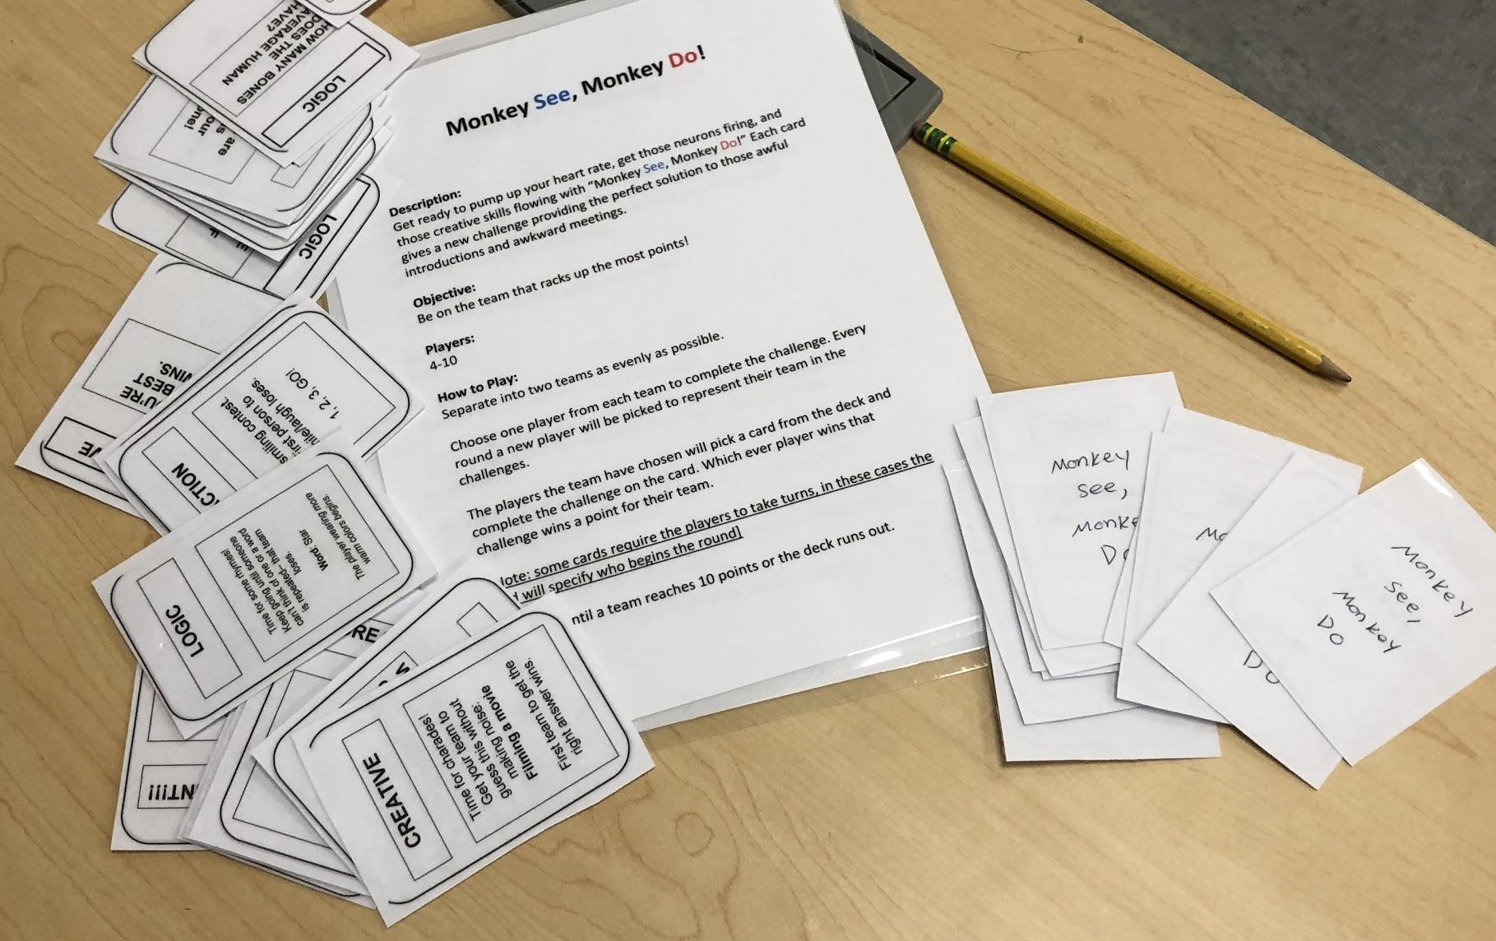
Summary of Rules
Separate into two teams as evenly as possible.
Choose one player from each team to complete the challenge.
Flip over the card and GO!
Continue until a team reaches 10 points or the deck runs out.
Be on the team with the most points to win!

Slide 4

How to Play Video

