Slide 1
CALL Course Planning - Needs Analysis
Presenter: Humaira Jamshed

Slide 2
CALL Course Development and Implementation
On-line University is planning to offer a M.A ELT degree program.
Plan to develop and execute the CALL course as an integral module course of this degree program
Points highlighting the analysis of anticipated needs and necessities related to Course, Teacher, Student and Institution

Slide 3

COURSE CONTENT

Slide 4
Institutional Expectations and Parameters
Determined Factors
Undetermined Factors
Part of Regular Curriculum- ELT
Multiple campuses(University campuses all around the country)
Cohorts- Course team fellows
Independent study
Strength: 900 students
In which semester it will be offered?
Conducted and handled by one teacher or different instructors?

Slide 5
What kinds and amount of institutional support will I have?
Who will be my go-to people?
Determined Factors
Undetermined Factors
Top-down and bottom-up
University funding
In- campus training
IT support
Student support
Exact amount of funding
Out-campus training
In-house faculty or outsourcing will be needed

Slide 6
Will I be expected to let others teach the course you have developed? What is my timeline? When do I plan to start teaching this course?
Determined Factors
Undetermined Factors
Both cases, I may teach or let others to teach the course
3 months
Spring 2019 semester
How much support will be provided by Finance department?
Delay can occur

Slide 7
What learning management system or medium will be used?
Available technology resources for students and teacher.
Determined Factors
Undetermined Factors
Online University’s own LMS will be delivery mode
MS office
LMS
Adobe
Skype
Team viewer
Face to face sessions can also be expected
Other technology resources can be expected to be implemented by the university

Slide 8
What do I already perceive as institutional limitations? Where do I need help or other technology options beyond what my institution offers?
Determined Factors
Undetermined Factors
Time crunch
No video lecture recording just audio lectures recordings
Camtasia studio 8 technology option is available
Other technology option can be offered by university

Slide 9
What is expected of the teacher?
What is the length of the course
Determined Factors
Undetermined Factors
Student: 900
16 classes in semester
Student-teacher hours: 40 per week
Office: 8 hours
Homework: no
Correction/grading : 12 hours
1 semester length
Contact with parents

Slide 10

Learners

Slide 11
Who will be our online students?
Where & when will the learners engage in their learning?
Determined Factors
Undetermined Factors
Age: 18-80 years
Access to tech & support: yes
Campus, Off campus, home and all other conditions for engagement in learning will be expected
Level of language competency
Proficiency of technology usage
Learning autonomy

Slide 12
What learner needs should we anticipate?
Why are students taking our course?
Determined Factors
Undetermined Factors
Technology access and support needs
Its module course of M.A ELT degree program
They know that they don’t have to meet regularly
Aware of due dates and deadlines
ADA compliance and special needs

Slide 13

Content

Slide 14
What content will be covered?
Will the online program keep its students segregated from ‘regular’ language courses?
Determined Factors
Undetermined Factors
English Language Teaching
High proficiency
No segregation from regular language courses
In which semester it will be offered?

Slide 15
Will the selection of materials (textbooks, online resources) be outside of my course control? How do I see integrating the four skills and culture? How will I integrate the 5 Cs?
Determined Factors
Undetermined Factors
Selection of material in control in form of:
Handouts
Audio lectures
Additional books
Recommended books
4 skills will be integrated
Course content and activities will integrate 5 Cs

Slide 16

Delivery Format

Slide 17
What do you need to consider before you think about how you will deliver your course? How will you deliver your course? (Synchronous, Asynchronous, Hybrid)
Determined Factors
Undetermined Factors
Online Asynchronous audio lectures and handouts
Hybrid can be considered, if needed

Slide 18
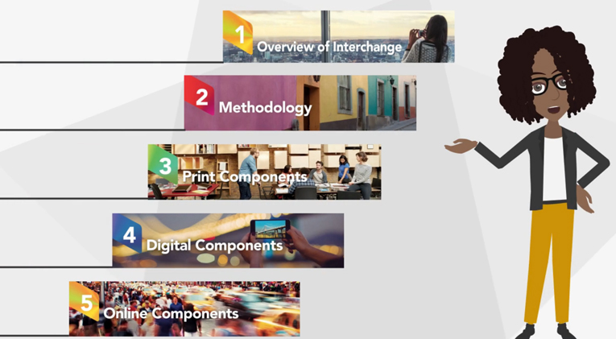
Institutional Support and Professional Development and Preparation to Teach Online

Slide 19
What does your institution require (or recommend) to ensure quality online/hybrid courses?
What kind of review is required before the course goes live?
Is there any sort of guideline or checklist for a quality online/hybrid course?
Continuous professional training
QA committee review of course
ELT experts and HOD review the course before going live
Audio lectures and course content quality check
Department support the online teachers and courses

Slide 20
What can I do if I have no institutional support?
What other resources can I turn to for support?
Can I find classes or certificates that are offered online that I can take? (are they free or not?)
Will do my personal research and use personal resources
Online net
HEC digital library
British Council offered courses with fee
AE Resources, BBC and VOA resources for ELT (Free)

Slide 21
Thank You

