Slide 1



INTEGRATED EMPLOYABILITY SKILL DEVELOPMENT PROGRAM

Slide 2

Assessment
Psychometric
Job-Fit
Training
Technologies
Personality
Industry Interface
Career Development
Placement Assistance
Internship
Profiling & Promotion
Industry Overview
Placement Assistance
Self Development
Inborn Talent
Career Planning
Continued Professional development
On the Job Training
Project Assistance
For unemployed/Studying Engg/Mngt/Dip/Gen Grads/PGs/Others
Stand out from the Rest
make your Career Best
Integrated Employability Skills Development
Most Comprehensive Finishing School Concept
Financial
Support

Slide 3
Composition
Industry-Institution-Interface
Personality Development
Employability Gaps
Skills & Competencies, Hard Skills & Soft Skills
College to Corporate – change management
Intra-Personal Skills
Interpersonal Skills
Time Management
Communication Skills
Presentation Skills
Self-Grooming
Stress Management
Etiquettes
Communication
Aptitude
Corporate selection process
Written Tests, Group Discussion, Interview Skills
SWOT Analysis
Competency based Goal Setting
Higher Studies/ Entrepreneurship Counseling
Career Planning
Resume & Covering Letters Skills
Job Hunting Techniques
Social Media presence & Personal Branding
Counseling & Guidance
Internship Assistance
Inborn Potential Assessment
Project Guidance
Center of Excllence
Industry oriented Remote Virtual Courses
On-Job Training
Industry Interface
Guest Lectures
Career Planning
Skill Assessment
Personality Assessment
Inborn Potential Assessment
Employability Competencies Assessment
Technical Skills
Industrial Automation & Process Control
IoT & IIoT
EPC
Field Instrumentation
Embedded Systems
Mechatronics & Robotics
/RPA
BMS
CAD / HVAC
Structural & Construction Engineering
Oracle / Julia
Software Testing
Mobile Technology.
RFID/Barcode Technologies
Cyber-Security
Reliability Engineering
Mechanical Design Engineering
Data Science & AI, ML
MEP HVAC
MATLAB
Advace LABView
ESD, ETAP & Dialux
CNC Programming & Operation
Piping Design
Robotics & Embedded

Slide 4
The Plan & Purpose
To understand and learn all the Soft Skills
College to Corporate – change management
Competency based Goal Settings & Career Plans
Counseling & Guidance
Skill Assessment
Technical Training
To understand your own Personality, Multiple Intelligences, Strengths, weaknesses
Industry Interface
Higher Studies/ Entrepreneurship / Family Business Guidance
Personality Development
Career Planning
To understand the Skills up gradation needs and areas
To project the above in a Documented format to the recruiters
To get identified by the prospective Companies as a Candidate
To know your actual inclination and Potential and suitable field of Work
To stand out in the mass
To understand how to apply the knowledge
To be in the competition with others
To upgrade Technical Skills
Practical aspects of the Knowledge
To learn and improve your Personality and Attitude
To learn how to learn
To be ready to deal Emotional and People aspect of the Job
Upgrading Presentability of yourself and your Candidature
To gain any additional Professional Value added Qualifications & Skills
To understand the Jobs landscape and situations and how to be ready for it
All aspects of Job hunting & getting placed - Resume preparation, GD, Interview Skills , Self Branding
Live Industry Projects & Problems
Industry Internship for Talent mapping & matching
Industry and Landscape information
Apprentice/ Placement Assistance
OJT for complete knowledge and practice to become more Employable
Early Industry atmosphere exposure to Candidate

Slide 5
Program Road Map – Crash Plan
On-Campus during Course
Off-Campus after Course
Personality Assessment
Personality Development
Career Planning
Placement Assistance
Technical Assessment
Project Assistance
Technical Training
On the Job Training
4th Year

Slide 6
Program Road Map – Integrated Plan
On-Campus during Course
Off-Campus after Course
Personality Assessment
Personality Development
Personality Development
Personality Assessment
Technical Assessment
Technical Assessment
Internship
Career Planning
Technical Training
Placement Assistance
Project Assistance
Technical Training
Technical Training
On the Job Training
2nd Year
3nd Year
4th Year

Slide 7
Execution Plan – Crash Plan
Technical Training – 55 hours
Personality Development – 20 hours
Project Assistance – 40 hours
Career Planning – 30 hours
Higher/Abroad Education Guidance
Placement Assistance
Assessment – 2 hours
Total Hours - 380
Technical – 155
Personality Development – 40
Internship – 120
Career Planning – 30
Project Assistance – 40
Assessment – 15
Practical/Hands-on
At Campus Labs &
Our Centers at RJNGR/JNGR/BSK/JPNGR/MYSURU/PEENYA/TUMKUR

Slide 8
Execution Plan – Integrated Plan
2nd Year
Assessment – 2 hours
3rd Year
Technical Training-Section-2 – 60 hours
Technical Training Section-3 – 80 hours
Technical Training-Section-1 – 20 hours
Personality Development-Section-1 – 20 hours
Internship – 30 Days
4th Year/ After Completion
Personality Development Section-2 – 20 hours
Project Assistance
Career Planning – 40 hours
Assessment – 3 hours
Higher/Abroad Education Guidance
Placement Assistance
Personality Development – 20 hours
Total Hours 435(615)
Technical – 180 (360 hours for Placement Candidates)
Personality Development – 40
Internship – 120
Career Planning – 40
Project Assistance – 40
Assessment – 15
Practical/Hands-on
At Campus Labs &
Our Centers at RJNGR/JNGR/BSK/JPNGR/MYSURU/PEENYA/TUMKUR

Slide 9
Financial Plan
SL | PROGRAM | DURATION | SCHEDULE | BATCH MIN-MAX | INVESTMENT | REMARKS
 | FINAL YEAR & SHORT TERM
1 | Assessment Services | 2 hours
2 | Personality Development | 40 hours
3 | Career Planning | 40 hours
4 | Technical Skill Development | 120 hours
5 | Internship | 120 hours
6 | Project Assistance | 40 hours
7 | On the Job Training | 3 months
8 | Virtual Skill Development
 | LONG TERM (2ND TO 4TH YEAR)
1 | Assessment Services | 2 hours
2 | Personality Development | 40 hours
3 | Career Planning | 40 hours
4 | Technical Skill Development | 180 hours
4A | Technical Skill Development (with Placement) | 360 hours
5 | Internship | 120 hours
6 | Project Assistance | 40 hours
7 | On the Job Training | 3 months
8 | Assessment Services | 2 hours
9 | Placement Assistance
10 | Virtual Skill Development
 | Note :
 | A. GST, Logistic Expenses for Staff and Faculty towards Working lunch & Tea and Transport/Conveyance as applicable are addition to the quited Charges.
 | B. Venue and Laboratory arrangements by Institution.
 | C. Payment Terms:
 | D.Institution to take lead in collection of Fee from Students.
 | E. Payment Mode : Online Bank Transfer only

Slide 10
Financial Plan – Long Term
Assessment
Technical Training
Rs
Personality Training
Career Planning
Rs
Rs
Rs
Placement Assistance
Rs
Internship
Rs
Project Assistance
Rs
OJT
Rs
Virtual Skill Development
Rs
Additional
GST @ 18%
Logistics for Staff & Faculty
Venue arrangements
20% of the estimated net amount along with Order towards mobilization
50% of the estimated net amount before the start of the Program
30%of the estimated amount + Taxes before the end of the Program
Each year execution is considered as independent PO
Payment Terms
Payment through On-line Bank Transfers only
Others
The Deal is B2B between Institution & ACTS (representing the consortia of it’s Partners)
Institution to take lead in Collection of Fee from Students where it is applicable.
All the Venue & laboratory arrangements is in the scope of the Institution
Institution to provide Working Lunch and Tea and Conveyance (where ever applicable) to ACTS Staff and Faculties.
ACTS may require some safe custody Storage space within the Campus.

Slide 11
Financial Plan – Short Term (Final Year /Completed)
Assessment
Technical Training
Rs
Personality Training
Career Planning
Rs
Rs
Rs
Placement Assistance
Virtual Skill development
Rs
Project Assistance
Rs
OJT
Rs
Rs
Additional
GST @ 18%
Logistics for Staff & Faculty
Venue & Laboratory arrangements
20% of the estimated net amount along with Order towards mobilization
50% of the estimated net amount before the start of the Program
30%of the estimated amount + Taxes before the end of the Program Payment through On-line Bank Transfers only
Payment Terms
Others
The Deal is B2B between Institution & ACTS (representing the consortia of it’s Partners)
Institution to take lead in Collection of Fee from Students where it is applicable.
All the Venue & laboratory arrangements is in the scope of the Institution
Institution to provide Working Lunch and Tea and Conveyance (where ever applicable) to ACTS Staff and Faculties.

Slide 12
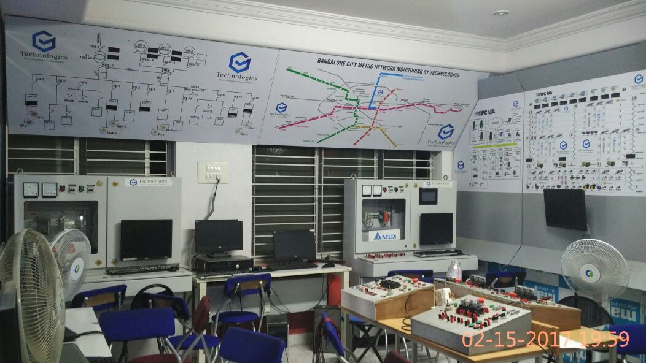
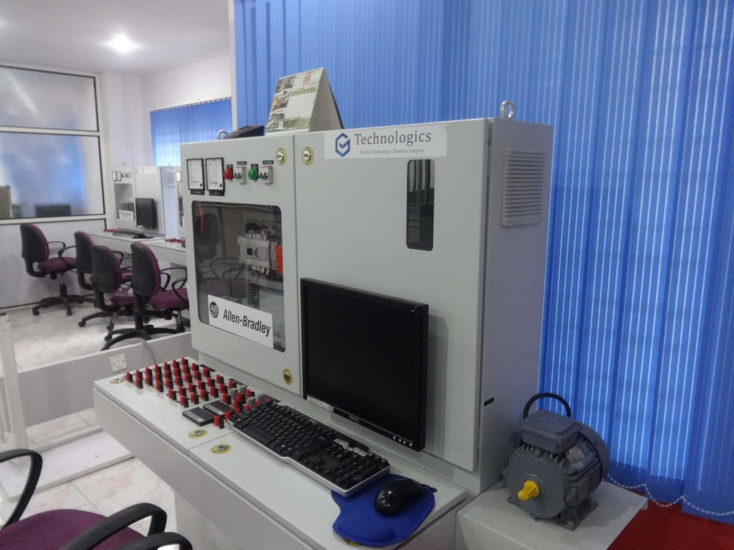

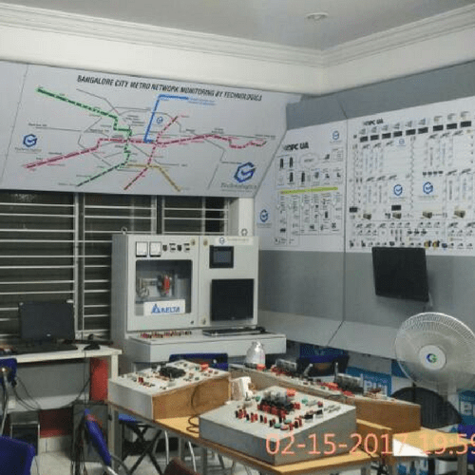
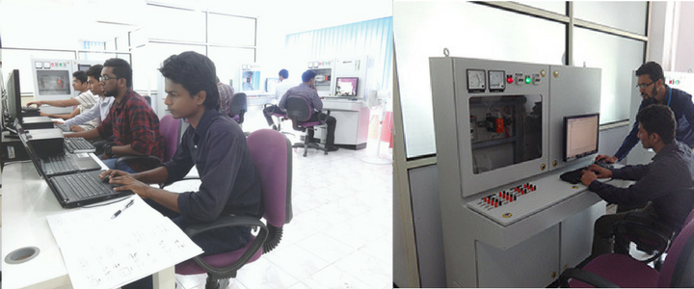

Slide 13
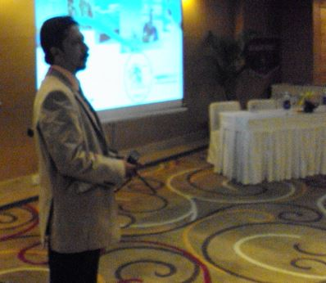
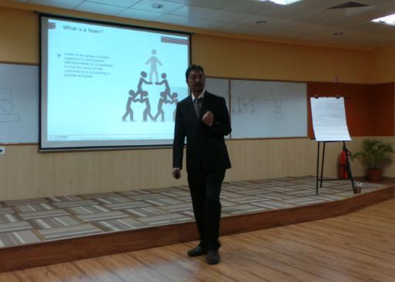
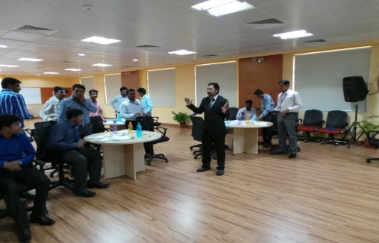
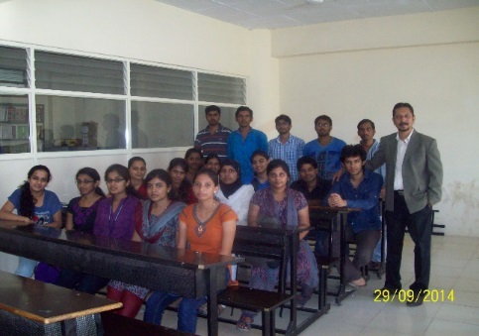
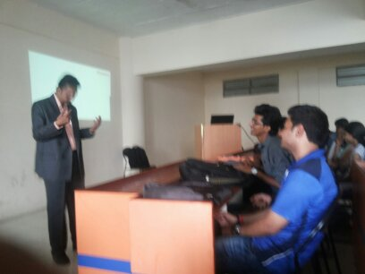
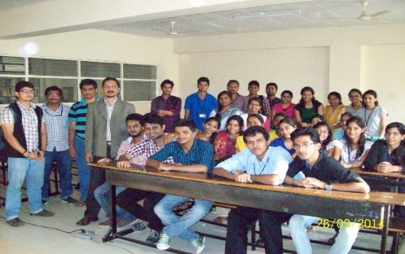
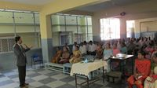
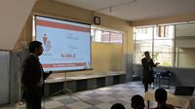
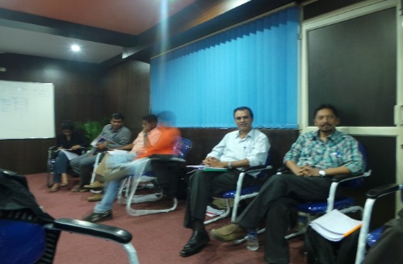

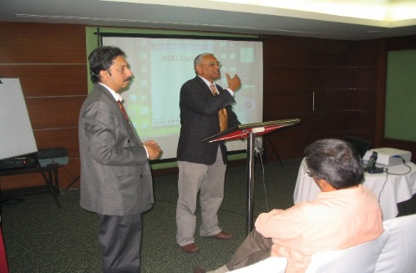
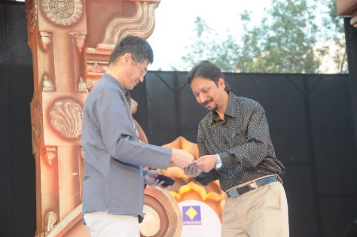

Slide 14
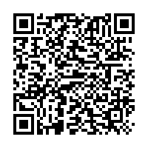
FEEDBACK/INTEREST
https://zfrmz.com/H2WU7E2fSqmrXPh2xaPS

Slide 15

Presentation slides can be accessed at:
Your professional Career starts
NOW
UPDATE LINK
http://www.swinburne.edu.au/careers/pep

Slide 16

What we do?
Industrial Automation & Process Control
Enterprise Empowerment Solutions
Enterprise Mobility Solutions
Training ,Development & Coaching
Consultancy & Professional Services
Software Development

Slide 17
Partial List Of Assignments Delivered
Conceptualization, Design, development and Delivery of Training & Interventions -
  Management Lessons from Mahabharata -YIL
  Effective Presentation Skills - YIL
  Customer Delight – Next Level - YIL
  Team Building in working Environment - YIL
  Professional Service Sales Essentials - YIL
  Time Management for Sales Professionals – Mahindra Finance
  Sales Skills for Service Personnel- Training - YIL
  Negotiation Skills for Managers – Hutti Gold Mines
  Performance Appraisal and Review System – Hutti Gold Mines
  Creative Problem Solving and Innovation – Hutti Gold Mines
  Time Management & Self Organizing – Hutti Gold Mines
  Customer Service and Communication Skills – SJIL
  Effective Communication in Business – Presentation – SJIL
  Interpersonal Skills for Junior Managers – L&T
  Communication Skills for Junior Managers-L&T
  Team Building, Communication Skills for better Customer Satisfaction for SJ InfoTech, Bangalore
  Performance Appraisal & Review – For a State Government Unit
  Creative Problem Solving Techniques – For a State Government Unit
  Effective Time Management – For a State Government Unit
  Negotiation Skills for Managers – For a State Government Unit
  Performance Appraisal Systems for Enn Vee Solutions Pvt Ltd, Bangalore
Employability Competencies Development Training Program
  for MBA & M Com Graduates at Maharani’s College
  Engineering Students at Sambhram Engg College
  Industry Expectations and getting prepared for it – R C College of Management & Commerce
  UniqVal Software Solutions, Bangalore
Career and Higher Education path Training for
  Camel High School
  Vidya Niketan College, Shimoga
Workshop & Seminar on Employability for Graduates & Post Graduates at
  Poornapragna Academy of Skill Development
  Engineering Students at MCE,Hassan
  Sambhram Engineering College, Bangalore
  RC College, Bangalore
  JSSATE, Bangalore
  Rajiv College Of Engineering, Hassan
  Bapuji Institute of Commerce & Management, Bangalore
  UniqVal Software Solutions
  I-LEAP, Bangalore
Train The Trainer – Interventions 3 Sessions
Career Inclination and Guidance Workshops and Counseling - Many
Relationship and Fun program - outbound Training
Spearheaded and guided a Team of Subject Matter Experts and developed Contents for Graduate Instrumentation Finishing School – I-POINT
Program Manager for successful Conceptualization, Planning, Execution and Project Management – Year 2000 solution for all Non-IT Systems at all Facilities of Malaysia Airlines, Malaysia.
Business Development Consultation for Education
I-LEAP, Bangalore for a start-up of Education Business
promote a Flow Sensor Product in the Indian Market
Design and Development of Complete Course Curriculum and Training Kit on around 50 HR Topics for a leading Software Giant.

Slide 18
Connect with us…
Business Address :32, 1st Floor,
Brindavan Street,
Off 80 Feet Road,(Kanakapura Main Road)
Sahara Layout, Gubbalala,
BENGALURU-560 061
Tel : 8971470582
Email :info@acts-consultants.com
Website : www.acts-consultants.net

Slide 19


