Slide 1
EVOLUTION OF CANCER CELLS THROUGH VARIOUS SPECIES

Slide 2
RESEARCH PAPERS
Sr.no | Title | Author | Publisher | Year
1 | Myc-driven murine prostate cancer shares molecular features with human prostate tumors. | Thomas.G. Graeba, Katharine Ellwood Yen | Elsevier | 2003
2 | Ensembl compara gene trees: complete duplication-aware phylogenetic trees in vertebrates. | Albert J. Viella, Jessica Severin | Cold Spring Habour Laboratory Press | 2009
3 | Phylogenic classification of human papillomaviruses; correlation with clinical manifestations | Van Ranst, Marc, Jeffrey B. Kaplan and Robert D Burk. | Journal of general Virology | 1992

Slide 3
OBJECTIVE
To study and observe the growth and development of cancer cells through evolution since its origin till now through different species

Slide 4
BLAST
BLAST which stands for ‘BASIC LOCAL ALIGNMENT SEARCH TOOL’ is an algorithm for comparing biological sequence information such as amino acid sequences of proteins or the nucleotides of DNA

Slide 5
FASTA FORMAT
A text based format for representing nucleotide sequences or amino acid sequences in which nucleotides or amino acids are represented using single letter codes.

Slide 6
SPECIES TO BE STUDIED

Slide 7
HOMO SAPIENS
Class:(Vertebra)
Humans

Slide 8
PAN TROGLODYTES
Cass:(Vertebra)
chimpanzee

Slide 9
CANIS LUPUS FAMILIARIS
Class:(Vertebra)
Grey wolves

Slide 10
BOS TAURUS
(Vertebra)
bovine

Slide 11
MUS MUSCULUS
Class:(Vertebra)
House mouse

Slide 12
Rattus norvegicus
Class:(Vertebra)
rat

Slide 13
GALLUS GALLUS
Class:(Aves)
Red jungle fowl

Slide 14
Xenopus tropicalis
Class:(Amphibilia)
Western clawed frog

Slide 15
Danio rerio
Class:(vertebra)
Zebra fish

Slide 16
METHODOLOGY

Slide 17
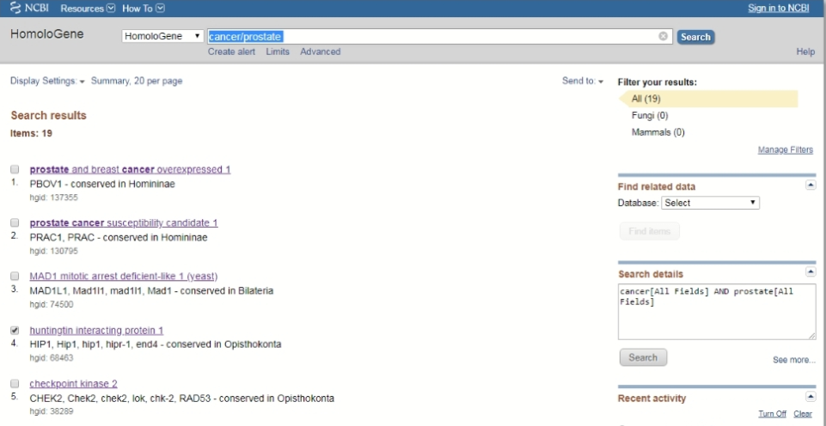

Slide 18
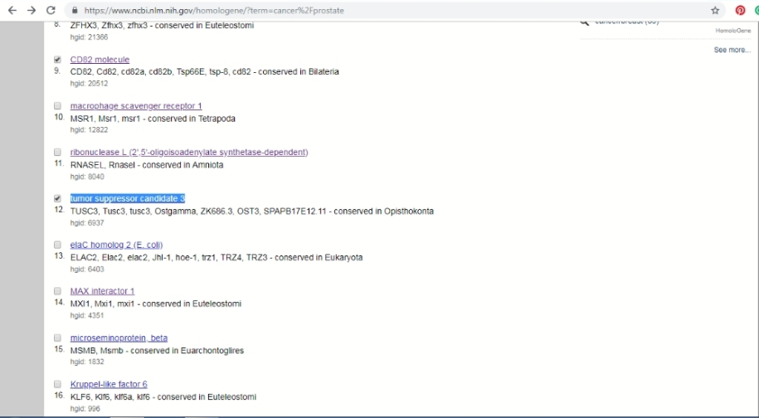

Slide 19
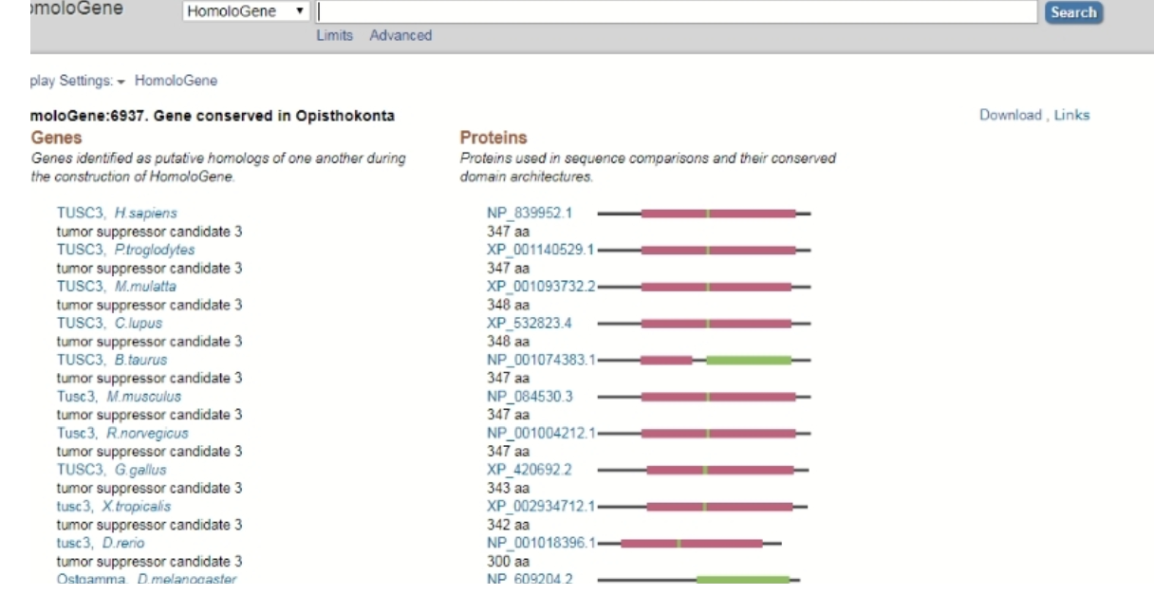

Slide 20
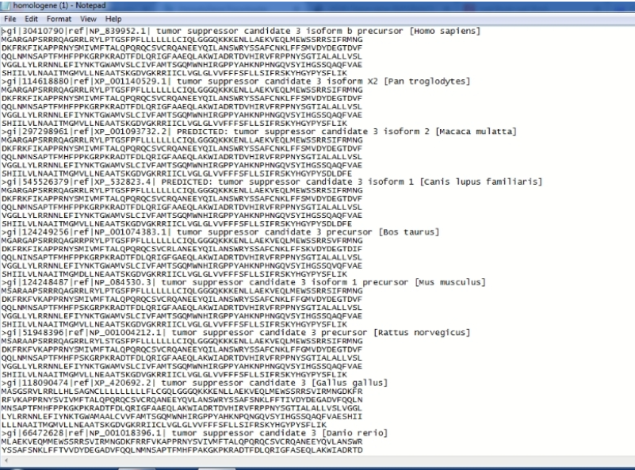

Slide 21
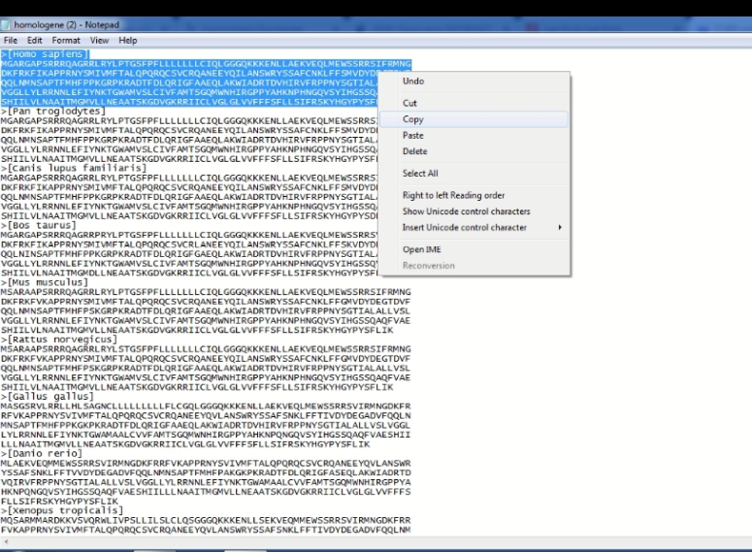

Slide 22
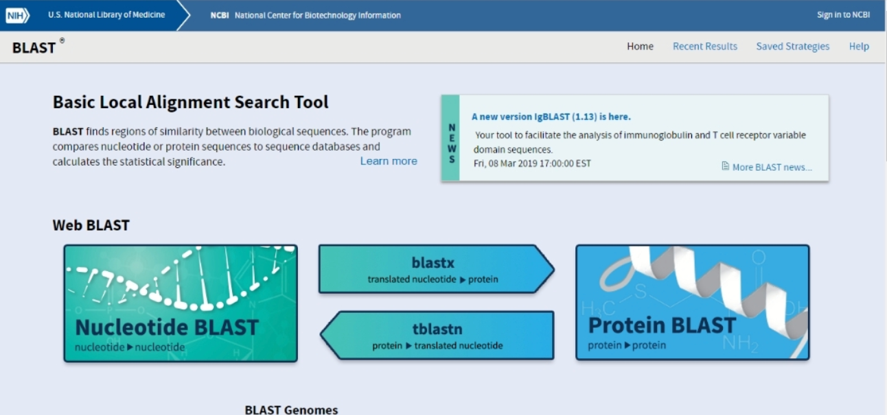

Slide 23
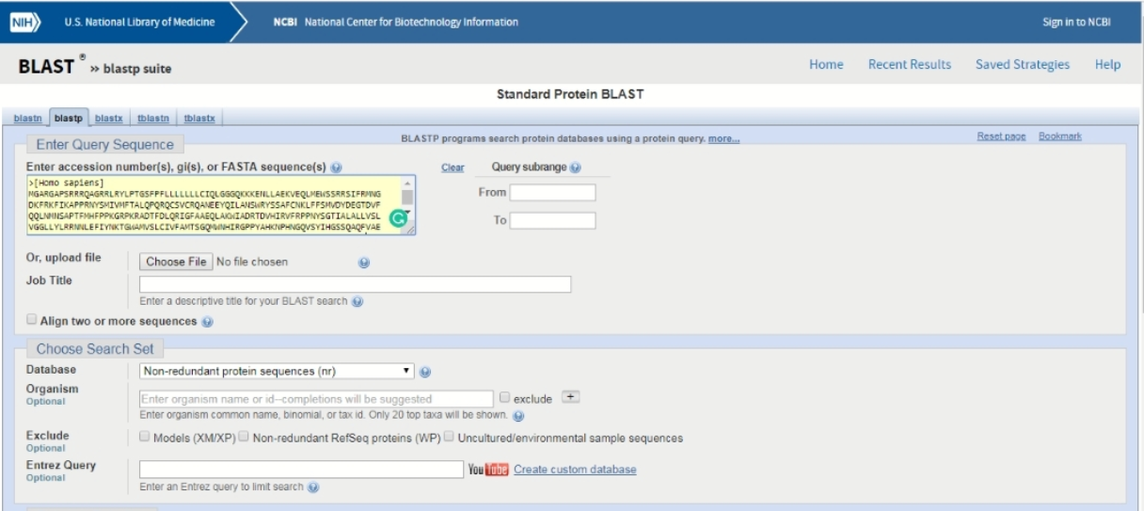

Slide 24
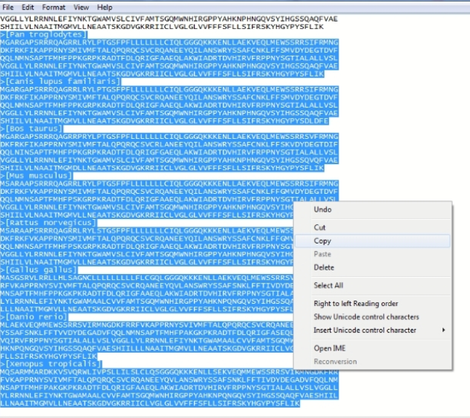

Slide 25
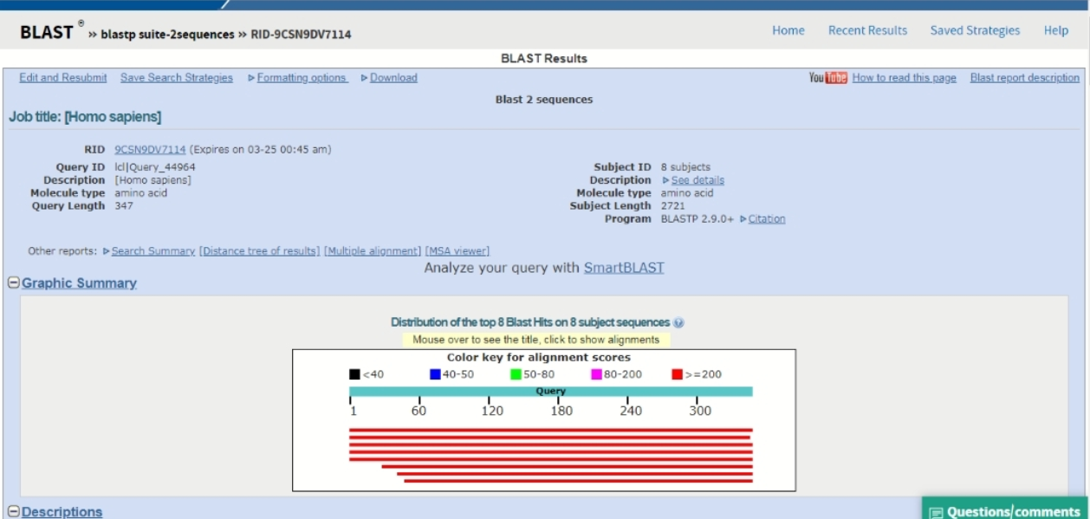

Slide 26
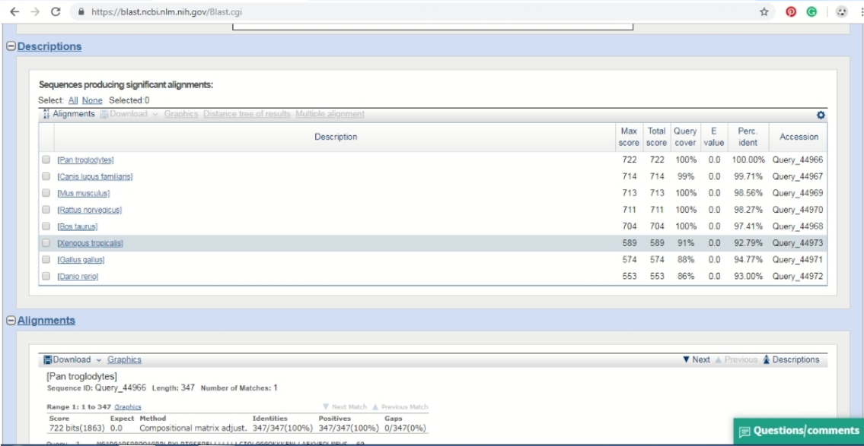

Slide 27
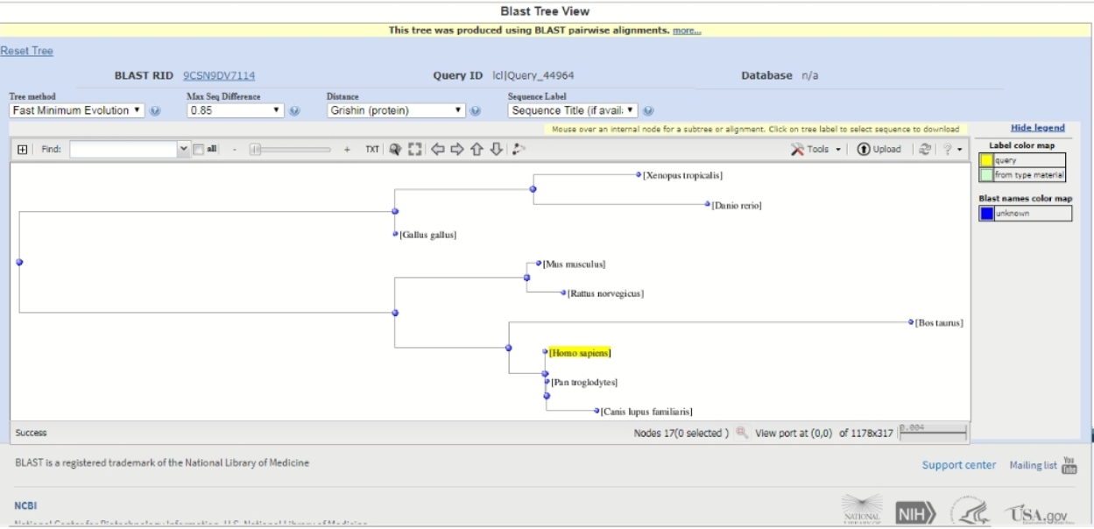

Slide 28
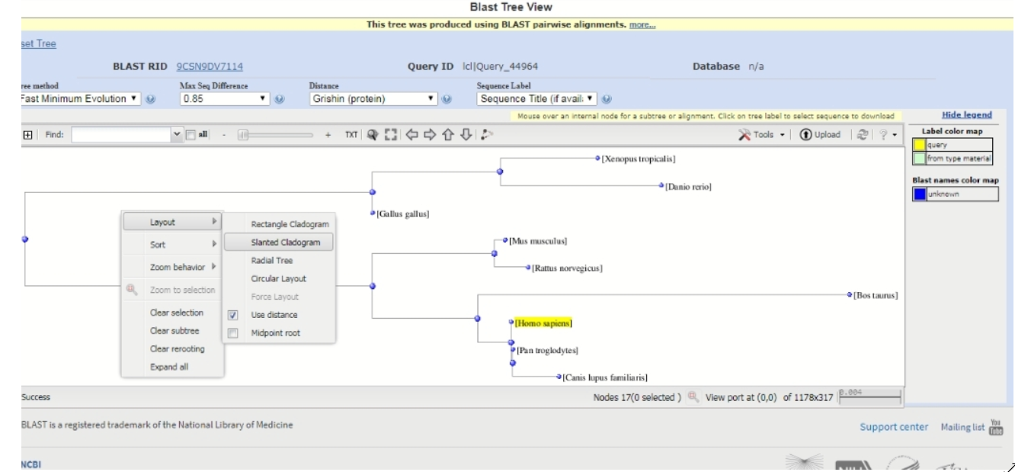

Slide 29
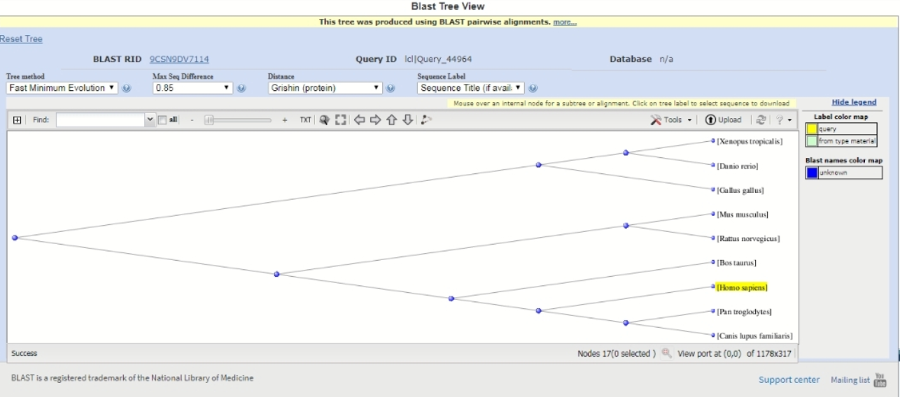

Slide 30
EXPECTED OUTCOME
We would be able to know the origin of cancer cells, the species of organisms affected and maybe foresee the species it will affect in the future.
A weak point in the cancer development may be found that will help in design of a drug

Slide 31
FUTURE SCOPE
Development of epigenetic drugs that lead cancer cells back towards normal growth instead of destroying them

Slide 32
THANK YOU

