Slide 1
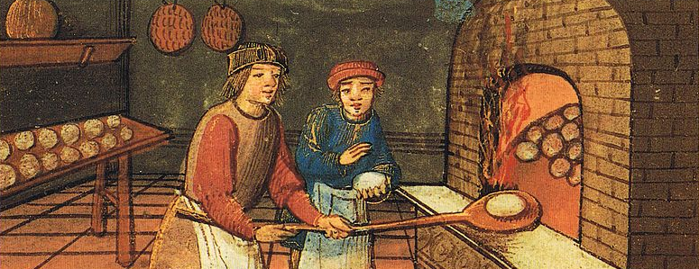
Crafts regulation in Portugal in the Late Middle Ages: 14th - 15th centuries
Arnaldo Sousa Melo
(Lab2PT – University of Minho)
Joana Sequeira
(CITCEM- Faculty of Arts, University of Porto)

Slide 2
WHAT?
WHAT FOR?
WHO?
HOW?

Slide 3
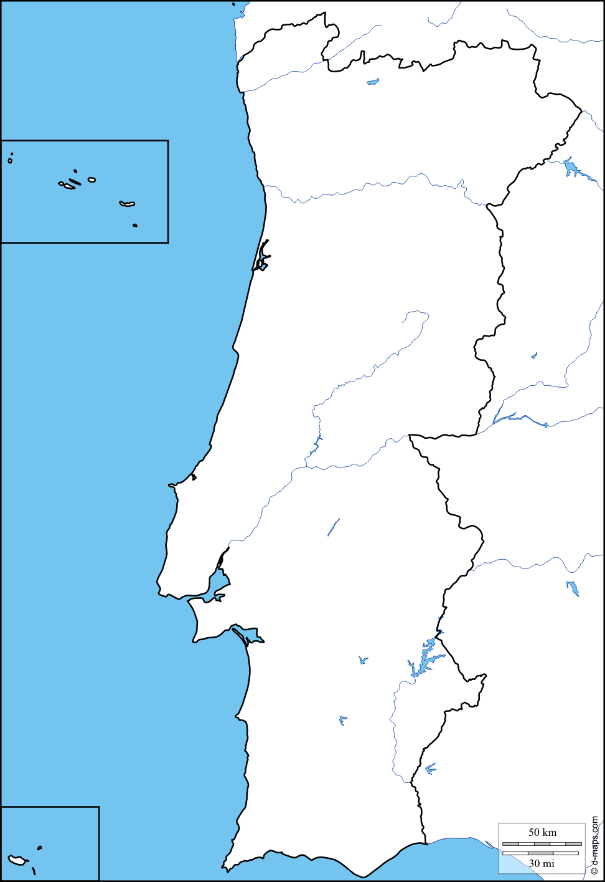
WHAT? → Definition
Braga
MEDCRAFTS PTDC/HAR-HIS/31427/2017
Study of the regulations of crafts activities in late medieval Portugal, in the 14th and 15th centuries, through the analysis of several Portuguese towns, from different regions, in a comparative perspective.
Guimarães
Porto
Coimbra
Integrated vision of regulation systems and social practices in their historical context
Comparative approach to determine similarities and specificities between different regions and towns
Focus on the relations between craftsmen and public authorities
Holistic analysis including all forms of craft’s regulations (statutes, ordinances, judicial sentences, etc.)
Santarém
Lisboa
Setúbal
Évora
Loulé

Slide 4
WHAT FOR? → Objectives
Develop an in-depth study of the reality of craft’s activities in Portugal, namely its organization and production structures, its spatial integration and its real estate properties
Reinforce the idea of the existence of multiple models of craft’s regulation and organisation in medieval Europe
Contribute for the knowledge about the economic and social evolution of Portugal during the crucial era of maritime expansion
Understand the diversity and specificity of crafts organisations and regulations in Portuguese towns and regions
Understand the particularities of the Portuguese evolution and the similarities with other European regions
Contribute for the development of an hypothetical circulation of ideas and models in Europe
Determine the influence of Islamic tradition in craft’s activities
Provide data and conclusions for other research projects
Rediscover historical memory with potential to be applied in cultural and touristic projects

Slide 5
WHO? → Research team
PI → Arnaldo Melo (Lab2PT – University of Minho)
Co-PI → Joana Sequeira (CITCEM- Faculty of Arts, University of Porto)
6 PORTUGUESE UNIVERSITIES = 29 RESEARCHERS
8 FOREIGN CONSULTANTS
WIDERANGING TEAM OF SPECIALISTS FOR AN INTEGRATED AND COMPARATIVE STUDY

Slide 6
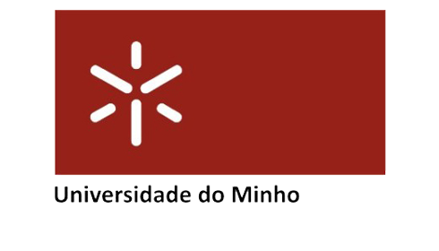
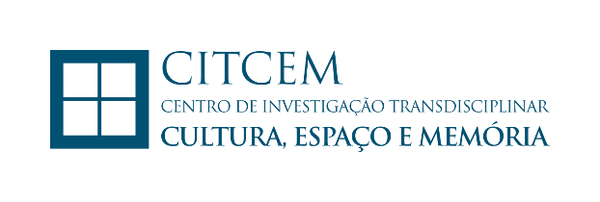
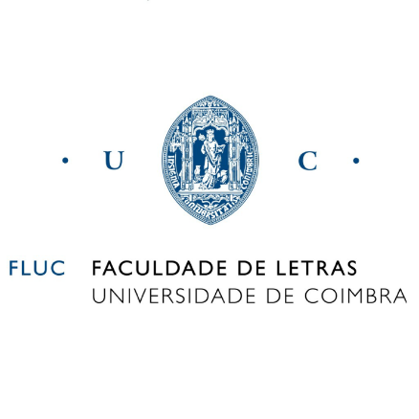
WHO? → Research team
PI (senior researcher)
1 senior researcher
3 junior researchers
1 post-doc researcher (to be recruited)
1 junior researcher (to be recruited)
Co- PI (assistant researcher)
1 coordinator in the Unit (senior researcher)
2 senior researchers
1 junior researcher (to be recruited)
1 coordinator in the Unit (senior researcher)
2 junior researchers
1 assistant researcher
1 junior researcher (to be recruited)

Slide 7
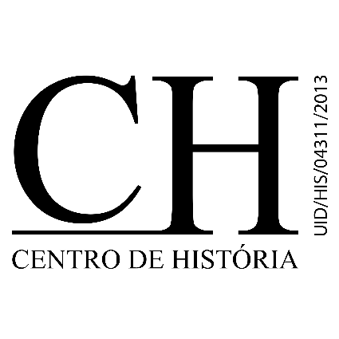
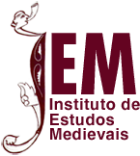
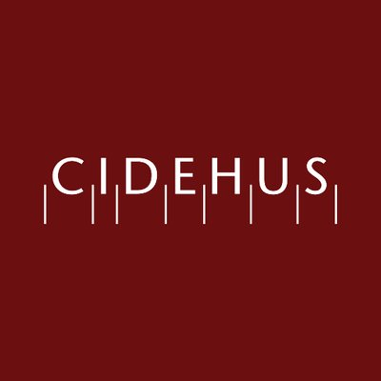
WHO? → Research team
1 coordinator in the Unit (senior researcher)
1 junior researcher (to be recruited)
1 coordinator in the Unit (senior researcher)
1 junior researcher
2 assistant researchers
1 senior researcher
1 junior researcher (to be recruited)
1 coordinator in the Unit (senior researcher)
2 senior researchers
1 junior researcher (to be recruited)

Slide 8
WHO? → Research team
CONSULTANTS
Germán Navarro Espinach, University of Zaragoza
Ricardo Córdoba, University of Cordoba
Jesus Ángel Solorzano Telechea, University of Cantabria
Philippe Bernardi, LAMOP - University of Paris 1 Panthéon – Sorbonne / CNRS
Gabriela Piccinni and Franco Franceschi, University of Sienna
Sarah Rees Jones, University of York
Mathew Davies, Birkbeck, University of London

Slide 9
HOW?→ Methodologies
HOW?→ Methodologies
Starting point: published works about the 9 towns included and specific studies on crafts, food trade and provisioning, urban organisation, etc.
3 YEARS PROJECT WITH €238.263.12 OF FUNDING
TASKS
The historical sources: description and characterisation of the documents
Data collection and analysis
Analysis and characterisation of the crafts regulations and control agents and mechanisms
Analysis of the aspects object of regulations and control
Characterisation of craftsmen forms of organisation and of crafts economic structure
Integrated analysis of each town and development of the global comparisons between them

Slide 10
HOW?→ Methodologies
EXPECTED OUTPUTS
Participation in national and international scientific events
Publication of articles and chapters in journals and books
Participation of team members in PhD and Master seminars
Organization of conferences, free courses and seminars for the general public, in cooperation with civic societies
Creation of a website, a blog and a Facebook page for dissemination of the project’s activities
Organization of a final congress/conference to present the project’s results
Publication of a collective book with the project’s results

Slide 11
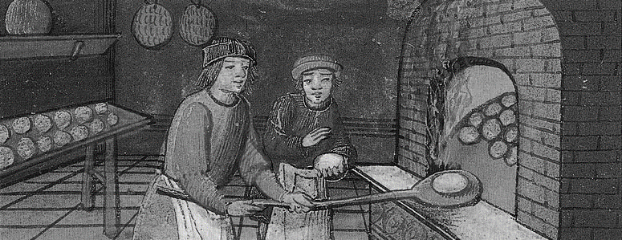
Crafts regulation in Portugal in the Late Middle Ages: 14th - 15th centuries
Arnaldo Sousa Melo
amelo@ics.uminho.pt
Joana Sequeira
jsequeira@letras.up.pt

