Slide 1
DIGITAL MARKETING ANALYSIS
AN ASSESSMENT OF ACKERMAN CANCER CENTER’S DIGITAL PRESENCE
Prepared by Nicole Cassis | 06.05.19

Slide 2
ABOUT THIS ANALYSIS
COMPONENTS
This digital audit is a compilation of my exploration into your digital footprint. It begins with a high-level look at the competitive landscape and then provides insights into each of the key components, identifying strengths and weaknesses in your digital strategy, as well as opportunities to capitalize on quickly.
LANDSCAPE
SEO
Social Media
COMPETITION
PAY PER CLICK

Slide 3
LANDSCAPE
In 2019, there will be an estimated 1,762,450 new cancer cases diagnosed (National Cancer Institute).
Cancer patients have more choices for their care than ever before.
Above all else, cancer patients demand world-class clinical care. Forty-three percent of patients say that “a physician who specializes in my particular cancer” is the most important factor guiding their decision about where to seek treatment.
Convenience is king. Cancer patients don’t want to deal with traveling between far-flung facilities. Co-location of services can help cancer programs stand out in the marketplace.
A new type of cancer care consumer is emerging—one who is more active in researching providers. These days, patients don’t rely solely on their physician’s recommendation. In fact, “recommendation from my doctor” was the fifth-ranked factor influencing patients’ decisions about where to go for care.
Many cancer patients consider cost a decisive factor in their treatment decisions. More than 24% of respondents chose “cancer center is in-network for my insurance” as the single most important factor in their decision.
Patients now research cancer providers online. Thirty-eight percent of survey respondents indicated that they had read provider reviews online, and 28% looked at quality performance websites.
Age isn’t just a number: younger patients really are different. Survey results reveal that younger patients (ages 18–54) have very different priorities and preferences than patients 55 and over.
Except where noted, all data was taken from a survey produced by the Advisory Board Company: Oncology Roundtable Survey. https://www.advisory.com/research/oncology-roundtable/expert-insights/2015/10-insights-cancer-patient-survey

Slide 4
COMPETITION
TIER 1
TIER 2
Mayo Clinic (341 reviews)
Baptist MD Anderson Cancer Center (192 reviews)
The University of Florida Health Proton Therapy Institute (24 reviews)
Cancer Specialists of North Florida Baptist South (9 reviews)
Terk Oncology (126 reviews)
Florida Cancer Specialists & Research Institute: Fleming Island (6 reviews)
Florida Oncology Associates (1 review)
Southside Cancer Center (5 reviews)
Cancer Specialists of North Florida Southside (9 reviews)
Note: Methodology for segmentation is not scientific. I considered number of reviews and my own personal knowledge of and affiliation toward the brands. However, this assessment could be similar to how newly diagnosed patients are also seeing the market.

Slide 5
COMPETITION CONTINUED
WHERE COMPETITION WINS
Owning more real estate on the SERPS
Higher organic ranking for keywords
Running paid search campaigns to catch intent-driven searches
More robust (and claimed!) Google My Business listings
Stronger brand awareness
Higher number of backlinks to site, stronger domain authority

Slide 6
SEO / WEBSITE ASSESSMENT
Higher rankings for quality terms and greater visibility drive to more leads and patients.
Search engine presence: Below Average
Mobile-friendly: Yes
Website Health: Above Average & Secure
Backlinks score: Fair
Traffic Estimation: Low
Page Speed: Fast (2.5s)

Slide 7
SEO / WEBSITE | RECOMMENDATIONS
Fast Fixes:
Own more real estate on the SERPs by running PPC, ranking higher in organic for key terms and claiming your Google My Business Listing.
Optimize images on the website. An accurate text description of an image is valuable to search engines, and visually-impaired or blind website visitors. It’s also valuable to websites in potentially generating traffic from image searches as well as avoiding losing potential customers.
Publish a site map and submit it to Google (an XML site map).
Build a plan to secure more reviews; Google puts significant weight into reviews.
Conduct a keyword analysis and aim to include these in blog posts and throughout website. Build your content strategy accordingly.

Slide 8
PAY PER CLICK / SEM ASSESSMENT
PPC Spend: Low
Landing Page Review: Couldn’t locate any
Conversion Analysis: Unknown
Display / Retargeting / Geofencing: Unknown

Slide 9
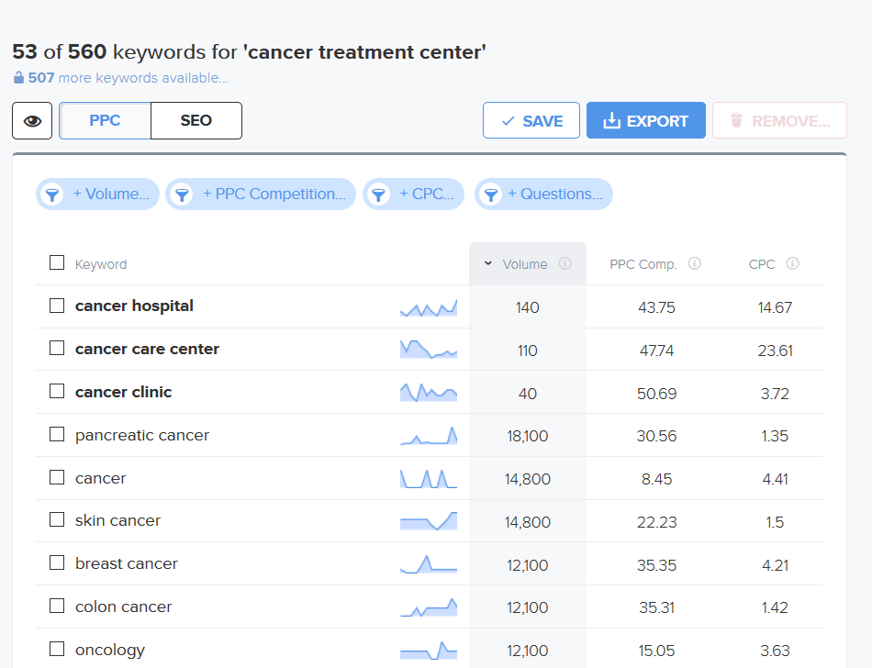
PAY PER CLICK / SEM RECOMMENDATION
Efficient and accurate search engine marketing spend will increase how many new patients you generate from paid campaigns. Ensure you aren’t missing out on opportunities.
Run some PPC campaigns to claim more space in the SERPs.
Begin using Display ads to help generate top-of-funnel awareness for your brand.
Retarget the visitors to your website.
Consider geofencing at/around bigger hospitals.

Slide 10
SOCIAL MEDIA ASSESSMENT
Facebook: Active, frequent posts (almost daily) (2500+ followers)
Twitter: Active, frequent posts (almost daily) (1400+ followers)
LinkedIn: Active, but in frequent posts (1K followers)
Instagram: No account
YouTube: No channel
Paid Social: Uncertain

Slide 11
SOCIAL MEDIA RECOMMENDATION
You need to be reaching the right consumers and telling the right stories. Get in front of potential customers and drive engagement through to conversion.
Post more often on social.
Explore affiliate marketing and micro-influencer strategies.
Host events and promote via social.
Increase post reach by promoting (paid) posts and run paid social ads.

Slide 12
If you have asked yourself these questions…
Why are we not meeting our growth goals and seeing more new patients?
Is my digital marketing working and am I generating new patients from it? (Are you doing any digital marketing?)
Are my social media efforts getting new patients and/or supporters?
Is my marketing team/agency doing good work? (Do you have a team?)
Is this the best my SEO can get? (Do you know your baseline organic traffic and how it is trending?)
Is it worth the investment to hold community events, and how do I measure success?
Where are the bulk of our new clients coming from and how do I get more of them?

Slide 13
… If you have been asking those questions, and you don’t know the answers, it might be time to bring onboard a marketing leader who can help.

Slide 14
NICOLE CASSIS
COMMUNICATOR · MARKETER · STRATEGIST
My name is NICOLE CASSIS and I am a senior strategic marketing leader specialized in brand strength and revenue growth. I am a creative, data-driven, customer-centric marketing leader focused on aligning marketing strategy with business objectives and customer acquisition programs with market opportunities. My rich set of versatile marketing and team leadership skills was acquired through 15+ years of B2B and B2C ‘head of marketing’ roles with corporations, academic institutions, publishing companies, non-profits and in the political arena – around the globe.
NICOLE CASSIS
cassis.nicole@gmail.com
904.303.5142
1810 Providence Hollow Lane, Jacksonville, FL 32223
nicolecassis.com

Slide 15
FOR YOUR TIME
THANK YOU
nicolecassis.com

