Slide 1
Interconnection with GB
Ireland’s Energy Security in the Context of Brexit
and the Renewable Energy Transition
Simon Ludlam, Project Director of Greenlink Interconnector, Element Power
15 March 2018

Slide 2
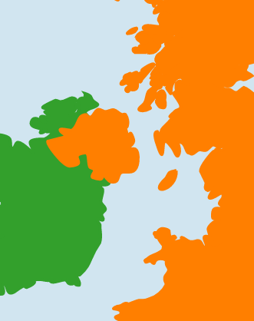
Irish – GB interconnection
A growing economy and increasing renewable energy mix requires further interconnection
Ireland (SEM) has two interconnectors
Moyle (2001)
EWIC (2012)
Greenlink will add a further 500MW by 2023
Interconnectors with GB exhibit bi-directional flow
Import cheaper power from GB
Export power at periods of high wind
Further interconnection is required
Security of supply – 65% renewables by 2030
Huge export potential of surplus wind and solar
Moyle 450MW
EWIC 500MW
Greenlink 500MW

Slide 3
Irish Interconnector flows
Irish interconnectors are already strong exporters of power
(MW)
Import to UK
Export to Ireland
IFA and Britned Importing to GB
EWIC Moyle
2 way flows
Source Elexon

Slide 4
Ramping rates
Slow ramping rates materially reduce economic impact of Irish interconnection
Illustrative Interconnection flows over 26 and 27 February 2018
(MW)
IFA capable of
fast ramping 4GW
Import to UK
Export to Ireland
EWIC constrained to 5MW/min

Slide 5

Project overview
Greenlink is Ireland’s next interconnector
TECHNICAL PARAMETERS
500MW
HVDC ±320kV - single symmetrical monopole
CABLE ROUTE
Great Island sub station - County Wexford
Pembroke sub station – Wales
PROJECT TIMING
Regulatory finalisation in
2H 2019
Construction 2020 - 2023
Voltage Source Convertors
~170km of HVDC land and marine cable and ~1km of HVAC

Slide 6
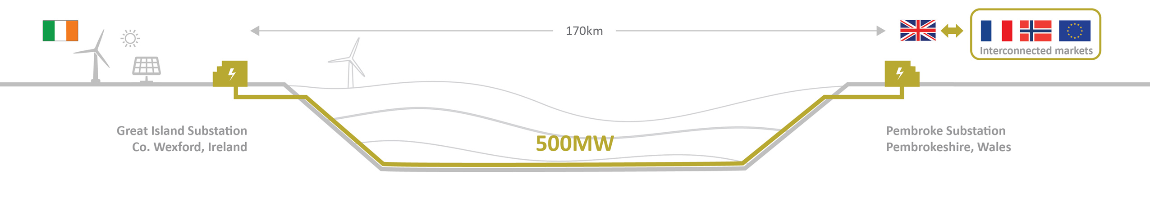
Greenlink project status
Greenlink has made material progress to meet its development goals – subject to CRU approval the project can advance to the construction phase
✓
✓
✓
GRID CONNECTION
500MW
agreed with National Grid
PLANNING
PCI status
with Welsh Assembly
REGULATION
Cap & Floor regime agreed with Ofgem
Construction & Commissioning
2020-2023
✓
✓
✓
GRID CONNECTION
500MW application
with Eirgrid
PLANNING
PCI status
with An Bord Pleanála
REGULATION
Developing
Cap & Floor regulation
with CRU

Slide 7
Cap and floor
Cap and Floor regulation has limited recourse to consumers – private capital takes first loss
Development/Construction
Operation
5 10 15 20 25 yrs.
Ex-ante C&F levels
RAV model
Fixed 25 years
Payment from IC to Consumers via TSO
CAP
I/C revenues
Income received by I/C operator
Revenues
FLOOR
Guaranteed return - Floor
Payment from Consumers to IC via TSO
Opex
Capex > depreciation
Source Ofgem

Slide 8
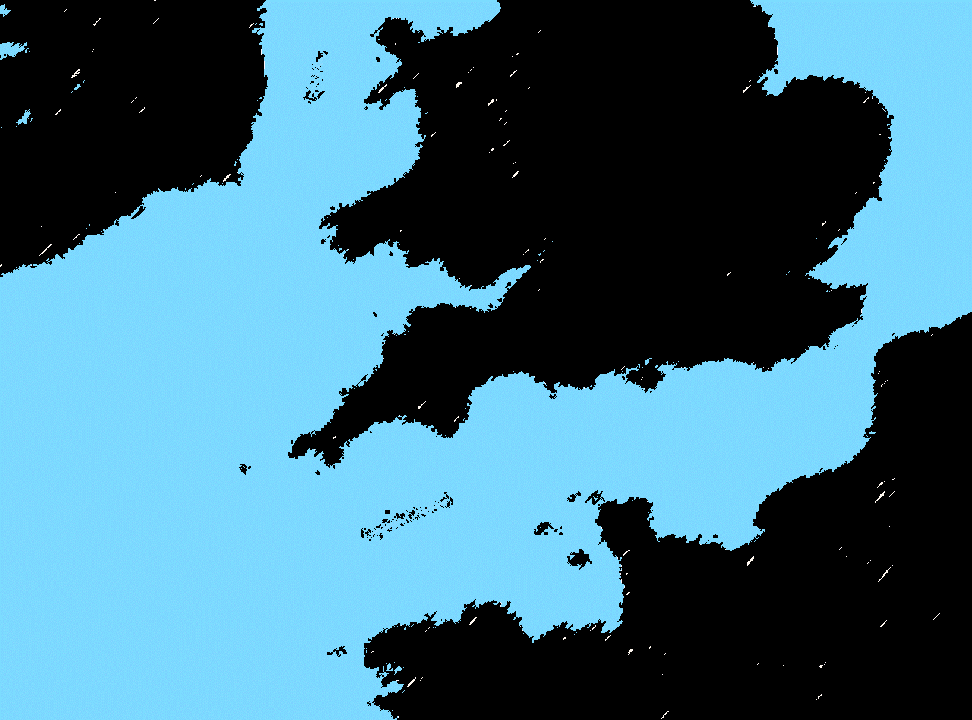
Greenlink power flows
Greenlink acts as an export route for surplus Irish low carbon power
Greenlink improves integration of Irish wind by reducing curtailment through 2047 by 5,500 GWh^{(a)}
This allows wind to capture a higher price in GB.
This value flows through to Irish consumers saving them over €800m^{(b)(c)}
In comparison Continental interconnection would be predominantly a one-way flow into Ireland.
GREENLINK
500MW
170km
€400m
2023
Exporting excess Irish low carbon power - reducing curtailment
IFA
2000MW
1986
TWh/year
CELTIC
700MW
600km
€1.0bn
2025
Sum of avoided curtailment between 2023-2047
NPV@3.5%, real 2017 €
Source: Baringa 2017, Greenlink CBA analysis Reference Case

Slide 9
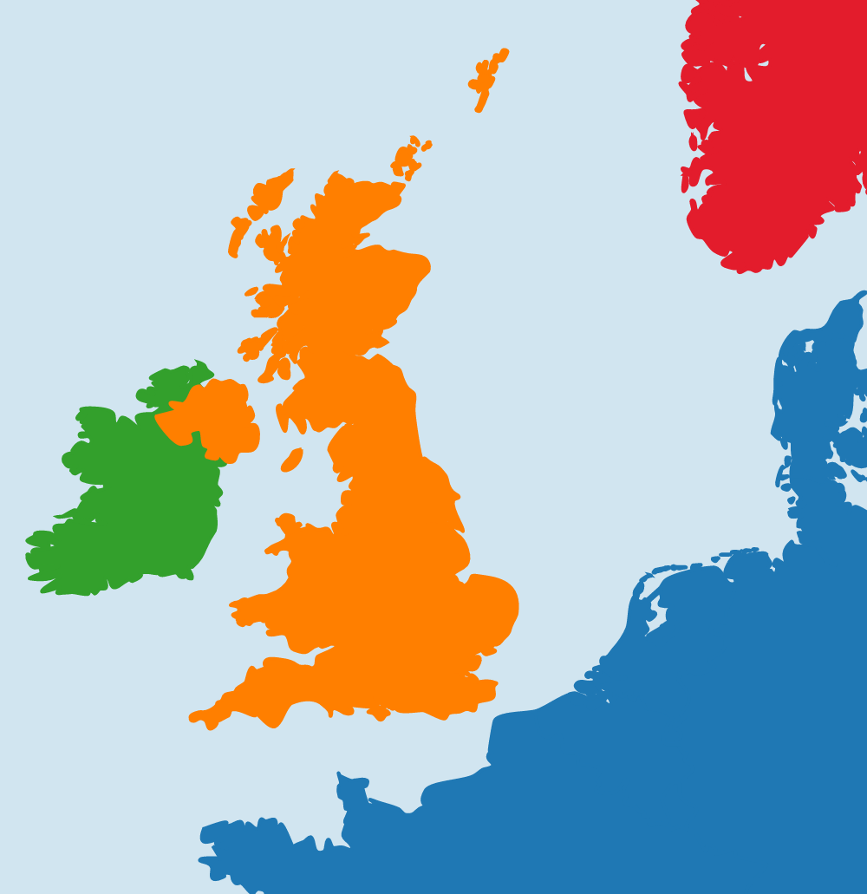
Brexit And power trading
Post Brexit the UK remains a natural stepping stone to connect to Europe’s energy markets
In the event of a hard Brexit
UK and EU are both WTO members
No tariffs on the trading of interconnector capacity
ISEM prevails
UK continues to support Greenlink
PCI status
Proactive and coordinated approach with CRU
UK is the third largest generator in Europe
UK 338.6 TWh cf. Ireland 30.4 TWh
A natural link to Europe that avoids excessive capex and line losses
Forecast 12.2GW of interconnector capacity with continental Europe and Scandinavia
2.8GW
1.5GW^{(a)}
9.4GW
(a) Include Greenlink

Slide 10


Greenlink inward investment
A privately sponsored project – limited recourse to consumers
Power Projects
Interconnection
Asset Management
215MW of wind energy delivered in Ireland - €380m investment
1.5GW being developed in Europe
Maali
Element Power develops, builds and operates projects in UK, Ireland, Sweden, Finland and the Americas
Greenlink
~€150m equity investment – non recourse to consumers, shareholder risk
~€250m debt supported by cap & floor – limited recourse to Irish & UK consumers
Development capital match funded by CEF

Slide 11






Greenlink Irish benefits
Greenlink is a cost-efficient source of future interconnection for Ireland
250 Irish jobs
during construction
Potential to power
380,000 homes
Enough to power 10
new large data centres
20 permanent
Irish jobs
Savings to consumers of
over €800m over life
€400m of private capital
for Ireland and Wales

Slide 12

The sole responsibility of this publication lies with the author. The European Union is not responsible for any use that may be made of the information contained therein.

